Slide 1
Clinical Practice Guidelines
Nutrition in chronic
liver disease

Slide 2
About these slides
These slides give a comprehensive overview of the EASL clinical practice guidelines on nutrition in chronic liver disease
The guidelines were first presented at the International Liver Congress 2018 and are published in the Journal of Hepatology
  The full publication can be downloaded from the Clinical Practice Guidelines section of the EASL website
Please feel free to use, adapt, and share these slides for your own personal use; however, please acknowledge EASL as the source

Slide 3

About these slides
Definitions of all abbreviations shown in these slides are provided within the slide notes
When you see a home symbol like this one: , you can click on this to return to the outline or topics pages, depending on which section you are in
Please send any feedback to: slidedeck_feedback@easloffice.eu
These slides are intended for use as an educational resource and should not be used in isolation to make patient management decisions. All information included should be verified before treating patients or using any therapies described in these materials

Slide 4
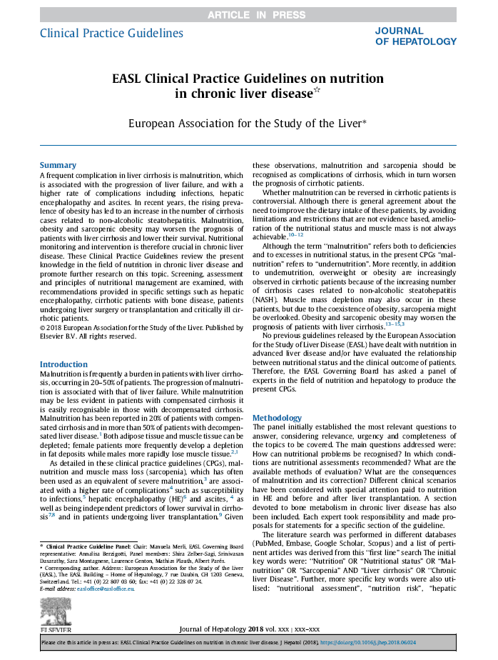
Guideline panel
Chair
  Manuela Merli
Panel members
  Shira Zelber-Sagi,
  Srinivasan Dasarathy,
  Sara Montagnese,
  Laurence Genton,
  Mathias Plauth, Albert Parés,
  Annalisa Berzigotti (EASL Governing Board Representative)
Reviewers
  Dominique Valla, Stephan Bischoff, Puneeta Tandon
EASL CPG nutrition in chronic liver disease. J Hepatol 2018; doi: 10.1016/j.jhep.2018.06.024

Slide 5
Outline
Methods
Grading evidence and recommendations
Background
Present knowledge
Key recommendations
Guidelines
The future
Unresolved issues
Methodology
EASL CPG nutrition in chronic liver disease. J Hepatol 2018; doi: 10.1016/j.jhep.2018.06.024

Slide 6
Methods
Grading evidence and recommendations
Methodology

Slide 7
Grading evidence and recommendations
Grading is adapted from the GRADE system¹
Level of evidence
I | Randomized, controlled trials
II-1 | Controlled trials without randomization
II-2 | Cohort or case-control analytical studies
II-3 | Multiple time series, dramatic uncontrolled experiments
III | Opinions of respected authorities, descriptive epidemiology
Evidence quality
A | High: Further research is very unlikely to change our confidence in the estimated effect
B | Moderate: Further research is likely to have an important impact on our confidence in the estimated effect and may change the estimate
C | Low: Further research is likely to have an important impact on our confidence in the estimated effect and is likely to change the estimate. Any change of estimate is uncertain
Grade of recommendation
1 | Strong: Factors influencing the strength of the recommendation included the quality of the evidence, presumed patient-important outcomes, and costs
2 | Weak: Variability in preferences and values, or more uncertainty. Recommendation is made with less certainty: higher costs or resource consumption
Guyatt GH, et al. BMJ 2008:336:924–6
EASL CPG nutrition in chronic liver disease. J Hepatol 2018; doi: 10.1016/j.jhep.2018.06.024
Notes:
GRADE, Grading of Recommendations Assessment, Development and Evaluation

Slide 8
Methodology
Questions to address were established
  Taking into account relevance, urgency and completeness of each
Key questions addressed
Literature search
  PubMed, Embase, Google Scholar, Scopus
    Initial key words: “nutrition” OR “nutritional status” OR “malnutrition” OR “sarcopenia” AND “liver cirrhosis”
    OR “chronic liver disease”
    Specific key words: ‘‘nutritional assessment”, ‘‘nutrition risk”, ‘‘hepatic encephalopathy”, ‘‘osteoporosis”,
    ‘‘liver transplantation”
References selected based on appropriateness of study design, number of patients, and publication in peer-reviewed journals
  Original data were prioritized
  How can nutritional problems be recognized?
  In which conditions are nutritional assessments recommended?
  What are the available methods of evaluation?
  What are the consequences of malnutrition and its correction?
EASL CPG nutrition in chronic liver disease. J Hepatol 2018; doi: 10.1016/j.jhep.2018.06.024

Slide 9
Background
Malnutrition definition
The burden of malnutrition in cirrhosis

Slide 10
Malnutrition definition
The term “malnutrition” can refer both to deficiencies and to excesses in nutritional status
  However, in the present guideline, “malnutrition” is used as a synonym of “undernutrition” only
In addition to cirrhotic patients with undernutrition, overweight or obese patients with cirrhosis are increasingly being seen, due to the increased number of cirrhosis cases related to NASH
  Muscle mass depletion may also occur in these patients, but due to the coexistence of obesity, sarcopenia might be overlooked
Malnutrition, obesity and sarcopenic obesity may worsen the prognosis of patients with cirrhosis
EASL CPG nutrition in chronic liver disease. J Hepatol 2018; doi: 10.1016/j.jhep.2018.06.024
Notes:
NASH, non-alcoholic steatohepatitis

Slide 11
Prevalence and implications of malnutrition and sarcopenia in cirrhosis
Malnutrition is a frequent burden in cirrhosis
  In 20% of patients with compensated cirrhosis
  In >50% of patients with decompensated cirrhosis¹
Progression of malnutrition is associated with progression of liver failure
  May be less evident in compensated cirrhosis
  Easily recognizable in patients with decompensated cirrhosis
Both adipose tissue and muscle tissue can be depleted
  In female patients, depletion of fat deposits is more frequent
  In men, loss of muscle tissue is more rapid^{1,2}
1. Italian multicentre cooperative project on nutrition in liver cirrhosis. J Hepatol 1994;21:317–25;
2. Caregaro L, et al. Am J Clin Nutr 1996;63:602–9
EASL CPG nutrition in chronic liver disease. J Hepatol 2018; doi: 10.1016/j.jhep.2018.06.024

Slide 12
Prevalence and implications of malnutrition and sarcopenia in cirrhosis
Malnutrition and muscle mass loss (sarcopenia), which is often used as an equivalent of severe malnutrition,¹ associate with complications:²
  Susceptibility to infections
  Hepatic encephalopathy
  Ascites
  Independent predictors of lower survival in cirrhosis and in patients undergoing liver transplantation
Malnutrition and sarcopenia should be recognized as complications of cirrhosis that worsen the prognosis of patients
  General agreement that these patients’ dietary intake needs to improve
  Whether malnutrition can be reversed in patients with cirrhosis is unclear
1. Dasarathy S, et al. J Cachexia Sarcopenia Muscle 2012;3:225–37;
2. Huisman EJ, et al. Eur J Gastroenterol Hepatol 2011;23:982–9
EASL CPG nutrition in chronic liver disease. J Hepatol 2018; doi: 10.1016/j.jhep.2018.06.024

Slide 13
Relationship between malnutrition, complications of cirrhosis, transplantation, and survival
Decompensated cirrhosis
Malnutrition and/or
sarcopenia
Hepatic encephalopathy
Bacterial infections
Recurrent ascites
Reduced overall survival
In HCC: increased complications and reduced survival
After surgery: reduced survival
In liver transplantation: increased waiting list mortality and post-operative complications
Tandon P, et al. Hepatology 2017;65:1044–5
EASL CPG nutrition in chronic liver disease. J Hepatol 2018; doi: 10.1016/j.jhep.2018.06.024
Notes:
HCC, hepatocellular carcinoma

Slide 14
Guidelines
Key recommendations

Slide 15
Topics
Screening and assessment for malnutrition and obesity in cirrhosis
Nutritional management principles in patients with cirrhosis
Approach to sarcopenia in patients with cirrhosis
Approach and management of obesity in patients with cirrhosis
Micronutrients
Nutritional treatment options for hepatic encephalopathy
Nutritional treatment options in patients with cirrhosis and bone disease
Clinical scenarios requiring special considerations
The future for nutrition in chronic liver disease
N.B. these guidelines refer specifically to adult patients with cirrhosis
EASL CPG nutrition in chronic liver disease. J Hepatol 2018; doi: 10.1016/j.jhep.2018.06.024

Slide 16
Screening for malnutrition in cirrhosis
As malnutrition is associated with worse prognosis, all patients with advanced chronic liver disease, especially decompensated cirrhosis, should undergo a rapid nutritional screen
Two criteria stratify patients at high risk of malnutrition:
  Being underweight (BMI <18.5 kg/m²)
  Advanced decompensated cirrhosis (Child–Pugh C)
All patients at risk of malnutrition should undergo detailed nutritional assessment by a registered dietician or nutrition expert
Grade of evidence
Grade of recommendation
Recommendations
Perform a rapid nutritional screen in all patients with cirrhosis and complete a detailed assessment in those at risk of malnutrition to confirm the presence and severity of malnutrition | II-2 B | 1
Assume malnutrition risk is high if BMI <18.5 kg/m² or Child–Pugh C. In all other cases, utilize nutritional screening tools to assess risk of malnutrition | II-2 B | 1
EASL CPG nutrition in chronic liver disease. J Hepatol 2018; doi: 10.1016/j.jhep.2018.06.024
Notes:
BMI, body mass index

Slide 17
Detailed nutritional assessment
In patients at high risk of malnutrition, assess each component every 1–6 months in the outpatient setting and for inpatients, at admission and periodically throughout the hospital stay:¹
  Muscle mass and sarcopenia
    Direct quantification of skeletal muscle mass via CT image analysis at the L3 vertebra (only when CT is available as being performed for other reasons)
    Body mass assessment via anthropometric methods*
    Bone mineral density, fat mass and fat-free mass via DEXA
    Limb non-fat mass quantification via tetrapolar BIA
    Sarcopenia indicated by impaired skeletal muscle contractile function; via handgrip strength
  Subjective global assessment (SGA) uses clinical evaluation data to determine nutritional status without objective measurements
    Includes the Royal Free Hospital-global assessment (RFH-GA)²
  Patient-reported dietary intake
*Including mid-arm muscle circumference (MAMC), mid-arm muscular area (MAMA) and triceps skinfold (TSF)
1. Tandon P, et al. Hepatology 2017;65:1044–57; 2. Morgan MY, et al. Hepatology 2006;44:823–35
EASL CPG nutrition in chronic liver disease. J Hepatol 2018; doi: 10.1016/j.jhep.2018.06.024
Notes:
BIA, bioelectrical impedance analysis; CT, computed tomography; DEXA, dual-energy X-ray absorptiometry

Slide 18
Detailed nutritional assessment
Grade of evidence
Grade of recommendation
Recommendations
Include an assessment of sarcopenia within the nutritional assessment | II-2 B | 1
Assess muscle mass by CT imaging where available (having been performed for other purposes). Anthropometry, DEXA or BIA are possible alternatives, which also allow serial measurements | II-2 B | 1
Assess muscle function in the clinical setting with the most appropriate tools, such as handgrip strength (HGS) and/or the short physical performance battery (SPPB) | II-2 B | 1
Assessment of dietary intake by trained personnel (ideally a dietician with knowledge of managing patients with liver disease) working as part of a team with the hepatologist. Assessment should include: quality and quantity of food and supplements, fluids, sodium in diet, number and timing of meals during the day and barriers to eating | II-2 B | 1
EASL CPG nutrition in chronic liver disease. J Hepatol 2018; doi: 10.1016/j.jhep.2018.06.024
Notes:
BIA, bioelectrical impedance analysis; CT, computed tomography; DEXA, dual-energy X-ray absorptiometry

Slide 19
Nutritional screening and assessment in patients with cirrhosis: Summary
Cirrhosis/advanced chronic liver disease
Calculate Child–Pugh score
Assess whether fluid retention
Estimate dry weight if needed*
Child C
Child A or B
Underweight
<18.5 kg/m²
BMI
≥30 kg/m²
Obesity
18.5–29.9 kg/m²
Screen for malnutrition
Utilize nutritional screening tools
Nutritional assessment + lifestyle intervention in compensated cirrhosis/ACLD
Consider assessing sarcopenia
+
High risk
Medium risk
Low risk
Follow-up re-screen at least 1/year
Assess sarcopenia
Consider CT scan to measure muscle area at L3
Consider DEXA or BIA if no fluid retention
Detailed nutritional assessment (expert dietician)
Subjective global assessment (SGA)
Royal Free Hospital-global assessment (RFH-GA)
Reported dietary intake
Sarcopenia
Malnutrition
No malnutrition
Treat: Nutrition supplementation and appropriate follow-up (repeat assessment every 1–3 months in first year)
*In the case of fluid retention, body weight should be corrected by evaluating the patient’s dry weight by post-paracentesis body weight or weight recorded before fluid retention if available, or by subtracting a percentage of weight based upon severity of ascites (mild, 5%; moderate, 10%; severe, 15%), with an additional 5% subtracted if bilateral pedal oedema is present.
EASL CPG nutrition in chronic liver disease. J Hepatol 2018; doi: 10.1016/j.jhep.2018.06.024
Notes:
ACLD, advanced chronic liver disease; BIA, bioelectrical impedance analysis; BMI, body mass index; CT, computed tomography; DEXA, dual-energy X-ray absorptiometry

Slide 20
Nutritional screening and assessment in patients with cirrhosis: Summary
Cirrhosis/advanced chronic liver disease
Calculate Child–Pugh score
Assess whether fluid retention
Estimate dry weight if needed*
Child C
Child A or B
Underweight
<18.5 kg/m²
BMI
≥30 kg/m²
Obesity
18.5–29.9 kg/m²
Sedentary lifestyle is highly prevalent in patients with cirrhosis and might be seen as a cofactor
Screen for malnutrition
Utilize nutritional screening tools
Nutritional assessment + lifestyle intervention in compensated cirrhosis/ACLD
Consider assessing sarcopenia
+
High risk
Medium risk
Low risk
Follow-up re-screen at least 1/year
Assess sarcopenia
Consider CT scan to measure muscle area at L3
Consider DEXA or BIA if no fluid retention
Detailed nutritional assessment (expert dietician)
Subjective global assessment (SGA)
Royal Free Hospital-global assessment (RFH-GA)
Reported dietary intake
Sarcopenia
Malnutrition
No malnutrition
Treat: Nutrition supplementation and appropriate follow-up (repeat assessment every 1–3 months in first year)
*In the case of fluid retention, body weight should be corrected by evaluating the patient’s dry weight by post-paracentesis body weight or weight recorded before fluid retention if available, or by subtracting a percentage of weight based upon severity of ascites (mild, 5%; moderate, 10%; severe, 15%), with an additional 5% subtracted if bilateral pedal oedema is present.
EASL CPG nutrition in chronic liver disease. J Hepatol 2018; doi: 10.1016/j.jhep.2018.06.024
Notes:
ACLD, advanced chronic liver disease; BIA, bioelectrical impedance analysis; BMI, body mass index; CT, computed tomography; DEXA, dual-energy X-ray absorptiometry

Slide 21
Nutritional management principles in cirrhosis:
Energy and protein requirements
Cirrhosis is a state of accelerated starvation characterized by a rapid post-absorptive physiology and reduced respiratory quotient
  Protein synthesis is decreased and gluconeogenesis from amino acids increased, necessitating proteolysis, which contributes to sarcopenia
Energy supply needs to balance total energy expenditure (TEE)
  Most interventions aim for ≥35 kcal/kg.BW/day*
Grade of evidence
Grade of recommendation
Recommendations
Performance of nutritional counselling in patients with malnutrition and cirrhosis by a multidisciplinary team to help the patient achieve adequate calorie and protein intake | II-2 C | 2
Optimal daily energy intake should not be lower than the recommended 35 kcal/kg actual BW/day (in non-obese individuals) | II-2 B | 1
Optimal daily protein intake should not be lower than the recommended 1.2–1.5 g/kg actual body weight/day | II-2 B | 1
Include late evening oral nutritional supplementation (ONS) and breakfast in the dietary regimen of malnourished patients with decompensated cirrhosis | II-1 B | 1
*Use of actual BW corrected for ascites is considered safe
EASL CPG nutrition in chronic liver disease. J Hepatol 2018; doi: 10.1016/j.jhep.2018.06.024
Notes:
BW, body weight

Slide 22
Practical advice for patients
Healthy eating of a variety of foods is advisable for all patients
With the exception of alcohol, virtually no food damages the liver and is genuinely contraindicated in patients with chronic liver disease
In most cases eating adequate calories and protein is much more important than avoiding specific types of food
  It is important that patients have a good, varied diet that they enjoy
Food intake should be split
  Three main meals: breakfast, lunch and dinner
  Three snacks:
    Mid-morning, mid-afternoon, late evening
    Late-evening snack is the most important
EASL CPG nutrition in chronic liver disease. J Hepatol 2018; doi: 10.1016/j.jhep.2018.06.024

Slide 23
Practical advice for patients
Fruit and vegetables should always be included in the diet
Salt should be restricted
Some patients with liver disease may have hepatic encephalopathy
  May tolerate animal proteins less well than vegetable and dairy proteins
Patients with concomitant disease* may require dietary adjustments
Patients should report reduced food intake as a result of this advice to their doctor or dietician
Patients should always consult a doctor or dietician before altering their protein intake
Patients should report any coexisting condition or previous dietary advice
*For example diabetes or obesity
EASL CPG nutrition in chronic liver disease. J Hepatol 2018; doi: 10.1016/j.jhep.2018.06.024

Slide 24
Practical advice for patients
As many fruit and vegetables as possible should be eaten
Salt should be restricted
Some patients with liver disease may have hepatic encephalopathy
  May tolerate animal proteins less well than vegetable and dairy proteins
Patients with concomitant disease* may require dietary adjustments
Patients should report reduced food/protein intake as a result of this advice to their doctor
or dietician
A reduction in total protein intake is not advisable
in cirrhosis
Patients should always consult a doctor or dietician before altering their protein intake
Patients should report any coexisting condition or previous dietary advice
*For example diabetes or obesity
EASL CPG nutrition in chronic liver disease. J Hepatol 2018; doi: 10.1016/j.jhep.2018.06.024

Slide 25
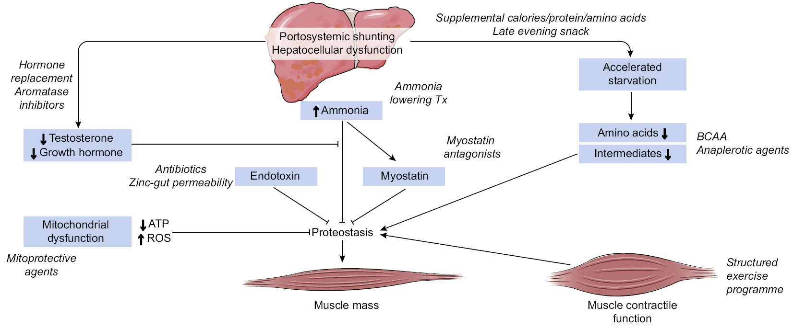
Mechanisms resulting in sarcopenia and failure to respond to standard supplementation
Anabolic resistance and dysregulated proteostasis result in sarcopenia and/or failure to respond to standard supplementation
These mechanisms represent potential therapeutic targets
Figure adapted from Dasarathy S. Curr Opin Gastroenterol 2016;32:159–65
EASL CPG nutrition in chronic liver disease. J Hepatol 2018; doi: 10.1016/j.jhep.2018.06.024
Notes:
ATP, adenosine triphosphate; ROS, reactive oxygen species

Slide 26
Approach to sarcopenia in patients with cirrhosis
Skeletal muscle mass is the largest protein store in the body
  Depends on age, gender, ethnicity, severity/aetiology of liver disease
Adequate calorie and protein intake can be difficult to achieve in malnourished patients with sarcopenia and advanced liver disease
  Limited but consistent data suggest supplemental nutrition improves quality of life if it results in increased lean body mass¹
Despite potential adverse effects, a combination of resistance and endurance exercise is likely to be appropriate and beneficial²
1. Maharshi S, et al. Clin Gastroenterol Hepatol 2016;14:454–60; 2. Berzigotti A, et al. Hepatology 2017;65:1293–305
EASL CPG nutrition in chronic liver disease. J Hepatol 2018; doi: 10.1016/j.jhep.2018.06.024

Slide 27
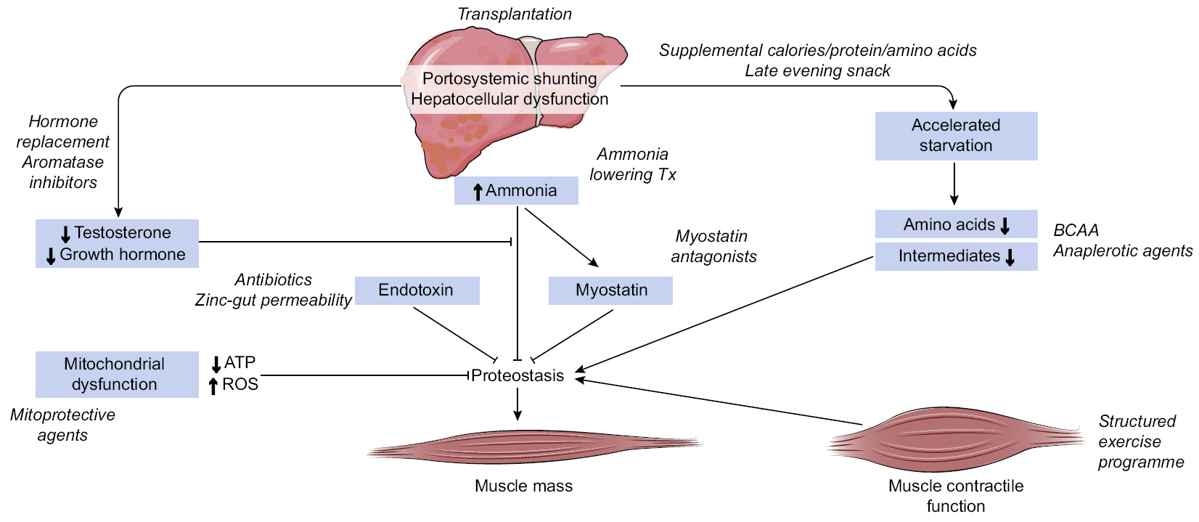
Potential management approaches to sarcopenia:
Oral supplements
Supplemental calories/ protein/amino acids
Grade of evidence
Grade of recommendation
Recommendations
In patients with malnutrition and cirrhosis who are unable to achieve adequate dietary intake with the oral diet (even with oral supplements), a period of enteral nutrition is recommended | II-1 B | 1
Figure adapted from Dasarathy S. Curr Opin Gastroenterol 2016;32:159–65
EASL CPG nutrition in chronic liver disease. J Hepatol 2018; doi: 10.1016/j.jhep.2018.06.024
Notes:
ATP, adenosine triphosphate; ROS, reactive oxygen species

Slide 28
Potential management approaches to sarcopenia:
BCAA supplements and anaplerotic agents
BCAA supplements
Anaplerotic agents
Grade of evidence
Grade of recommendation
Recommendations
BCAA supplements and leucine-enriched amino acid supplements should be considered in patients with decompensated cirrhosis when adequate nitrogen intake is not achieved by oral diet | II-1 C | 1
Figure adapted from Dasarathy S. Curr Opin Gastroenterol 2016;32:159–65
EASL CPG nutrition in chronic liver disease. J Hepatol 2018; doi: 10.1016/j.jhep.2018.06.024
Notes:
ATP, adenosine triphosphate; BCAA, branched chain amino acid; ROS, reactive oxygen species

Slide 29
Potential management approaches to sarcopenia:
Exercise
Structured exercise programme
Grade of evidence
Grade of recommendation
Recommendations
Avoid hypomobility in patients with cirrhosis whenever possible, and progressively increase physical activity to prevent and/or ameliorate sarcopenia | II-1 C | 2
Figure adapted from Dasarathy S. Curr Opin Gastroenterol 2016;32:159–65
EASL CPG nutrition in chronic liver disease. J Hepatol 2018; doi: 10.1016/j.jhep.2018.06.024
Notes:
ATP, adenosine triphosphate; ROS, reactive oxygen species

Slide 30
Potential management approaches to sarcopenia:
Other approaches
Transplantation
Hormone replacement
Aromatase inhibitors
Ammonia-lowering therapy
Myostatin antagonists
Mitoprotective agents
Antibiotics
Zinc-gut permeability
Figure adapted from Dasarathy S. Curr Opin Gastroenterol 2016;32:159–65
EASL CPG nutrition in chronic liver disease. J Hepatol 2018; doi: 10.1016/j.jhep.2018.06.024
Notes:
ATP, adenosine triphosphate; ROS, reactive oxygen species

Slide 31
Obesity in cirrhosis: Assessment and interpretation
A sedentary lifestyle is highly prevalent in patients with cirrhosis, increasing obesity risk, but obesity does not rule out malnutrition
  Obesity is present in most cases of NASH-related cirrhosis
  ‘Sarcopenic obesity’ describes loss of skeletal muscle/gain of adipose tissue and is observed in patients with cirrhosis
Estimate and treat malnutrition routinely in obese patients with cirrhosis (BMI >30 kg/m² in absence of fluid retention)
Grade of evidence
Grade of recommendation
Recommendations
In the diagnosis of obesity (BMI >30 kg/m²) always consider the confounding effect of fluid retention. Estimate dry body weight, although accuracy is low | II-2 B | 2
EASL CPG nutrition in chronic liver disease. J Hepatol 2018; doi: 10.1016/j.jhep.2018.06.024
Notes:
BMI, body mass index; NASH, non-alcoholic steatohepatitis

Slide 32
Nutritional management principles in cirrhosis:
Approach and management of obesity
Multiple studies suggest a reduction in body weight improves outcomes in obese patients with compensated cirrhosis^{1–3}
Weight loss can be achieved by nutritional therapy and supervised moderate-intensity physical exercise tailored to the patient’s ability
Grade of evidence
Grade of recommendation
Recommendations
Implement a nutritional and lifestyle programme to achieve progressive weight loss (≥5–10%) in obese patients with cirrhosis (BMI >30 kg/m² corrected for water retention) | II-2 C | 1
Adopt a tailored, moderately hypocaloric (-500–800 kcal/day) diet, including an adequate amount of protein (>1.5 g protein/kg ideal BW/day) to achieve weight loss without compromising protein stores in obese patients with cirrhosis | II-1 C | 2
1. Zenith L, et al. Clin Gastroenterol Hepatol 2014;12:e1922; 2. Everhart JE, et al. Gastroenterology 2009;137:549–57;
3. Macias-Rodriguez RU, et al. Clin Transl Gastroenterol 2016;7:e180
EASL CPG nutrition in chronic liver disease. J Hepatol 2018; doi: 10.1016/j.jhep.2018.06.024
Notes:
BMI, body mass index; BW, body weight

Slide 33
Micronutrients
Vitamin deficiencies in liver disease are generally related to hepatic dysfunction and
diminished reserves
  Inadequate dietary intake and malabsorption increase with disease severity
Serum 25(OH)D concentrations in patients with cirrhosis, stratified by Child–Pugh score in four individual studies^{1–4}
A
Child–Pugh score
B
Crawford, et al.¹
Fisher, et al.²
Chen, et al.³
Putz-Bankuti, et al.⁴
C
0
10
20
30
40
Vitamin D (ng/ml)
1. Crawford BAL, et al. Osteoporos Int 2003;14:987–94; 2. Fisher L, et al. Clin Gastroenterol Hepatol 2007;5:513–20;
3. Chen CC, et al. J Gastroenterol Hepatol 1996;11:417–21; 4. Putz-Bankuti C, et al. Liver Int 2012;32:845–51
EASL CPG nutrition in chronic liver disease. J Hepatol 2018; doi: 10.1016/j.jhep.2018.06.024

Slide 34
Micronutrients
A majority of liver disease patients considered for liver transplantation present with vitamin A
and D deficiencies
  Vitamin D levels <20 ng/ml are reported in chronic cholestatic conditions, and often inversely correlate with disease severity and Child–Pugh score
  Vitamin D also correlates with treatment response in HCV, NAFLD and patients who develop HCC
Grade of evidence
Grade of recommendation
Recommendations
In patients with cirrhosis, administer micronutrients and vitamins to treat confirmed or clinically suspected deficiency | II-1 C | 1
Assess vitamin D levels in patients with cirrhosis as deficiency is highly prevalent and may adversely affect clinical outcomes | II-3 B | 1
Supplement vitamin D orally in patients with cirrhosis and vitamin D levels <20 ng/ml, to reach serum vitamin D (25(OH)D) >30 ng/ml | II-1 B | 1
EASL CPG nutrition in chronic liver disease. J Hepatol 2018; doi: 10.1016/j.jhep.2018.06.024
Notes:
HCC, hepatocellular carcinoma; HCV, hepatitis C virus; NAFLD, non-alcoholic fatty liver disease

Slide 35
Micronutrients
Hyponatraemia is common in patients with cirrhosis, and more likely when sodium intake is low with water unchanged or increased. Careful monitoring of sodium and water intake is required
Confirmed or clinically suspected micronutrient deficiencies should be treated based on accepted general recommendations and common practice
Grade of evidence
Grade of recommendation
Recommendations
In patients with cirrhosis and ascites under sodium restriction (recommended intake of sodium ~80 mmol day = 2 g of sodium corresponding to 5 g of salt added daily to the diet according to EASL guidelines) take care to improve diet palatability as this may cause a reduction in calorie intake | II-2 B | 1
EASL CPG nutrition in chronic liver disease. J Hepatol 2018; doi: 10.1016/j.jhep.2018.06.024

Slide 36
Nutritional treatment options for hepatic encephalopathy (HE)
HE is more common in malnourished patients with cirrhosis
  Inverse relationship between muscle mass and blood ammonia levels
Hyperammonaemia may impair muscle function and contribute to muscle loss¹
Patients with cirrhosis and HE have the same energy requirements as those without HE
Although dysregulated nitrogen metabolism plays a key role in HE development, nitrogen requirements are the same as patients without HE
Grade of evidence
Grade of recommendation
Recommendations
Nutritional status and sarcopenia should be evaluated in patients with HE | II-3 B | 1
Avoid protein restriction in patients with HE | II-1 A | 1
Optimal daily protein and energy intake should not be lower than the general recommendations for patients with cirrhosis | II-1 A | 1
Encourage the consumption of vegetables and dairy protein | II-3 B | 1
BCAA supplementation should be considered to improve neuropsychiatric performance and to reach the recommended nitrogen intake | I-1 A | 1
Oral dietary intake is preferred in patients who can tolerate it. In patients with grade III–IV encephalopathy who are unable to eat, provide nutrition by nasogastric tube (in patients with protected airways) or parenterally | II-1 B | 1
1. McDaniel J, et al. Am J Physiol Gastrointest Liver Physiol 2016;310:G163–70
EASL CPG nutrition in chronic liver disease. J Hepatol 2018; doi: 10.1016/j.jhep.2018.06.024
Notes:
BCAA, branched chain amino acid; HE, hepatic encepahalopathy

Slide 37

Nutritional treatment options in patients with cirrhosis and bone disease – risk factors
~30% patients with chronic liver disease, and 30% eligible for liver transplantation have osteoporosis, with higher prevalence in cholestasis
  Characterized by loss of bone mass and quality, causing fragility fractures
Risk factors for osteoporosis in chronic liver disease
Male hypogonadism
Family history of osteoporotic fracture
Alcohol abuse
Treatment with corticosteroids*
Smoking
Advanced age
BMI <19 kg/m²
Secondary amenorrhoea
>6 months
Early menopause
*≥5 mg/d prednisone for ≥3 months
EASL CPG nutrition in chronic liver disease. J Hepatol 2018; doi: 10.1016/j.jhep.2018.06.024
Notes:
BMI, body mass index

Slide 38
Nutritional treatment options in patients with cirrhosis and bone disease – diagnosis
According to the WHO, bone densitometry of the lumbar spine and hip is the gold standard for diagnosis of osteoporosis and osteopenia
  Should be evaluated in:
    Patients with previous fragility fractures
    Those treated with corticosteroids
    Before liver transplantation
    In cholestatic diseases
    Patients with cirrhosis
    If any other risk factors are found
Grade of evidence
Grade of recommendation
Recommendations
Evaluate BMD in patients with cirrhosis, cholestatic liver disease, receiving long-term corticosteroid treatment, and before liver transplantation | II-2 A | 1
Utilize lumbar and femoral densitometry (DEXA) for diagnosing osteoporosis and osteopenia. Use lateral X-rays of dorsal and lumbar spine for diagnosing vertebral fractures | II-3 A | 1
Repeat DEXA after 2–3 years in patients within normal BMD, and within 1 year when rapid bone loss is expected | II-1 B | 1
EASL CPG nutrition in chronic liver disease. J Hepatol 2018; doi: 10.1016/j.jhep.2018.06.024
Notes:
BMD, bone mass density; DEXA, dual-energy X-ray absorptiometry; WHO, World Health Organization

Slide 39
Nutritional treatment options in patients with cirrhosis and bone disease – treatment
A balanced diet is recommended
  Including calcium and 25(OH)D supplements to preserve normal levels
Physical activity is recommended
  Especially exercises to improve mechanics of the spine
Factors that increase bone loss (alcohol, tobacco, corticosteroids etc.) should be minimized
Although studies are limited, bisphosphonates* are reported to increase bone mass in patients with PBC with no serious adverse events^{1,2}
Grade of evidence
Grade of recommendation
Recommendations
Include supplements of calcium (1,000–1,500 mg/day) and 25(OH)D (400–800 IU/day or 260 µg every 2 weeks) in patients with chronic liver disease and a T-score below -1.5 | II-3 A | 1
Utilize bisphosphonates in patients with cirrhosis and osteoporosis, and in those waiting for liver transplantation | I A | 1
Consider testosterone supplementation and venesection in males with haemochromatosis and hypogonadism | II-2 B | 1
*Including etidronate, alendronate, and ibandronate
1. Guanabens N, et al. Am J Gastroenterol 2003;98:2268–74; 2. Guanabens N, et al. Hepatology 2013;58:2070–8
EASL CPG nutrition in chronic liver disease. J Hepatol 2018; doi: 10.1016/j.jhep.2018.06.024
Notes:
PBC, primary biliary cholangitis

Slide 40
Diagnosis and management of bone disease in patients with chronic liver disease – summary
Diagnosis
Management
Bone densitometry (DEXA) of lumbar spine and hip
Lateral X-rays of dorsal and lumbar spine
Laboratory measurements to identify abnormal calcium and vitamin D metabolism
DEXA
Treatment
Repeat in
2–3 years
Normal
T-score >-1.5
Ca + 25(OH)D*
Repeat in
1–2 years†
Osteopenia
T-score ≤-1.5 and >-2.5
Ca + 25(OH)D*
Bisphosphonates‡
Repeat in
1 year†
Osteoporosis
T-score ≤-2.5
Ca + 25(OH)D*
Bisphosphonates
New agents
*Calcium (1,000–1,500 mg/d) and 25-hydroxy-vitamin D (400–800 IU/day or 260 μg every 2 weeks) to preserve normal levels;
†According to the severity of liver disease and cholestasis, and in patients taking corticosteroids;
‡Depending on additional risk factors
EASL CPG nutrition in chronic liver disease. J Hepatol 2018; doi: 10.1016/j.jhep.2018.06.024
Notes:
DEXA, dual-energy X-ray absorptiometry

Slide 41
Malnutrition in patients undergoing liver surgery and liver transplantation – preoperative nutrition
Patients with severe undernutrition* or obesity† undergoing liver surgery have higher risk of morbidity and mortality
  Waiting list patients are also at risk due to inadequate food or caloric intake
Liver glycogen is depleted in patients with cirrhosis
  Periods without nutrient intake should be reduced
Grade of evidence
Grade of recommendation
Recommendations
Screen for malnutrition and sarcopenia in patients with cirrhosis listed for LT or scheduled for elective surgery. Treat sarcopenia prior to elective surgery, to enable improvement in body protein status and clinical outcomes | III B | 2
Screen for sarcopenic obesity with body composition analysis in obese patients with cirrhosis considered for surgery | III C | 2
If treatment goal is maintenance of nutritional status, plan: • Total energy intake 30 kcal/kg.BW/day and protein intake 1.2 g/kg.BW/day If treatment goal is improvement of nutritional status, plan: • Total energy intake 35 kcal/kg.BW/day and protein intake 1.5 g/kg.BW/day | II-3 B | 1
Utilize standard nutrition regimens. Specialized regimens (e.g. BCAA-enriched, immune-enhancing diets) have not been shown to improve morbidity or mortality | II-1 B | 1
*BMI <18.5 kg/m²; †BMI >40 kg/m²
EASL CPG nutrition in chronic liver disease. J Hepatol 2018; doi: 10.1016/j.jhep.2018.06.024
Notes:
BCAA, branched chain amino acid; BMI, body mass index; BW, body weight; LT, liver transplantation

Slide 42
Malnutrition in patients undergoing liver surgery and liver transplantation – postoperative nutrition
Versus fluid and electrolytes only, post-operative nutrition decreases:
  Ventilator time
  Length of ICU stay
  Bacterial and viral infections
  Bile duct and other complications
Grade of evidence
Grade of recommendation
Recommendations
After LT, initiate normal food and/or enteral tube feeding within 12–24 hours, or as soon as possible, to reduce infection rates | II-2 B | 1
When oral or enteral nutrition are not possible, parenteral nutrition should be used over not feeding | II-2 B | 1
After the acute postoperative phase, provide an energy intake of 35 kcal/kg.BW/day and protein intake of 1.5 g/kg.BW/day | II-2 C | 1
After other surgical procedures, manage patients with chronic liver disease according to ERAS protocols | III C | 2
Consider parenteral nutrition in patients with unprotected airways and HE when cough and swallow reflexes are compromised, or enteral nutrition is contraindicated or impractical | II-2 C | 1
EASL CPG nutrition in chronic liver disease. J Hepatol 2018; doi: 10.1016/j.jhep.2018.06.024
Notes:
BW, body weight; ERAS, enhanced recovery after surgery; HE, hepatic encephalopathy; ICU, intensive care unit; LT, liver transplantation

Slide 43
Malnutrition in patients undergoing liver surgery and liver transplantation – postoperative nutrition
Patients remain in negative nitrogen balance after LT
  Necessitates an increase in protein or amino acid provision
  Nutrition improves nitrogen economy in non-transplant visceral surgery
Chronic dilutional hyponatraemia should be carefully corrected after LT to avoid
pontine myelinolysis
Long-term LT survivors risk weight gain/obesity due to metabolic syndrome
  Stringent physiotherapy and dietary counselling should be used
Grade of evidence
Grade of recommendation
Recommendations
In obese patients, utilize enteral tube feeding and/or parenteral nutrition with a reduced target energy intake (25 kcal/kg ideal BW*/day) and an increased target protein intake (2.0 g/kg ideal BW*/day) | III C | 2
*Ideal body weight as calculated based on height and gender
EASL CPG nutrition in chronic liver disease. J Hepatol 2018; doi: 10.1016/j.jhep.2018.06.024
Notes:
BW, body weight; LT, liver transplantation

Slide 44
Malnutrition in critically ill patients with cirrhosis
Critically ill patients include those:
  Hospitalized for severe complications of chronic liver disease
  With acute-on-chronic liver failure
  In an ICU
  With acute alcoholic hepatitis
Grade of evidence
Grade of recommendation
Recommendations
Consider nutritional status and presence of sarcopenia. Provide nutritional support while treating other manifestations of severe decompensation | II-3 C | 1
Daily energy intake should not be lower than 35–40 kcal/kg.BW/day, or 1.3x measured REE | II-2 B | 1
Daily protein intake should not be lower than 1.2–1.3 g/kg.BW/day | II-2 B | 1
EASL CPG nutrition in chronic liver disease. J Hepatol 2018; doi: 10.1016/j.jhep.2018.06.024
Notes:
BW, body weight; ICU, intensive care unit; REE, resting energy expenditure

Slide 45
Malnutrition in critically ill patients with cirrhosis
Direct measurement of REE by indirect calorimetry is advisable
As in all critically ill patients, tight glucose control is indicated
Enteral or parenteral nutrition is more likely to be required
Grade of evidence
Grade of recommendation
Recommendations
Supplement dietary intake by enteral nutrition in patients unable to achieve adequate intake by mouth. If oral diet or enteral nutrition are not tolerated or contraindicated, provide parenteral nutrition | III A | 1
Utilize standard nutrition regimens. Specialized regimens (e.g. BCAA-enriched, immune-enhancing diets) have not been shown to improve morbidity or mortality | II-1 B | 2
In patients with HE, consider BCAA-enriched solutions | I A | 1
EASL CPG nutrition in chronic liver disease. J Hepatol 2018; doi: 10.1016/j.jhep.2018.06.024
Notes:
BCAA, branched chain amino acid; HE, hepatic encephalopathy; REE, resting energy expenditure

Slide 46
Malnutrition and other special considerations
Alcoholic liver disease and severe/acute alcoholic hepatitis
Patients with active alcohol abuse may have a higher REE
Gastrointestinal bleeding
Withhold enteral nutrition for 48–72 hours after acute bleeding due to risk of increased portal pressure and variceal re-bleeding
Grade of evidence
Grade of recommendation
Recommendations
Naso-gastroenteric tubes are not contraindicated in patients with non-bleeding oesophageal varices | II-2 A | 1
Avoid PEG insertion in patients with cirrhosis due to risk of bleeding | III B | 2
In cirrhosis and severe/acute alcoholic hepatitis, provide nutritional support as it may accelerate resolution of hepatic encephalopathy and improve survival in patients with low calorie intake | II-1 A | 1
EASL CPG nutrition in chronic liver disease. J Hepatol 2018; doi: 10.1016/j.jhep.2018.06.024
Notes:
PEG, percutaneous endoscopic gastrostomy; REE, resting energy expenditure

Slide 47
The future for nutrition in chronic liver disease

Slide 48
New research should address the following topics
Nutritional strategies:
  Does the improvement in muscle mass and/or muscle function improve clinical outcomes (reduced risk of first decompensation, ascites, infection and encephalopathy, hospital readmissions or falls, decreased length of hospital stay, improved survival)?
  Do ammonia-lowering strategies in decompensated cirrhosis reverse muscle loss and improve
  clinical outcomes?
  Does a gradual increase in physical activity delay or reverse muscle loss and contractile dysfunction? What type and duration of exercise is beneficial in patients with cirrhosis?
  Is the addition of supplements (leucine, isoleucine, or other nutrient supplements) needed to lower ammonia and increase mitochondrial intermediates during training?
  How to implement therapies targeting muscle protein synthesis pathways or dysregulated
  muscle autophagy
  How to overcome anabolic resistance or reverse the underlying causes of anabolic resistance in patients with cirrhosis
EASL CPG nutrition in chronic liver disease. J Hepatol 2018; doi: 10.1016/j.jhep.2018.06.024

Slide 49
New research should address the following topics
In patients with bone diseases:
  The use and safety of anabolic drugs such as PTH 1–34 and denosumab as potential new therapies for osteoporosis in patients with cirrhosis
In patients with special considerations:
  In the absence of indirect calorimetry, what is the best way to calculate energy needs in critically ill patients with liver diseases?
  Does increased energy and protein intake improve outcomes in critically ill patients with liver diseases?
  Should nutritional recommendations differ according to the patient’s nutritional status at baseline?
EASL CPG nutrition in chronic liver disease. J Hepatol 2018; doi: 10.1016/j.jhep.2018.06.024
Notes:
PTH, parathyroid hormone

