Slide 1
Best of ILC 2018
Metabolism, alcohol and toxicity

Slide 2
About these slides
These slides provide highlights of new data presented at the International Liver Congress 2018
Please feel free to use, adapt, and share these slides for your own personal use; however, please acknowledge EASL as the source
Definitions of all abbreviations shown in these slides are provided within the slide notes
These slides are intended for use as an educational resource and should not be used to make patient management decisions. All information included should be verified before treating patients or using any therapies described in these materials

Slide 3
Contents – section 1
1. NAFLD – Phase 1/2/3 clinical trials
GS-002 | Cenicriviroc treatment for adults with non-alcoholic steatohepatitis: Year 2 analysis of the Phase 2b CENTAUR study
GS-009 | MGL-3196, a selective thyroid hormone receptor-beta agonist significantly decreases hepatic fat in NASH patients at 12 weeks, the primary endpoint in a 36 week serial liver biopsy study
GS-014 | NGM282 improves fibrosis and NASH-related histology in 12 weeks in patients with biopsy-confirmed NASH, which is preceded by significant decreases in hepatic steatosis, liver transaminases and fibrosis markers at 6 weeks
LBO-001 | A multicenter, randomized, double-blind, PLB-controlled trial of Galectin-3 inhibitor (GR-MD-02) in patients with NASH cirrhosis and portal hypertension
LBO-006 | JKB-121 in patients with nonalcoholic steatohepatitis: A phase 2 double blind randomized placebo control study
PS-105 | Proof of concept study of an apoptosis-signal regulating kinase (ASK1) inhibitor (selonsertib) in combination with an acetyl-CoA carboxylase inhibitor (GS-0976) or a farnesoid X receptor agonist (GS-9674) in NASH
PS-111 | Preclinical and first-in human development of SGM-1019, a first-in-class novel small molecule modulator of inflammasome activity for the treatment of nonalcoholic steatohepatitis (NASH)
Click here to skip to this section

Slide 4
Contents – section 2
2. NAFLD – other aspects of disease
PS-112 | Web-based counselling for NAFLD. Final results
PS-177 | Noninvasive prediction of oesophageal varices by liver stiffness measurement and platelet values in patients with liver cirrhosis due to nonalcoholic fatty liver disease: a multicenter cross-sectional study
PS-052 | Modelling non-alcoholic fatty liver disease using human induced pluripotent stem cells
PS-041 | Frequency and outcomes of liver transplantation for nonalcoholic steatohepatitis in Europe
PS-106 | Non-alcoholic fatty liver disease and relative risk of incident steatohepatitis, cirrhosis and hepatocellular carcinoma events in four European primary care databases
Click here to skip to this section

Slide 5
Contents – sections 3 and 4
3. Rare metabolic diseases
GS-016 | A Phase 1/2, randomized, placebo controlled and open label extension studies of givosiran and investigational RNA interference (RNAi) therapeutic, in patients with acute intermittent porphyria
PS-147 | ARO-AAT, a subcutaneous RNAi-based therapeutic for alpha-1 antitrypsin-related liver disease, demonstrates liver exposure-response and efficacy in preclinical studies
Click here to skip to this section
4. Basic science and preclinical
PS-127 | Intestinal microbiota modulates susceptibility to acetaminophen induced acute liver injury
PS-056 | NLRP3 inflammasome activation in hepatocytes results in pyroptotic cell death, release of NLRP3 particles and liver fibrosis
PS-145 | Autologous cell/gene therapy approach of hemophilia B using patient specific induced pluripotent stem cells
Click here to skip to this section

Slide 6
1. NAFLD – Phase 1/2/3 clinical trials

Slide 7
Cenicriviroc (CVC), a CCR2 and CCR5 inhibitor, in patients with NASH: Phase 2b CENTAUR study Year 2 analysis
Study design
Randomized, double-blind, placebo-controlled;
3 serial biopsies: Screening, Year 1 and 2
N=289 adults with NASH (NAS ≥4; F1–3)
Results
Arm A: CVC (150 mg qd) for 2 years (n=121)
Arm B: Placebo Year 1; cenicriviroc Year 2 (n=61)
Arm C: Placebo for 2 years (n=60)
n for patients who entered Year 2
Durability of antifibrotic response
(Responseª from Year 1 to Year 2) (mITT)
More CVC-treated patients achieved improvement in fibrosis by ≥2 stages AND no worsening of NASH
(Response from baseline to Year 2)
Worsened
Patients (%)
No change
Placebo
(Arm C) (n=34)
Maintained ≥1-stage improvement
Patients (%)
NS
CVC (Arm A) (n=65)
PBO
(n=10)
CVC (Arm A)
(n=30)
2x CVC-treated patients achieving ≥1-stage fibrosis improvement at Year 1 maintained benefit at Year 2 vs. placebo, particularly in Stage 3 fibrosis
Further supports Cenicriviroc’s antifibrotic MoA
Conclusions
Cenicriviroc was well tolerated and provided antifibrotic activity in adults with NASH
and liver fibrosis; Year 2 exploratory analyses supported Year 1 primary endpoint findings
Phase 3 evaluation of cenicriviroc for treatment of liver fibrosis associated with NASH
is underway (NCT03028740)
ª ≥1-stage fibrosis improvement
Ratziu V, et al. ILC 2018, GS-002
Notes:
Abbreviations: CCR, C-C chemokine receptor; MoA, mode of action; NAS, Nonalcoholic fatty liver disease Activity Score; NASH, nonalcoholic steatohepatitis; NS, not significant; PBO, placebo; qd, once daily

Slide 8
MGL-3196, a selective thyroid hormone receptor beta (THR-β) agonist: Phase 2 NASH study
Background
MGL-3196 lowers LDL-C and TGs; and could reduce NASH by increased β-oxidation of liver lipids and improved mitochondrial function
Safe and well tolerated in >300 dosed subjects (Phase 1)
Methods
125 patients with biopsy-proven NASH* and ≥10% liver fat on baseline MRI-PDFF randomized 2:1 to oral
MGL-3196 qd or placebo for 36 weeks; blinded increase or decrease in dose possible based on exposure
Serial liver biopsies performed
Results (Week 12)
Liver enzymes: Decreases in ALT and AST in high-exposure MGL-3196 vs. PBO (p=0.04, 0.02, respectively)
Fibrosis biomarkers: MGL-3196 significantly decreased ELF™ and Pro-C3 (up to 40% vs. PBO; p=0.009, 0.002, respectively) in patients with >ULN levels at baseline
(reflective of more advanced fibrosis stage)
Safety
  Study still blinded; MGL-3196 shows very good tolerability: mostly mild–moderate AEs, balanced between all groups
  Three SAEs, all unrelated to drug
  No change in thyroid axis, heart rate or vital signs
  Significant decreases in S/DBP for MGL-3196 vs. PBO
Conclusions
MGL-3196 reduced NASH and liver fibrosis
Histopathological assessment (36-week liver biopsy) will allow for correlations with baseline biopsy and multiple
12- and 36-week non-invasive imaging and biomarkers
Primary endpoint: Relative change in liver fat on MRI-PDFF at 12 weeks
  Patients achieving
  ≥30% fat ⬇
†
Change from
BL (%)
†
Patients (%)
*
*
†
†
MGL-3196
MGL-3196
n= 38 78 44 34
n= 38 78 44 34
*p<0.05 vs PBO; †p<0.0001
Lipids: meaningful reductions in atherogenic lipids (p<0.0001)
PBO (n=38)
MGL-3196 (n=78)
High MGL-3196 (n=44)
Change from
BL (%)
Multiparametric MRI-PDFF substudy: Statistically sig. improvements in cT1 (shown to correlate with inflammation on liver biopsy)
BL cT1 926 ms
Week 12 cT1 840 ms
Change in cT1
p=0.03
MGL-3196-treated patient (nl cT1 826 ms)
*NAS ≥4, F1–3
Harrison A, et al. ILC 2018, GS-009
Notes:
Abbreviations: AE, adverse event; ALT, alanine aminotransferase; ApoB, apolipoprotein B; AST, aspartate aminotransferase; BL, baseline; cT1, corrected T1; ELF™, Enhanced Liver Fibrosis; HDL-C, high-density lipoprotein cholesterol; LDL-C, low-density lipoprotein cholesterol; Lp(a), lipoprotein(a); MRI-PDFF, magnetic resonance imaging-based proton density fat fraction; NAS, Nonalcoholic fatty liver disease Activity Score; NASH, nonalcoholic steatohepatitis; PBO, placebo; qd, once daily; SAE, serious adverse event; S/DBP, systolic/diastolic blood pressure; TG, triglyceride

Slide 9
NGM282, a non-tumourigenic FGF19 analogue:
Phase 2 trial in NASH
SCREENING
NGM282
3 mg
NGM282 3 mg
+ rosuvastatin
Follow-up
n=22 biopsy-confirmed NASH* patients
Day –28
Day 1
Wk 2
Wk 4
Wk 6
Wk 8
Wk 12
Wk 18
MRI-PDFF
MRI-PDFF
Liver biopsy
(n=19 with paired biopsies)
MRI-PDFF
Liver biopsy
MRI-PDFF
Change in absolute LFC at Week 12 (n=19)
12-week histology endpoints (n=19)
–11.2%
Improved
No change
Worsened
Change in absolute LFC (%)
Change in absolute LFC (%)
Primary endpoint: 100% patients had decrease in absolute LFC ≥5%
Mean decrease in relative LFC was 67%;
100% patients had relative LFC ≥30%
Rapid and significant reductions in: (C4), ALT and AST, fibrosis markers (PRO-C3), and LIF
68% patients (n=13) were early histological responders†
42% patients improved fibrosis ≥1 stage (3 patients F3→F1)
Elevations in LDL-C managed by rosuvastatin back to baseline or below target of 100 mg/dl
Safety and tolerability favourable: most common AEs were mild loose/frequent stools and injection site reactions
Conclusions
Unprecedented improvements in fibrosis and NASH-related histology, with earlier decreases in hepatic steatosis, liver transaminases and fibrosis markers
  *NAS ≥4 (≥1 in each component), stage 1–3 fibrosis , absolute LFC ≥8% (MRI-PDFF)
  †Defined as ≥1 stage fibrosis improvement, ≥2-point decrease in NAS or resolution of NASH
Harrison S, et al. ILC 2018, GS-014
Notes:
Abbreviations: AE, adverse event; ALT, alanine aminotransferase; AST, aspartate aminotransferase; FGF19, fibroblast growth factor 19; LDL-C, LDL-cholesterol; LIF, liver-inflammation-fibrosis; LFC, liver fat content; MRI-PDFF, magnetic resonance imaging-based proton density fat fraction; NAS, Nonalcoholic fatty liver disease Activity Score; NASH, nonalcoholic steatohepatitis

Slide 10
GR-MD-02, a Galectin-3 inhibitor, is better in patients with NASH cirrhosis without varices and mild portal hypertension (PH)
Background: Galectin-3 protein is implicated in the pathogenesis of NASH
Methods: 162 patients with NASH cirrhosis and PH, with no or small oesophageal varices (OVs), randomized 1:1:1 to
26 q2w IV infusions of GR-MD-02 2 mg/kg (GR2; n=54), 8 mg/kg (GR8; n=54), or PBO (n=54) over 52 weeks
Results:
No significant differences in ΔHVPG (primary endpoint), fibrosis, or NAS between PBO and GR in total population, only improvement in hepatocyte ballooning vs PBO with GR2 (p=0.03); trend with GR8 (p=0.08)
Mild PH subgroupª (n=53; 20 PBO, 17 GR2, 16 GR8): Significant difference in ΔHVPG between PBO and GR8 (p=0.036)
Safety: GR-MD-02 well tolerated; similar rate of AEs and SAEs. More patients discontinued GR8 due to AEs (n=5; PBO and GR2, n=0)
HVPG decrease greater in patients with no OV with GR2 but not GR8
Fewer GR-MD-02-treated patients developed new OVs at EOT
ΔHVPG in patients with no OVs at BL
ΔHVPG
% | 12 | –9 | 0.5
mmHg | 0.8 | –1.08 | 0.15
p=0.01
p=0.01 vs PBO
Responders (%)^{b}
Patients with new OVs (%)
HVPG (mmHg)
p=0.02
p=0.01
9/
52
15/
50
1/
42
4/
33
10/
23
4/
22
5/
23
5/
23
7/
29
6/
33
0/25
1/
23
1/48
33
31
25
23
23
22
BL
Wk 54
BL
Wk 54
BL
Wk 54
Conclusions
GR-MD-02 did not improve HVPG or liver fibrosis in total population, but significantly improved hepatocyte ballooning
Significant and clinically relevant beneficial effects in patients with NASH cirrhosis with no OV and mild PH with GR2
Significantly fewer GR2 patients developed new OVs at end-of-study
These data warrant further investigating GR-MD-02 in NASH cirrhosis without varices
ªHVPG between ≥6 and <10 mmHg at baseline; ^{b}HVPG decrease from baseline of both ≥2 mmHg and ≥20%
Chalasani N, et al. ILC 2018, LBO-001
Notes:
Abbreviations: AE, adverse event; EOT, end of treatment; HVPG, hepatic venous pressure gradient; IV, intravenous; NAS, Nonalcoholic fatty liver disease Activity Score; NASH, nonalcoholic steatohepatitis; PBO, placebo; q2w, every other week; SAE, serious adverse event

Slide 11
JKB-121, a TLR-4 receptor antagonist: Phase 2 trial for the treatment of NASH
Background: TLR-4 is a mediator of insulin resistance, hepatic inflammation and fibrosis. JKB-121 prevents NASH in
a methionine/choline deficient-diet-fed rat model of NAFLD, decreases NASH and fibrosis in the STAM model and inhibits hepatic stellate cell activation and collagen expression in vitro
Study design: Multicentre, randomized, double-blind, placebo-controlled, 24-week study of adults with NASH (NAS ≥4, F1–3), ALT >40 U/L for women or >60 U/L for men, MRI-PDFF >6%, randomized to JKB-121 5 mg, JKB-121 10 mg or placebo twice daily. Randomization stratified by diabetes status
Results
Conclusions
Notable improvements in LFC, ALT and FIB-4 observed in the placebo group at 24 weeks
JKB-121 did not further improve response rate in patients with NASH (F1–3) vs. placebo
Given the multiple relevant biological pathways of TLR-4 in NASH pathogenesis, further preclinical
investigation of TLR-4 inhibition and factors contributing to higher PBO response rates is warranted
Change in MRI-PDFF
Outcome | PBO (n=22) | JKB-121 5 mg (n=21) | JKB-121 10 mg (n=22)
Median relative LFC Δ (SE) from BL to Wk 24 | –2.3 (4.3)* | 1.1 (4.8) | –2.4 (5.2)
Median absolute LFC Δ (SE) from BL to Wk 24 | 3.3 (3.3)* | 3.2 (2.9)* | 4.4 (2.6)*
Patients with >5% relative reduction in LFC, % | 63 | 41 | 64
Patients with >30% relative reduction in LFC, % | 42 | 12 | 27
Patients with 20% reduction in ALT, % | 91 | 57 | 41
Patients with biochemical remission (normal ALT†), % | 33.3 | 27.8 | 30.8
Δ in FibroTest (SE) from BL to Wk 24 | –0.81 (0.60) | –0.09 (0.35) | 0.38 (0.54)
Δ in FIB-4 (SE) from BL to Wk 24 | –0.38 (0.67)* | –0.09 (0.61) | 0.08 (0.80)
Completed study | 21 (95.5) | 18 (85.7) | 13 (59.1)
Drug-related AEs | 0 | 2 (9.5) | 6 (27.3)
Withdrawal/lost to follow-up | 1 (4.8) | 1 (4.8) | 3 (13.6)
PBO JKB-121 5 mg JKB-121 10 mg
40
30
Mean PDFF (%)
20
10
Baseline
Observed Wk 12
Observed Wk 24
*p<0.05; †Normal ALT: <40 U/L on two consecutive measures
Diehl AM, et al. ILC 2018, LBO-006
Notes:
Abbreviations: AE, adverse event; ALT, alanine aminotransferase; BL, baseline; LFC, liver fat content; MRI-PDFF, magnetic resonance imaging-based proton density fat fraction; NAFLD, nonalcoholic fatty liver disease; NAS, NAFLD Activity Score; NASH, nonalcoholic steatohepatitis; NS, not significant; PBO, placebo; TLR-4, toll-like receptor 4

Slide 12
Selonsertib (ASK1 inhibitor) combined with GS-0976 (ACC inhibitor) or GS-9674 (FXR agonist): NASH proof-of-concept study
Week 0
4
8
12
Study design
Open-label, 12-wk study, n=70 patients with NASH
Inclusion criteria: MRI-PDFF ≥10% and MRE-stiffness ≥2.88 kPa, or NASH with F2–3 on biopsy
SEL 18 mg qd
GS-0976 (ACC) 20 mg qd
GS-9674 (FXR) 30 mg qd
SEL 18 mg qd + ACC 20 mg qd
SEL 18 mg qd + FXR 30 mg qd
MRI-PDFF, MRE
DNL, fibrogenesis
Results
  All regimens were safe and well-tolerated
  Combinations demonstrated beneficial effects on:
  Hepatic DNL and steatosis,
  Liver biochemistry, and/or
  Markers of fibrosis, including reduced lumican synthesis in SEL + ACC arm
% relative change from BL – Wk 12, median (IQR) | SEL (n=10) | ACC (n=10) | FXR (n=10) | SEL+ACC (n=20) | SEL+FXR (n=20
MRI-PDFF | 7.1 (-16.3, 28.9) | -42.7* (-52.3, -19.4) | -15.6* (-17.3, -12.7) | –32.0* (-45.3, -2.6) | -9.4 (-25.0, 18.7)
≥30% reduction in MRI-PDFF, % (n) | 10 (1) | 70 (7) | 0 | 50 (10) | 15 (3)
MRE | -8.6 (-15.6, 13.6) | -8.9 (-15.1, -6.3) | -8.3 (-14.7, 6.7) | -4.5 (-17.7, 9.3) | -5.2 (-15.3, 13.8)
ALT | -1.2 (-24.0, 11.4) | -33.5 (-39.8, -17.9) | -29.7 (-44.6, 12.1) | –27.2* (-42.8, -10.4) | -3.0 (-25.4, 8.8)
GGT | -4.4 (-17.3, 6.5) | -1.6 (-19.5, 11.5) | -19.3* (-42.5, -8.2) | 10.1 (-21.5, 19.2) | -14.7* (-34.8, 0.3)
TIMP-1 | 2.6 (-4.0, 16.7) | -11.6* (-17.1, 1.8) | 6.6* (-0.8, 8.6) | -1.9 (-11.3, 11.3) | 8.1 (-4.4, 27.8)
Conclusions
12-week treatment with combinations (SEL + GS-0976, SEL + GS-9674) was safe and led to improvements in noninvasive markers of disease severity
Phase 2, 48-week study with histological assessment is ongoing
*p<0.05 vs. BL
Lawitz E, et al. ILC 2018, PS-105
Notes:
Abbreviations: ACC, acetyl-CoA carboxylase; ALT, alanine aminotransferase; ASK1, apoptosis signal-regulating kinase 1; BL, baseline; DNL, de novo lipogensis by deuterated water labelling; GGT, gamma-glutamyltransferase; FXR, farnesoid X receptor; MRE, magnetic resonance elastography; MRI-PDFF, magnetic resonance imaging-based proton density fat fraction; NASH, nonalcoholic steatohepatitis; qd, once daily; SEL, selonsertib; TIMP-1, tissue inhibitor of matrix metalloproteinases 1

Slide 13
SGM-1019, a first-in-class novel small molecule modulator of inflammasome activity for NASH: preclinical and first-in-human studies
Background
The NLRP3 inflammasome drives fibrogenesis in NASH; P2X7 is a NLRP3 inflammasome activator
P2X7 knockout mice have less fibrosis than wild-type mice in NASH models
  P2X7 inhibitors (A438079 in rodents, SGM-1019 in primates) decrease inflammation, fibrosis in streptozotocin (STZ)/high-fat diet mouse, and CCl₄-induced liver injury in NHP models
Results
A438079 decreases inflammation and fibrosis in STZ-high-fat diet NASH mouse model
SGM-1019 decreases CCl₄-induced liver fibrosis NHP model
4
4
CCl₄-treated animals
p=0.011
*
†
†
3
3
Mouse liver
fibrosis (0–4)
2
2
α-SMA positive area (%)
1
1
0
0
Control
Normal
Vehicle
OCA
(15)
(5)
(10)
SGM-1019 mg/kg bid
A438079
30 mg/kg bid
(15)
First-in human study: SGM-1019 was well tolerated and substantially inhibited P2X7 at all doses in a 14-day study in healthy volunteers
A Phase 2a study of SGM-1019 in NASH is currently being initiated
*p≤0.01 vs. normal; †p≤0.01 vs. vehicle
Dabbagh K, et al. ILC 2018, PS-111
Notes:
Abbreviations: bid, twice daily; CCl₄, carbon tetrachloride; NASH, nonalcoholic steatohepatitis; NHP, non-human primate; OCA: obeticholic acid; α-SMA : alpha-smooth muscle actin

Slide 14
2. NAFLD – other aspects of disease

Slide 15
Feasibility and effectiveness of web-based vs. standard counselling programmes for NAFLD
Methods
Multidisciplinary, 5-week, group-based lifestyle modification programme aimed at healthy diet and habitual physical activity (Italy, 2010 to 2015)*
716 patients with NAFLD
Equal treatment provided for comorbidities,
but no specific therapy for liver disease
Routine observations every 6 months
Standard programme (Group Cohort, GC) (N=438; completed within 3 months)
Web-based intervention (Web Cohort, WC) (N=278; designed for people who could not enter GC because of logistical, job or time constraints; included 5 modules with interactive games, offline contact with centre, and questionnaires to investigate motivation, competence, and learning)
Results
Baseline: Mean ± SD age, 52 ± 13; similar BMI
(33 kg/m²); more males (67% vs. 45%), younger
age and higher education in WC
Attrition higher in WC (OR 2.46)
Primary outcome: 10% weight loss target† achieved in WC 8.6% v.s GC 10% (NS; ITT)
BMI decreased similarly; weight loss accompanied
by ⬇ calorie intake and ⬆ physical activity
Liver enzymes and surrogate markers of steatosis and fibrosis improved similarly in both groups
Conclusion: Structured web-based intervention as effective as group-counselling in achieving 10% weight loss in motivated patients
ANOVA: Time, p<0.001
Time x treatment, NS
Weight loss (%)
Months
Patients, n/N (%)
GC | – | 28/383 (7) | 38/352 (11) | 44/301 (15)
WC | – | 11/211 (5) | 21/160 (13) | 24/118 (20)
*Funded by FP7-HEALTH 2009-13 241762 contract; †Associated with improvement in NAFLD histology in other studies
Mazzotti A, et al. ILC 2018, PS-112
Notes:
Abbreviations: ANOVA, analysis of variance; BMI, body mass index; ITT, intention-to treat; NAFLD, nonalcoholic fatty liver disease; NS, not significant
secondary outcomes were changes in BMI, ALT, surrogate markers (FLI, FIB-4, NFS).

Slide 16
Noninvasive prediction of oesophageal varices by LSM and platelet values in patients with liver cirrhosis due to NAFLD
Aim To validate the noninvasive Baveno VI (LS <20 and PLT >150,000) and extended Baveno VI (LSM <25 and
PLT >110,000) criteria in patients with compensated cirrhosis due to NAFLD to screen for varices, and the potential differences in LSM from M and XL probes
Methods Multicentre, cross-sectional study. Retrospective review of 790 patients prospectively recruited at first diagnosis of NAFLD-related compensated Child–Pugh A cirrhosis* and with LSM by FibroScan (M or XL probes), endocopy (OGD) evaluation of Ovs, and OVs needing of treatment (OVNT)
Results n=314 had LSM by both M and XL probe (Training set); n=339 by only M probe (Validation set);
n=138 by only XL probe (Validation set)
NAFLD cirrhosis criteria:
PLT >110,000 and LSM <30 KPa for M probe†
NAFLD cirrhosis criteria:
PLT >110,000 and LSM <25 KPa for XL probe†
Training set (n=314)
Validation set (n=338)
Training set (n=314)
Validation set (n=338)
Patients (%)
Patients (%)
Conclusions The accuracy of noninvasive criteria in non-obese patients is worse
→ further validation is required and caution is suggested in interpretation of this result
*Histology and/or LSM >11.5 KPa for M and >11 KPa for XL probe;
†Similar results in patients with LSM ≥13 KPa and considering each centre separately
Petta S, et al. ILC 2018, PS-177
Notes:
Abbreviations: LS, liver stiffness; LSM, liver stiffness measurement; NAFLD, nonalcoholic fatty liver disease; OV, oesophageal varices; OGD, oesophagogastroduodenoscopy; PLT, platelet

Slide 17
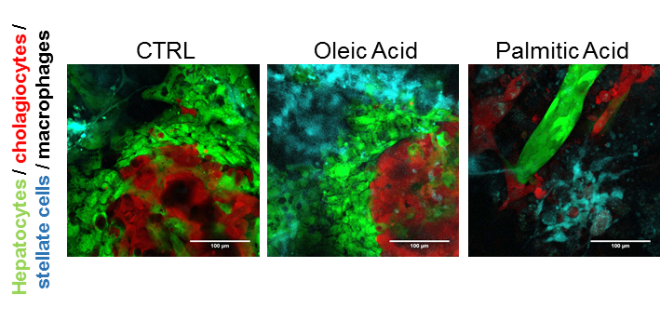
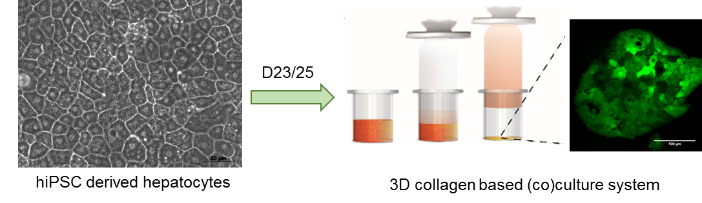
Modelling NAFLD using human induced pluripotent stem cells (hIPSCs)
Background
Therapies targeting NAFLD remain elusive due to lack of a suitable tool to faithfully recapitulate the human pathology
hIPSCs are proven to model disorders affecting the liver
A hIPSC-based platform is being developed to model the different aspects of NAFLD in vitro by reproducing the complexity of liver architecture and its multicellularity
Results
In the 3D environment, the different cell types retained proper phenotype and functional characteristics for >4 weeks, allowing for long-term cultures
Co-cultured cells spontaneously rearranged to model physiological cellular interactions
Fatty acid treatment led to steatosis and lipotoxicity in hepatocytes; the presence of nonparenchymal cells sustained fatty acid-induced hepatocyte damage
Methods
Liver cell types generated from hIPSCs;
alternatively, primary cultures or cell lines used
Hepatic microenvironment reproduced by co-culturing cells in a 3D matrix, taking advantage of fluorescent reporter cell lines to monitor cellular interactions
Conclusions
The system mimics the mechanisms of hepatocyte steatosis and lipotoxicity, including the inflammatory and fibrotic response associated with NAFLD progression → represents an important step forward to model NAFLD in vitro
Morell CM, et al. ILC 2018. PS-052
Notes:
Abbreviations: CTRL, control; NAFLD, nonalcoholic fatty liver disease

Slide 18
Frequency and outcomes of liver transplantation for NASH in Europe
Aim: To describe the changing frequency of LTx
for NASH in Europe, determine clinical outcomes
and prognostic factors
Methods
Retrospective cohort analysis of 68,950 adult patients who underwent primary LTx for chronic liver disease between 01/01/2002 and 31/12/2016 using the ELTR database; data prospectively collected from 174 centres in 33 countries
Conclusions
The proportion of LTxs performed for patients with NASH has risen more than for any other indication
Significantly higher proportion of NASH recipients with concomitant HCC than for other indications.
NASH is not an independent predictor of post-LTx patient or graft survival
Amongst NASH recipients, older age, higher MELD and extremes of BMI carry a post-LTx mortality risk, ➔ can aid risk stratification and careful selection of patients with NASH for LTx
Results
Changing indications for LTx
  Primary indication was NASH (2,741 [4%] pts)
  ⬆ proportion of LTx performed for patients with NASH: 1.2% (2002) ➔ 8.4% (2016)
  ARLD was the most common indication (n=22,226; 32.3%)
Recipient differences
Patient and graft outcomes after LTx
  NASH not an independent predictor of post-LTx patient survival*
Key determinants of post-LT survival in NASH recipients
 | NASH | Non-NASH
Age years; (IQR) | 60 (54–64) | 55 (48–61)
BMI kg/m^{–2} (SD) | 32.6 (4.57) | 25.8 (4.45)
HCC (%) | 39.1 | 28.9
 | For patient survival | For graft survival
HR | 1.06 (0.97–1.17) | 0.90 (0.79–1.04)
For recipients without HCC | HR
Recipient age (years) 61–65 >65 | 1.96 (1.29–2.98) 1.77 (1.11–2.82)
MELD >23 | 1.54 (1.04–2.30)
Recipient BMI (kg/m²) <18.5 18.5–25 >40 | 5.04 (1.18–21.56) 2.34 (1.28–4.26) 2.24 (1.30–3.87)
Donor blood group B | 0.41 (0.23–0.72)
*Multivariable Cox regression; adjusted for donor and recipient factors
Haldar D, et al. ILC 2018, PS-041
Notes:
Abbreviations: ARLD, alcohol-related liver disease; BMI, body mass index; ELTR, European Liver Transplant Registry; HCC, hepatocellular carcinoma; MELD, Model for End-Stage Liver Disease; NASH, nonalcoholic steatohepatitis; LTx, liver transplantation

Slide 19
NAFLD and risk of incident NASH, cirrhosis and HCC in 18 million European electronic healthcare records
134,854 NAFLD or NASH patients
  From Italy, Spain, the Netherlands, and UK
Matching 100:1 by practice site, gender, age ±5 years, and visit
Mean follow-up 3.5 years (>500,000 person years)
Association with cirrhosis
Association with HCC
Exposure database |  | HR (95% CI)
NAFLD/NASH HSD IPCI SIDIAP THIN Subtotal (I-squared=96.6%, p=0.000) |  | 2.45 (1.68, 3.58) 5.20 (3.60, 7.42) 3.62 (3.03, 4.32) 10.47 (8.76, 12.52) 4.73 (2.43, 9.19)
NAFLD SIDIAP THIN Subtotal (I-squared=98.6%, p=0.000) |  | 3.26 (2.70, 3.94) 10.40 (8.62, 12.54) 5.83 (1.87, 18.13)
NASH SIDIAP THIN Subtotal (I-squared=90.2%, p=0.001) |  | 11.56 (6.63, 20.15) 45.19 (24.14, 84.59) 22.67 (5.96, 86.23)
Exposure database |  | HR (95% CI)
NAFLD/NASH HSD IPCI SIDIAP THIN Subtotal (I-squared=92.0%, p=0.000) |  | 1.63 (1.00, 2.65) 7.92 (4.02, 15.57) 2.11 (1.59, 2.80) 6.07 (4.38, 8.43) 3.51 (1.72, 7.16)
NAFLD SIDIAP THIN Subtotal (I-squared=94.8%, p=0.000) |  | 1.90 (1.39, 2.58) 5.26 (3.76, 7.36) 3.15 (1.16, 8.56)
NASH SIDIAP THIN Subtotal (I-squared=0.0%, p=0.506) |  | 6.99 (3.18, 15.38) 11.75 (3.16, 43.64) 8.02 (4.08, 15.77)
.6
1
2
4
8
16
32
64
128
.6
1
2
4
8
16
32
64
HR (95% CI)
HR (95% CI)
HR values adjusted for age, smoking status and BMI
Alexander M, et al. ILC 2018, PS-106
Notes:
Abbreviations: BMI, boy mass index; HCC, hepatocellular carcinoma; NAFLD, nonalcoholic fatty liver disease; NASH, nonalcoholic steatohepatitis
Abstract 4096 title: Non-alcoholic fatty liver disease and relative risk of incident steatohepatitis, cirrhosis and hepatocellular carcinoma events in four European primary care databases
Alazawi, et al. ILC 2018, abstract 4096.

Slide 20
3. Rare metabolic diseases

Slide 21
Givosiran, an RNA interference therapeutic: Phase 1/2 and OLE studies in patients with acute intermittent porphyria (AIP)
Background Givosiran targets liver ALAS1 (rate limiting enzyme in haem synthesis) to reduce neurotoxic ALA and PBG accumulation in patients with AIP
Methods Safety, tolerability, PK-PD, and clinical activity of givosiran SC in patients with AIP
Part A: Single ascending dose
Part B: Multiple ascending dose
Part C: Multiple dose (6 months): patients completing Part C → OLE (42 months)
    AIP patients with recurrent attacks* (≥2 attacks in
    past 6 months or on haemin prophylaxis) randomized 3:1 givosiran:PBO after experiencing 1 attack in observational run-in
Safety
8 SAEs† in 6 patients; none related to givosiran in Phase 1
  2 SAEs† in 2 patients in OLE, with one related case of anaphylaxis in a patient with asthma and atopy
  No clinically significant changes in laboratory or physical examination with ongoing dosing in the OLE
  Efficacy
Durable lowering of induced ALAS1 and ALA with givosiran
Monthly dosing led to mean reductions in AAR and annualized haemin doses vs. PBO, up to 83% and 88%, respectively
Interim OLE results demonstrate maintenance, and potential enhancement, of clinical activity with extended dosing
  In patients treated wth givosiran, further reductions in AAR by 93% in OLE relative to run-in
  PBO-treated patients crossing over to givosiran in OLE had >90% reductions in AAR relative to run-in
ALA lowering was correlated with AAR
Part C: Annualized attack rate (AAR)
–83%
–75%
Conclusions: Givosiran was generally well tolerated and resulted in durable lowering of ALAS1 and ALA towards normal levels, which was associated with clinically meaningful reductions in AAR and haemin use
PBO
(n=4)
2.5
(n=3)
5
(n=4)
2.5
(n=3)
5
(n=3)
Quarterly
Monthly
Givosiran (mg/kg)
*Attacks requiring hospitalization, urgent health care visit, or haemin; †SAEs other than porphyria attacks
Sardh E, et al. ILC 2018, GS-016
Notes:
Abbreviations: ALA, aminolevulinic acid; ALAS1, aminolevulinic acid synthase 1; OLE, open-label extension; PBG, porphobilinogen; PBO, placebo; PK-PD, pharmacokinetics and pharmacodynamics; SAE, serious adverse event; SC, subcutaeneous

Slide 22
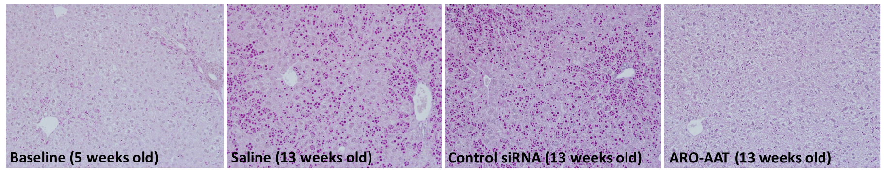
ARO-AAT, an RNAi therapeutic, for alpha-1 antitrypsin (AAT) liver disease
Background: ARO-AAT is subcutaneously administered, liver-targeted, and provides deep and durable AAT reduction (stops Z-AAT production by silencing AAT gene)
Methods: ARO-AAT PK, biodistribution, AAT reduction, liver exposure efficacy, AAT mRNA and Z-AAT proteins were evaluated in rats, NHPs and PiZ mice
Results
  Single-dose ARO-AAT durably reduced Z-AAT liver mRNA and serum protein in PiZ mice. The degree of mRNA reduction correlated with amount of siRNA in the liver
  Repeat dosing (4 x q2w, 4 mg/kg) of young PiZ mice:
    Reduced Z-AAT liver mRNA (95%), plasma Z-AAT (96%), monomeric liver Z-AAT (98%) and polymeric Z-AAT (41%)
    ARO-AAT prevented increases of Z-AAT polymer globules that were observed in untreated controls of same age: 2.6-fold increase in number, 8-fold increase in affected area of liver, 3.3-fold increase in globule size
  NHPs given 2 doses (3 mg/kg), 4 weeks apart, had mean 89–91% reduction of serum AAT sustained more than
  7 weeks after second dose
Globule formation and accumulation prevented with ARO-AAT
PAS-D-stained Z-AAT globules in PiZ mice
Conclusions
  These results support monthly or less frequent dosing
  Clinical trials with ARO-AAT began in March 2018
Wooddell C, et al. ILC 2018, PS-147
Notes:
Abbreviations: AAT, alpha-1 antitrypsin; NHP, nonhuman primate; PAS-D, Periodic acid–Schiff–diastase; PK, pharmacokinetics; q2w; every 2 weeks; RNAi, RNA interference; siRNA, small interfering RNA

Slide 23
4. Basic science and preclinical

Slide 24

Intestinal microbiota modulates susceptibility to paracetamol-induced acute liver injury
Study design
  DILI with paracetamol was studied in WT and Nlrp6–/– mice
  The impact of intestinal microbiota was tested by FMT
Results
  Necrosis and inflammation were aggravated in dysbiotic Nlrp6–/– mice
  FMT from Nlrp6–/– mice into WT mice augmented liver injury upon paracetamol treatment in recipient WT mice and skewed monocyte polarization towards a Ly6C^{hi} inflammatory phenotype
Conclusions
Intestinal dysbiosis, e.g. as seen in Nlrp6^{-/-} mice, controls monocyte polarization and modulates
paracetamol-induced DILI
Monocytes are sensors of gut-derived signals orchestrating the inflammatory response
Microbiota are potentially druggable disease modifiers in acute liver injury
Necrotic areas in the liver
Ly6C^{hi}
FMT
Nectrotic areas (%)
% of MoMFs
WT^{FMT(Nlrp6–/– )}
Nlrp6^{–/–FMT(Nlrp6–/– )}
WT^{FMT(Nlrp6–/– )}
Control
WT
Nlrp6–/–
WT^{FMT(Nlrp6–/– )}
WT^{FMT(WT)}
WT^{FMT(Nlrp6–/– )}
–FMT
+FMT
12-hour paracetamol
*p<0.05 vs. WT untreated; †p<0.001 vs. WT^{FMT (WT)}
Elfers C, et. al. ILC 2018, PS-127
Notes:
Abbreviations: DILI, drug-induced liver injury; FMT, faecal microbiota transfer; MoMF, monocyte-derived macrophage; WT, wild type

Slide 25
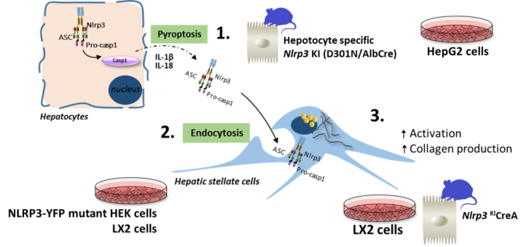

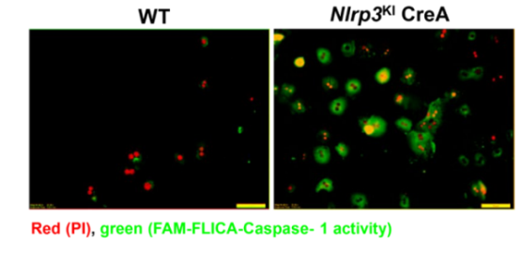

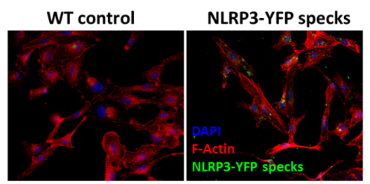
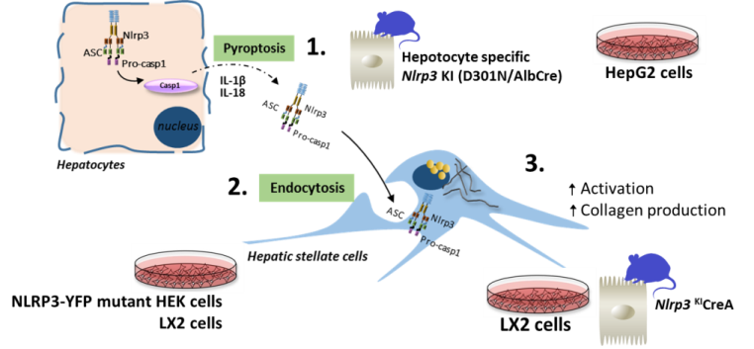
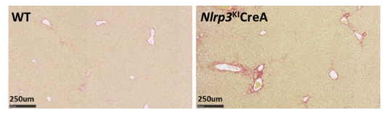
NLRP3 inflammasome activation in hepatocytes results in pyroptotic cell death, release of NLRP3 particles and liver fibrosis
Hypothesis: NLRP3 activation in hepatocytes leads to pyroptotic cell death, and release of NLRP3 inflammasomes that is sufficient to induce hepatic stellate cell (HSC) activation and liver fibrosis in-vivo
Methods
1.
Isolated primary hepatocytes
HepG2 cells
Relative fluorescence
(% of control)
2.
LX2 cells stimulated with NLRP3 particles
LDH release
(fold over control)
LPS
Conclusions
Inflammasome activation in hepatocytes induces caspase-1-dependent pyroptosis and release of NLRP3 inflammasome particles that are engulfed by HSCs
Hepatocyte-specific NLRP3 mutant mice showed HSC activation and liver fibrosis, demonstrating a novel crosstalk between hepatocytes and HSC to propagate liver injury and liver fibrosis development
3.
Livers of hepatocyte-specific
NLRP3^{KI} CreA mice
Sirius Red
*
Sirus red+ cells
(% of area)
Schuster S, et al. ILC 2018, PS-056
Notes:
Abbreviations: FAM-FLICA, fluorochrome inhibitor of caspases; LDH, lactate dehydrogenase; PI, Propidium iodide; WT, wild type

Slide 26

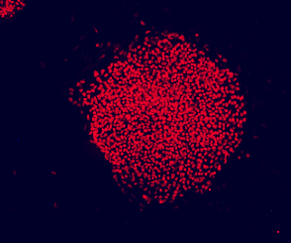
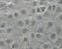
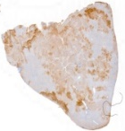




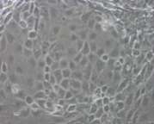
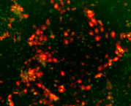
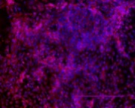
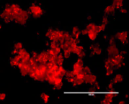
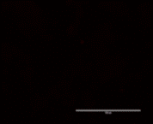
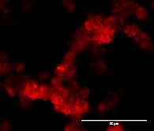
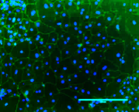
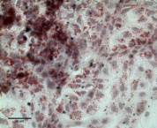
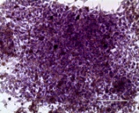
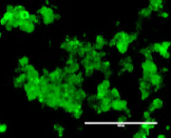
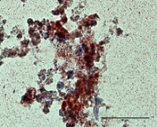
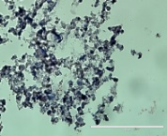


Autologous cell/gene therapy approach of haemophilia B (HB) using patient-specific induced pluripotent stem cells (iPSCs)
Patient specific iPSCs
In vivo validation of the correction
Reprogramming
Autologous transplantation
OCT4
NANOG
<3 weeks
HB patient
SSEA4
TRA1-60
FIX patient’s mutation:
mRNA : yes
Protein : yes
Activity : no
Intrahepatic transplantation of 10⁵ 2D-Corr-HB-iHeps into newborn (24-48h) F9KO mouse
Targeted genome insertion at the AAVS1 site
(CRISPR/Cas9)
In vitro validation of the correction after 3D differentiation
Hepatocyte differentiation
kDa
Concentration in coagulant FIX in 3D-iHeps
70
2D culture
3D culture
50
HB-iHeps
HB-iHeps
Corr-HB-iHeps
Corr-HB-iHeps
Human plasma
200µm
400µm
400µm
2D
3D
HNF4α/AFP
ALB/DAPI
ALB
AFP
HB-iHeps
D30
200µm
100µm
FIX in 3D-Corr-HB-iHeps
Corr-HB-iHeps
ZO-1/DAPI
Lipid storage
Glycogen storage
ZO-1
Lipid storage
Glycogen storage
HB-iPSCs derived from a severe HB patient’s skin fibroblasts were genetically corrected using CRISPR/Cas9 technology
Correction of the phenotype was validated in vitro by detection of FIX clotting activity in the supernatant of corrected cells
after 3D differentiation into hepatocyte-like cells (3D-corr-HB-iHeps)
Liver IHC analyses after transplantation of corr-HB-iHeps into the liver of newborn HB mice showed
the cell engraftment into mouse livers. Further experiments are ongoing to evaluate FIX activity in
animal plasma to assess the efficacy of our cell/gene therapy approach
Luce E, et al. ILC 2018, PS-145
Notes:
Abbreviations: CRISPR, clustered regularly interspaced short palindromic repeats; FIX, factor IX; IHC, immunohistochemistry

