Slide 1
Best of ILC 2018
Liver tumours

Slide 2
About these slides
These slides provide highlights of new data presented at the International Liver Congress 2018
Please feel free to use, adapt, and share these slides for your own personal use; however, please acknowledge EASL as the source
Definitions of all abbreviations shown in these slides are provided within the slide notes
These slides are intended for use as an educational resource and should not be used to make patient management decisions. All information included should be verified before treating patients or using any therapies described in these materials

Slide 3
Contents – section 1
1. Clinical management of hepatocellular carcinoma (HCC)
LBO-005 | The impact of combining selective internal radiation therapy (SIRT) with sorafenib on overall survival in patients with advanced hepatocellular carcinoma: the SORAMIC trial palliative cohort
GS-008 | Sustained efficacy of adjuvant immunotherapy with cytokine-induced killer cells for hepatocellular carcinoma: an extended 5-year follow-up
GS-003 | Sorafenib with versus without concurrent conventional transarterial chemoembolization (cTACE) in patients with advanced hepatocellular carcinoma (HCC): results from a multicenter, open-label, randomized, controlled Phase III STAH trial
PS-017 | Personalized T cell therapy against HBV-related hepatocellular carcinoma
PS-018 | Role of 99mTc-Macroaggregated Albumin SPECT/CT based dosimetry in predicting survival and tumor response of patients with locally advanced and inoperable hepatocellular carcinoma (HCC) treated by selective intra-arterial radiation therapy (SIRT) with yttrium-90 resin microspheres, a cohort from SARAH study
PS-024 | Hepatic safety and biomarker assessments in sorafenib-experienced patients with advanced hepatocellular carcinoma treated with nivolumab in the CheckMate-040 study
PS-022 | Efficacy and safety of regorafenib in real life in the treatment of hepatocellular carcinoma. Multicenter experience
Click here to skip to this section

Slide 4
Contents – section 2
2. Hepatocellular carcinoma (HCC) risk factors (public health)
PS-061 | Cost-effectiveness analysis of hepatocellular carcinoma screening in hepatitis C cirrhosis after sustained viral response
PS-064 | Analysis of the influence of alcohol abstinence on the risk of developing hepatocellular carcinoma (HCC) in patients with alcoholic liver cirrhosis (ALC)
Click here to skip to this section

Slide 5
Contents – section 3
3. Hepatocellular carcinoma (HCC) risk factors (impact of HCV cure)
PS-020 | Lower compliance to prior HCC surveillance and liver function impairment explain the apparent higher HCC incidence under direct antivirals in HCV compensated cirrhotic patients: the French multicenter prospective ANRS CO12 CirVir cohort
PS-021 | Post-treatment liver stiffness measurement is not useful to predict hepatocellular carcinoma in HCV patients who achieve SVR
PS-023 | Pathological characteristics and early post-hepatic-resection outcome of patients with hepatocellular carcinoma occurred after hepatitis C treatment with new direct-acting antivirals: a multicenter cohort study
PS-154 | SVR is the strongest predictor of occurrence and recurrence of hepatocellular carcinoma in HCV cirrhotic patients after treatment with DAAs: a prospective multi-centric Italian study
PS-153 | HCC recurrence under all-oral DAAs-based antiviral therapy in HCV-infected patients: data from Navigatore web platform
PS-152 | IFN-free DAA treatment of cirrhotic HCV patients with or without history of HCC: a multicenter prospective trial in Italy
Click here to skip to this section
Notes:
HCV, hepatitis C virus

Slide 6
Contents – section 4
4. Extrahepatic cholangiocarcinoma
GS-004 | Integrative molecular classification of extrahepatic cholangiocarcinoma
Click here to skip to this section

Slide 7
1. Hepatocellular carcinoma (HCC) treatment

Slide 8
The impact of combining SIRT with sorafenib on overall survival in patients with advanced HCC: the SORAMIC trial palliative cohort
Methods:
Randomized controlled comparison: SOR+SIRT vs. SOR in advanced HCC
Primary outcome: OS in the ITT population
ITT population | SOR+SIRT (n=216) | SOR (n=208)
Median OS, months (95% CI) | 12.1 (10.6, 14.6) | 11.5 (9.8, 13.8)
 | HR 1.0067 (0.82,1.25) p=0.951
OS in the PP population (N=288)
1.0
PP population | SOR+SIRT (n=114) | SOR (n=174)
Median OS, months (95% CI) | 14.07 (10.9, 16.4) | 11.14 (9.7, 13.9)
 | HR 0.86 (0.67,1.11) p=0.253
0.8
0.6
Survival probability
0.4
PP population subgroup analysis* | SOR+SIRT vs. SOR
 | HR | p-value
≤65 years | 0.65 | 0.05
Non-alcoholic aetiology | 0.63 | 0.012
Without cirrhosis | 0.46 | 0.02
SOR+SIRT
SOR
Censored
0.2
0.0
0
12
24
36
48
60
Months
Number at risk:
114
62
20
5
1
0
174
75
23
8
2
0
Conclusions:
Addition of SIRT to SOR did not result in a significant improvement in OS vs. SOR alone
Subgroup analyses (hypothesis generating) suggest a potential clinical benefit for younger patients, and patients presenting with non-alcoholic aetiology, or without cirrhosis
*Stratified by portal vein thrombosis
Ricke J, et al. ILC 2018, LB-005
Notes:
Abbreviations: HCC, hepatocellular carcinoma; ITT, intention-to-treat; OS, overall survival; PP, per protocol; SIRT, selective internal radiation therapy; SOR, sorafenib
Full title: The impact of combining Selective Internal Radiation Therapy (SIRT) with Sorafenib on overall survival in patients with advanced hepatocellular carcinoma: The SORAMIC trial palliative cohort

Slide 9
Sustained efficacy of adjuvant immunotherapy with cytokine-induced killer cells for HCC: an extended 5-year follow-up
Methods:
Randomized, open-label, multi-centre clinical trial (ClinicalTrials.gov NCT01890291)
Efficacy and safety of CIK cell (Immuncell-LC group) vs. control
0
2 yr
5 yr
Follow-
up
Extended follow-up
Immunotherapy (N=114)
16 injections of CIK cells
6.4x10⁹ cells/injection
N=89
Primary
endpoint†
RFS
Patients who underwent
curative treatment*
for stage I or II HCC
Screening and randomization N=230
Control (N=112)
N=73
RFS
CIK vs. control HR (95% CI)
RFS: 0.67 (0.48, 0.94), p=0.009
OS: 0.33 (0.15, 0.76), p=0.006
CSS: 0.33 (0.13, 0.86), p=0.02
1.0
HR=0.67 (95% CI 0.48, 0.94); p=0.009
0.8
Immunotherapy
Control
Censored
0.6
RFS probability
0.5
0.4
0.2
▼ 33% risk of recurrence or death
▼ 67% risk of overall death
CIK cell might have a prolonged antitumour activity
0.0
30
44
0
6
12
18
24
30
36
42
48
54
60
66
72
78
84
90
Time (months)
Number at risk:
114
98
89
85
97
74
67
58
45
40
40
34
23
16
10
1
112
87
67
54
52
50
42
38
35
32
28
24
14
9
6
1
*Resection, radiofrequency ablation, or percutaneous ethanol injection; †Secondary endpoints: OS, CSS, AFP level changes
Lee J-H, et al. ILC 2018, GS-008
Notes:
Abbreviations: AFP, alpha fetoprotein; CIK, cytokine-induced killer cells; CSS, cancer-specific survival; HCC, hepatocellular carcinoma; OS, overall survival; RFS, recurrence-free survival
Full title: Sustained efficacy of adjuvant immunotherapy with cytokine-induced killer cells for hepatocellular carcinoma: an extended 5-year follow-up

Slide 10
Sorafenib with versus without concurrent cTACE in patients with advanced HCC: Results from the STAH trial
Methods: randomized, multicentre, open-label, controlled Phase 3 trial (NCT01829035)
Advanced HCC
Child–Pugh A–B7
ECOG 0–2
TACE refractory
Stratification by:
mUICC stage
Vascular invasion
Child–Pugh score
AFP
SOR + cTACE
(n=169)
Endpoints
Primary: OS
Secondary: TTP, PFS, TRR, AEs
Randomization
SOR
(n=169)
Secondary outcomes | Median | HR | 95% CI | p
TTP, months | 5.3 vs. 3.5 | 0.67 | 0.53, 0.85 | 0.003
PFS, months | 5.2 vs. 3.6 | 0.73 | 0.59, 0.91 | 0.01
TRR | 60.6% vs. 47.3% |  |  | 0.005
Overall survival | SOR+cTACE (n=170) | SOR (n=169)
Median OS, months (90% CI) | 12.8 (11.5, 15) | 10.8 (8.7, 12.7)
 | 0.91 (0.687, 1.205) p=0.2898
1.00
0.75
Survival probability
Safety outcomes |  | Arm C | Arm S
SAEs |  | 33.3% | 19.8%
Grade 3+ AEs in >10% | Increased ALT Hyperbilirubinaemia Ascites Hand-foot skin reaction | 20.3% 11.8% 11.8% 10.5% | 3.6% 3.0% 4.2% 11.4%
0.50
0.25
Arm C
Arm S
Censored
0.00
0
12
24
36
48
60
Months
Conclusions:
SOR + cTACE did not improve OS vs. SOR alone in patients with advanced HCC
SOR + cTACE significantly improved TTP, PFS, and TRR, and a survival benefit was observed in the patients who received SOR+cTACE ≥2 sessions
Number at risk:
153
46
13
3
0
0
167
44
12
3
1
0
Subgroup analysis: survival benefit for the 46% of patients in the SOR+cTACE arm who received ≥2 cTACE vs. SOR:
18.6 vs. 10.8 months; HR, 0.58; 95% CI, 0.40–0.82; p=0.006
Park J-W, et al. ILC 2018, GS-003
Notes:
Abbreviations: AE, adverse event; AFP, alpha fetoprotein; ALT, alanine aminotransferase; cTACE, conventional transarterial chemoembolization; ECOG, Eastern Cooperative Oncology Group; HCC, hepatocellular carcinoma; ITT, intention-to-treat; mICC, modified Union for International Cancer Control; OS, overall survival; PFS, progression-free survival; SAE, serious adverse event; SOR, sorafenib; TRR, tumour response rate; TTP, time to progression
Full title: Sorafenib with versus without concurrent conventional transarterial chemoembolization (cTACE) in patients with advanced hepatocellular carcinoma (HCC): Results from a multicenter, open-label, randomized, controlled phase III STAH trial

Slide 11
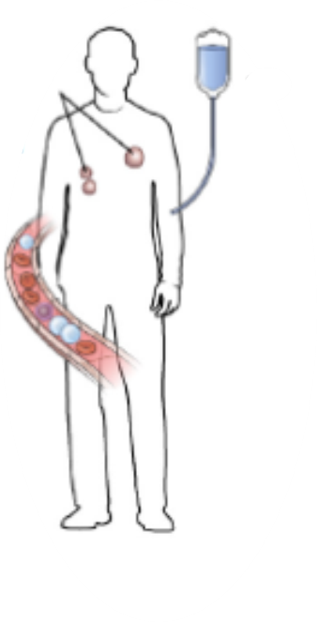
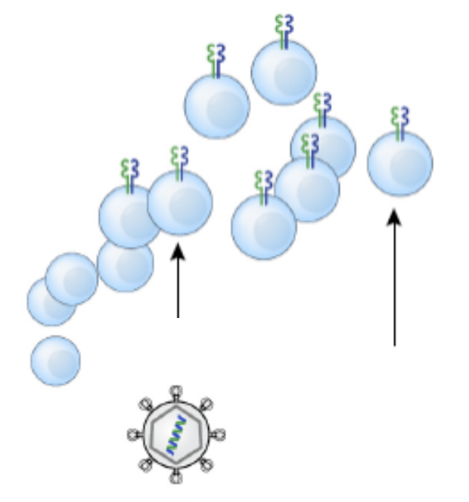
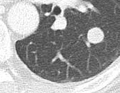
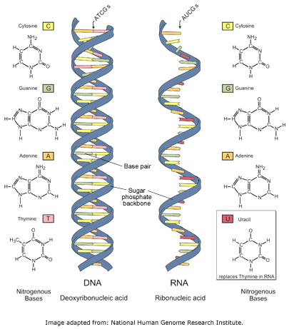
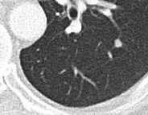
Personalized T cell therapy against HBV-related hepatocellular carcinoma
HBV-specific
T cell infusion
Therapy with T cells engineered
with selected HBV-specific TCRs demonstrated objective signs of clinical effectiveness
Treatment
HLA profile of patient and donor liver
+
Detection of HBV transcripts in HCC metastases
Before treatment
Adapted from Klebanoff et al.
2016 Nature Medicine
Retroviral vector encoding TCR
mRNA electroporation
of TCR
~1 year
Personalization
Engineer antigen
specificity with TCR
Selection of TCR
HLA specific to tumour
HBV-specific T cell epitopes expressed in HCC
Tan A, et al. ILC 2018, PS-017
Notes:
Abbreviations: HBV, hepatitis B virus; HCC, hepatocellular carcinoma; HLA, human leukocyte antigen; TCR, T cell receptor

Slide 12

Role of ^{99m}Tc-MAA SPECT/CT dosimetry in predicting OS/TR of patients treated by ⁹⁰Y-SIRT, from SARAH
Methods:
Tumour-absorbed dose computed using MAA-SPECT/CT
Visual agreement between CT, MAA-SPECT/CT and
⁹⁰Y-SPECT/PET rated as optimal, suboptimal or not optimal
Tumour response assessed on CT at 6 months (RECIST 1.1)
Overall survival
Median 95% CI
<100 Gy 6.1 months 4.9, 6.8
≥100 Gy 14.1 months 9.6, 18.6
HR, 0.38; 95% CI, 025, 0.57
1.0
Dose measures
Dose/survival
population: n=121
0.8
Randomization 1:1 n=460
SIRT
184 patients received ⁹⁰Y-SIRT
SOR
Dose/response
population: n=109 (146 treatments)
0.6
Response measures
Survival probability
Results:
In the dose/response population:
DC rate was 63.7%
Tumour-absorbed dose was significantly higher in treatments leading to DC (93 treatments) vs. no-DC, median (IQR):
  121.4 Gy (86.0–189.8) vs. 85.1 Gy (58.4–164.3), p=0.0204)
Highest DC rate (70.5%) was observed after treatments receiving
≥100 Gy with optimal visual agreement (40 treatments)
Conclusions:
Tumour-absorbed dose is significantly associated with OS
and DC
Highest OS and DC rates with both tumour-absorbed dose ≥100 Gy and optimal CT-MAA-⁹⁰Y agreement
0.4
0.2
P<0.0001
0.0
0
6
12
18
24
30
36
42
Time since randomization (months)
N at risk (n censored)
<100 Gy
54 (0)
28 (0)
14 (0)
7 (1)
3 (1)
1 (2)
0 (2)
≥100 Gy
67 (0)
52 (0)
34 (1)
22 (5)
18 (8)
9 (15)
2 (19)
0 (21)
Within the ≥100 Gy group, those with optimal visual agreement (n=24) had the longest median OS (24.9months, 95% CI 9.6–33.9)
*Using SIR-Spheres: Yittrium-90 resin microspheres
Hermann A-L, et al. ILC 2018, PS-018
Notes:
Abbreviations: CT, computed tomography; DC, disease control; MAA, macroaggregated albumin; OS, overall survival; PET, positron emission tomography; SIRT, selective intraarterial radiation therapy, SOR, sorafenib; SPECT, single-photon emission computed tomography TR, tumour response; ⁹⁰Y, yittrium-90
Full Title: Role of 99mTc-Macroaggregated Albumin SPECT/CT based dosimetry in predicting survival and tumor response of patients with locally advanced and inoperable hepatocellular carcinoma (HCC) treated by selective intra-arterial radiation therapy (SIRT) with yttrium-90 resin microspheres, a cohort from SARAH study

Slide 13
Hepatic safety and biomarkers in SOR-experienced patients with aHCC treated with nivolumab in CheckMate-040
Methods:
Updated hepatic safety and biomarker analyses for 154 SOR-experienced patients with aHCC who received nivolumab 3 mg/kg in the dose-escalation and dose-expansion phases of CheckMate-040
Results:
Viral load and AFP
Safety
Changes in HCV RNA and HBV DNA did not correlate with tumour response
31% (9/29) of HCV-infected patients had >1 log decrease in HCV RNA
11% (5/45) of HBV-infected patients had >1 log increase in HBV DNA
OS, ORR and DCR were similar regardless of baseline AFP levels
Baseline AFP levels were not associated with response to nivolumab
Most responders (88% of patients with CR or PR) had >1 log decline in AFP on treatment
Overall, hepatic TRAEs occurred in 9.1% (n=14) of patients
  3.9% were grade 3–4 (primarily lab abnormalities)
    Median time to onset (any grade) was 6.1 weeks
    78.6% (11/14) of patients with hepatic TRAEs resolved
      3 of the patients whose hepatic AEs resolved were treated with systemic corticosteroids
      Median time to resolution for any-grade hepatic TRAEs was 10.8 weeks
Conclusions:
Nivolumab had limited impact on viral kinetics in HBV- and HCV-infected patients
Baseline AFP levels id not impact OS or ORR; AFP declines were associated with response
The manageable safety profile of nivolumab, including immune-mediated and hepatic AEs, was consistent with other tumour types in which nivolumab is approved
  No unexpected emergent toxicity was observed in patients with current liver disease
  compared with patients without liver disease
Meyer T, et al. ILC 2018, PS-024
Notes:
Abbreviations: AE, adverse event; AFP, alpha fetoprotein; aHCC, advanced hepatocellular carcinoma; CR, complete response; HBV, hepatitis B virus; HCV, hepatitis C virus; PR, partial response; SOR, sorafenib; TRAE, treatment-related adverse event
Full Title: Hepatic safety and biomarker assessments in sorafenib-experienced patients with advanced hepatocellular carcinoma treated with nivolumab in the CheckMate-040 study

Slide 14
Efficacy and safety of regorafenib in real life in the treatment of HCC: multicentre experience
Aims:
Patients:
Results:
Assess applicability, AEs and radiological response at 3 months of REGO in real life
Determine if DAE60 with SOR is a predictor of HFS with REGO
97 patients prospectively recruited for REGO as 2nd line after SOR (including 6 after LTx,
and 3 as 3rd line after SOR and nivolumab)
DAE60 and HFS-REGO were associated with longer survival from start of SOR and REGO, respectively
1.0
DAE60 YES (n=32)
Median 24 months
95% CI 20.064, 27.936
1.0
HFS-REGO YES (n=24)
Median 14 months
95% CI 7.390, 20.610
0.8
DAE60 NO (n=37)
Median 19 months
95% CI 14.478, 23.522
0.8
0.6
0.6
p=0.021
Accumulated survival
Accumulated survival
0.4
0.4
p=0.042
HR 2.425
95% CI 1.703, 5.480
HFS-REGO NO (n=45)
Median 8 months,
95% CI 5.545, 10.455
0.2
0.2
0.0
0.0
0.0
10
20
30
40
50
60
0
2
4
6
8
10
12
14
Survival (months) since start of SOR
Survival (months) since start of REGO
Absence of DAE60 with SOR predicted absence of HFS with REGO in 89.18% of cases
4/37 (10.8%) patients who had not developed DAE60 on SOR had HFS-REGO
(NPV 89.2%)
Fraile M, et al. ILC 2018, PS-022
Notes:
Abbreviations: AE, adverse event; DAE60, dermatological adverse effects >grade 2 in the first 60 days; HFS, hand-foot syndrome; LTx, liver transplantation; NPV, negative predictive value; REGO, regorafenib; SOR, sorafenib

Slide 15
2. Hepatocellular carcinoma (HCC) risk factors (public health)

Slide 16
Cost-effectiveness analysis of HCC screening in hepatitis C cirrhosis after sustained viral response
AASLD-IDSA & EASL-EORTIC
recommend:
q6m ultrasound surveillance for patients with cirrhosis AND advanced fibrosis
before SVR
A Markov state-transition model was designed
Strategies: “Screen all” vs. “Screen None” with q6/12m ultrasound
Population: 50-year-old patients with CHC-related F3/4, post-SVR
Perspective: Healthcare payer; 5%/year discount for costs and effects
Willingness to pay threshold: $50,000/QALY and life-time horizon
Parameter | ICER ($/QALY) |  | HCC Incidence^{1,2} %/Year
 | q6m | q12m
No cirrhosis Cirrhosis | $339,876 $42,823 | $134,345 $31,096 | 0.16–0.34 1.39–1.82
FIB-4 < 3.25 FIB-4 > 3.25 | $103,976 $38,928 | $63,635 $28,898 | 0.41 2.16
APRI < 2 APRI < 2 | Dominated $55,916 | $841,181 $38,516 | 0.093 0.89
Under/over willingness to pay threshold of $50,000/QALY
Conclusions:
Cost effectiveness of HCC surveillance post-SVR is very sensitive to HCC incidence (~1.1%/year threshold for q6m US)
Ultrasound surveillance is likely to be cost effective in cirrhosis but very unlikely to be cost effective without cirrhosis
Simple tools like APRI and FIB-4 can identify patients for whom post-SVR surveillance is likely to
be cost-effective
1. Kanwal F, et al. Gastroenterology 2017;153:996–1005; 2. El-Serag HB, et al. Hepatology 2016;64:130–7;
Zangneh HF, et al. ILC 2018, PS-061
Notes:
Abbreviations: APRI, aspartate aminotransferase to platelet ratio index; CHC, chronic hepatitis C; HCC, hepatocellular carcinoma; ICER, incremental cost-effectiveness ratio; q6/12m, every 6/12 months; QALY, quality-adjusted life year; SVR, sustained virological response

Slide 17
Analysis of the influence of alcohol abstinence on the risk of developing HCC in patients with alcoholic liver cirrhosis
Aim: To investigate if abstinence reduces HCC risk in patients with ALC
Methods/results:
602 patients with ALC (Child–Pugh A/B)
Mean follow-up, 77±59 months; HCC n=93 (15.4%)
Mean annual HCC incidence: 2.40%
HCC risk factors, all patients
Variables | Univariate | HR† (95% CI)
Age >55 years | p=0.001 | 2.15 (1.39, 3.35)
Male sex | p=0.007 | 2.56 (1.26, 5.05)
BMI 25-30 | p=0.02
Platelets ≤145x10³/mm³ | p=0.003 | 1.94 (1.11, 1.61)
AST >45 (UI/L) | p=0.019
Abstinence | p=0.88 | 1.04 (0.66, 1.61)
1.0
Non-abstainers, n=304
HCC n=45; median FU: 60 months
0.8
Abstainers,* n=298
HCC n=48; median FU: 67 months
0.6
HCC risk factors, abstinent vs. non-abstinent patients
Annual incidence:
Non-abstainers: 2.39%
Abstainers: 2.42%
Variables | Abstainers HR† (95% CI) | Non-abstainers HR† (95% CI)
Age >55 years | 1.89 (1.03, 3.47) | 2.54 (1.32, .91)
Male sex |  | 3.65 (1.11, 11.96)
Platelets ≤145x10³/mm³ | 2.39 (1.00, 5.66) | 2.60 (1.12, 6.00)
Previous decompensation | 2.98 (1.17, 7.60)
0.4
0.2
Log rank
p=0.88
0.0
0
24
48
72
96
120
144
168
192
216
240
264
Months
Conclusions:
Alcohol abstinence in patients with advanced ALC not associated with reduced HCC risk
HCC risk factors (sex, age, degree of liver dysfunction) similar in abstinent and non-abstinent patients
Results highlight the need for an early diagnosis of alcoholic liver disease
*Abstinent meant absence of any alcohol consumption from inclusion; †Using multivariate analysis
Castano-Garcia A, et al. ILC 2018, PS-064
Notes:
Abbreviations: ALC, alcoholic liver cirrhosis; AST, aspartate aminotransferase; BMI, body mass index; FU, follow-up; HCC, hepatocellular carcinoma;
Full Title: Analysis of the influence of alcohol abstinence on the risk of developing hepatocellular carcinoma (HCC) in patients with alcoholic liver cirrhosis (ALC)

Slide 18
3. Hepatocellular carcinoma (HCC) risk factors (impact of HCV cure)

Slide 19
Compliance to prior surveillance and liver impairment explain HCC incidence in patients receiving DAAs for HCV
Methods: 1,270 patients with compensated, biopsy-proven HCV cirrhosis from the French multicentre prospective ANRS CO12 CirVir cohort were followed up for a median of 65 months
Results:
Crude incidence of HCC
IPTW
Weighted incidence of HCC
100
DAAs
SVR-IFN
Non-SVR IFN
100
DAAs
SVR-IFN
Non-SVR
80
80
60
60
Cumulative Incidence
of HCC (%)
Global p<0.001
DAAs versus SVR-IFN: p=0.030
Cumulative Incidence
of HCC (%)
Global p=0.014
DAAs versus SVR-IFN: p=0.77
40
40
20
20
0
0
0
12
24
36
48
60
0
12
24
36
48
60
Time (months)
Time (months)
Groups | Number of at risk (events)
DAAs | 336 | (12) | 263 | (3) | 117 | (0) | 13 | (0) | 6 | (0) | 4
SVR-IFN | 495 | (2) | 474 | (9) | 436 | (3) | 391 | (6) | 352 | (3) | 260
Non-SVR | 923 | (17) | 797 | (33) | 676 | (42) | 518 | (22) | 400 | (18) | 288
Groups | Number of at risk (events)
DAAs | 956 | 698 | 384 | 92 | 53 | 43
SVR-IFN | 1,076 | 1,043 | 965 | 849 | 771 | 532
Non-SVR | 1,029 | 892 | 760 | 613 | 478 | 357
Compared to the SVR-IFN group, DAA patients were older, and had higher rates of diabetes and endoscopic PH, lower platelet counts and more impaired liver function
Median rates of performed screenings were 81% in patients developing HCC under DAAs and 100% in the other groups
Multivariate analysis using IPTW to control for indication biases and patient characteristics showed that
DAAs were not associated with increased occurrence of HCC (in contrast to the appearance of the
uncorrected data)
Nahon P, et al. ILC 2018, PS-020
Notes:
Abbreviations: DAA, direct-acting antiviral; HCC, hepatocellular carcinoma; HCV, hepatitis C virus; IFN, interferon; IPTW, inverse probability of treatment weighting; PH, portal hypertension; SVR, sustained virological response
Full Title: Lower compliance to prior HCC surveillance and liver function impairment explain the apparent higher HCC incidence under direct antivirals in HCV compensated cirrhotic patients: the French multicenter prospective ANRS CO12 CirVir cohort experience.

Slide 20
Post-treatment liver stiffness measurement (LSM) is not useful to predict HCC in HCV patients who achieve SVR
Aim:
Prospective study to assess LSM and its evolution and evaluate risk factors associated with HCC in SVR HCV patients after DAA treatment
Methods:
2 French university hospitals (Bordeaux, Créteil)
May 2008–Nov 2016
Patients were treated with DAAs
LSM conducted before and after treatment
Delta LSM = follow-up LSM – baseline LSM
(<0 if improvement)
Results:
N=828, 52% male; median age 61 years;
15% diabetes; 41% cirrhosis
Median (range) Delta LSM:
–3.6 (–6.2, –1.1) kPa (p<0.0001)
Baseline LSM of 8–12.5 and no diabetes:
1/238 (0.4%) → no HCC screening
Diabetes regardless of baseline LSM:
21/390 (5.4%) → HCC screening
Risk of HCC
Parameter | HR (95% CI) | p-value
Males (vs. females) | 3.04 (1.10, 8.41) | 0.032
Age (years) | 1.06 (1.02, 1.10) | 0.005
Diabetes (yes vs. no) | 2.70 (1.12, 6.51) | 0.026
Baseline LSM (/kPa) | 1.05 (1.02, 1.07) | <0.0001
Delta-LSM (/kPa) | 0.99 (0.94, 1.04) | 0.705
Shili S, et al. ILC 2018, PS-021
Notes:
Abbreviations: DAA, direct-acting antiviral; HCC, hepatocellular carcinoma; HCV, hepatitis C virus; SVR, sustained virological response

Slide 21
Pathological characteristics of patients with HCC after HCV treatment with new DAAs
Methods:
Prospective multicohort study, 18 Italian hepato-biliary surgical units, Jan 2014–Dec 2016
420 consecutive patients with HCC, HCV and cirrhosis undergoing liver resection
77 patients (18.3%) with recurrent or de novo HCC after DAAs vs. 343 patients who did not receive DAAs
Results:
Conclusions:
DAA therapy does not seem to modify the biological aggressiveness of recurrent or de novo HCCs undergoing liver resection
Conversely, DAA therapy significantly improves early postoperative outcome of these patients
Pathological HCC characteristics (primary endpoint)
Early post-operative outcome (secondary endpoint)†
Pathologic HCC
characteristics
(weighted)
Characteristic, median (IQR) or n (%) | DAAs pre resection (n=324) | No DAAs (n=342)
Largest diameter (mm)** | 27 (20–43) | 34 (22–55)
Multinodular | 78 (24.1) | 76 (22.2)
Microvascular invasion | 112 (34.5) | 134 (39.2)
Macrovascular invasion | 33 (10.1) | 27 (7.9)
Poorly differentiated | 155 (47.7) | 164 (48.0)
Satellitosis | 49 (15.1) | 59 (17.3)
Margin <2 mm | 135 (41.6) | 135 (39.4)
Aggressive pathology | 222 (67.9) | 238 (69.6)
Variable, median (IQR) or n (%) Unweighted | Number of patients evaluated
 | DAAs pre resection | No DAAs
N evaluated | 78 | 342
Hospital stay (days) | 7 (5–10) | 8 (6–11)
Clavien >2* | 2 (2.6) | 32 (9.3)
6 month deaths | 2 (2.6) | 17 (5.4)
Weighted | DAAs pre resection | No DAAs
N evaluated | 324 | 342
Hospital stay (days) | 8 (6–14) | 8 (6–11)
Clavien >2* | 11 (3.4) | 32 (9.3)
6 month deaths* | 6 (2.0) | 17 (5.4)
*p<0.005; **p<0.01 for between-group comparison; †inverse probability of treatment weighting (IPTW) was used to balance the preoperative characteristics of the two groups for the evaluation of the secondary endpoint
Vitale A, et al. ILC 2018, PS-023
Notes:
Abbreviations: DAA, direct-acting antiviral; HCC, hepatocellular carcinoma; HCV, hepatitis C virus
Full title: Pathological characteristics and early post-hepatic-resection outcome of patients with hepatocellular carcinoma occurred after hepatitis C treatment with new direct-acting antivirals: a multicenter cohort study.

Slide 22
SVR is the strongest predictor of occurrence and recurrence of HCC in HCV cirrhotic patients after treatment with DAAs
Aim/methods:
The benefits of SVR after DAAs on disease progression and HCC development are still controversial
We prospectively assessed the risk of HCC occurrence and early recurrence in 1927 HCV-infected patients with cirrhosis* (161 with history of HCC) consecutively treated in 10 tertiary liver centres in Italy
HCC recurrence after initiation of DAAs (n=161)
HCC incidence after initiation of DAAs (n=1766)
100
No SVR
Log rank p<0.0001
100
Log rank p<0.0001
80
Average recurrence rate
24.8 per 100 years
Average incidence rate
2.4 per 100 years
80
60
SVR
60
HCC recurrence (%)
HCC recurrence (%)
40
40
20
20
No SVR
0
0
SVR
0
3
6
9
12
15
18
21
24
0
3
6
9
12
15
18
21
24
Months
Months
Patients at risk SVR No SVR | 153 8 | 144 4 | 130 3 | 101 1 | 70 - | 44 - | 21 - | 5 - | - -
HCC recurrence % SVR No SVR | 0.0 0.0 | 4.0 20.0 | 8.1 20.0 | 13.5 65.7 | 18.4 - | 19.9 - | 24.6 - | 44.7 - | - -
Patients at risk SVR No SVR | 1,679 87 | 1,673 68 | 1,613 59 | 1,438 50 | 1,141 46 | 718 34 | 345 19 | 59 8 | 4 -
HCC recurrence % SVR No SVR | 0.0 0.0 | 0.2 1.7 | 0.7 5.3 | 1.2 11.1 | 2.0 13.2 | 2.6 18.1 | 3.0 18.1 | 4.0 18.1 | 4.0 -
Conclusions:
SVR is associated with a significant decrease of recurrent or de novo HCC
Baseline AFP, platelet count and LSM can help to stratify the risk of HCC
*Either compensated or decompensated
Lleo A, et al. ILC 2018, PS-154
Notes:
Abbreviations: AFP, alpha fetoprotein; DAA, direct-acting antiviral; HCC, hepatocellular carcinoma; HCV, hepatitis C virus; LSM, liver stiffness measurement; SVR, sustained virological response
Full Title: SVR is the strongest predictor of occurrence and recurrence of hepatocellular carcinoma in HCV cirrhotic patients after treatment with DAAs: A prospective multi-centric Italian study

Slide 23
HCC recurrence under all-oral DAA-based antiviral therapy in HCV-infected patients: Navigatore web platform
Aim: to assess HCC recurrence rate and related risk factors using a large prospective cohort of HCV-infected patients treated with all-oral DAA regimens after successful HCC treatment
Methods: The Navigatore Web platform is a data network, registering all consecutive patients with chronic HCV infection receiving DAAs, followed by 26 clinical centre DAA prescribers within the Veneto region, Italy
From 147 patients with HCV-related HCC treated with DAAs between Jan 2015 and April 2017, 87 patients who received DAAs after complete response (CR) to HCC treatment were included in the study
Time-to-event analysis
Last HCC treatment
Last radiological
complete response
DAAs starting
Radiological
tumour progression
Whole population (n=87) | %
BCLC-A | 71%
Multifocal HCC | 25%
Curative HCC Tx | 64%
Cirrhosis | 95%
CTP A | 92%
HCV GT 1 | 70%
SVR12 | 92%
Time (months)
HCC recurrence post-DAAs (n=36) | %
Intrahepatic lesion – Single nodule – Multifocal | 47% 53%
Extrahepatic lesion/MVI | 5%
Locoregional Tx | 81%
AFP post-DAAs | 8 (4–51)
Progression/death | 22%
Complete response
time pre-DAAs
Time to recurrence (TTR):
8 months (IQR 4–12)
100
p=0.031
CR time ≤6 months
HCC recurrence
probability (%)
46%
Overall
50
34%
17%
CR time >6 months
0
10%
0
3
6
9
12
15
18
21
24
Time from starting DAAs (months)
Conclusions:
  42% HCV-infected patients treated with DAAs experienced HCC recurrence after successful HCC treatment (median time to recurrence: 8 months); at the time of HCC recurrence no aggressive pattern has been shown
  A short time of maintained HCC CR was an independent risk factor for HCC recurrence
  HCC recurrence was higher than expected in patients who started DAAs within <6 months
  of maintained radiological response
Gambato M, et al. ILC 2018, #PS-153
Notes:
Abbreviations: AFP, alpha fetoprotein; BCLC, Barcelona Clinic Liver Cancer; CTP, Child–Turcotte–Pugh; DAA, direct-acting antiviral; GT, genotype; HCC, hepatocellular carcinoma; HCV, hepatitis C virus; IFN, interferon; MVI, microvascular invasion; SVR, sustained virological response; Tx, transplant

Slide 24
IFN-free DAA treatment of cirrhotic HCV patients with or without history of HCC: multicentre prospective trial in Italy
Aim: to evaluate whether the incidence of de novo or recurrent HCC increases after starting DAA treatment and which variables are associated with HCC development in SVR cirrhotic patients
Methods: consecutive cirrhotic patients undergoing IFN-free DAA treatment*
Group 1 (n=1,160), no history of HCC: Child–Pugh A 1066 (92%), non-malignant nodules 113 (10%), SVR 1,118 (96%)
Group 2 (n= 125), history of HCC and complete response to HCC treatment: Child–Pugh A 112 (90%), SVR 119 (95.2%)
De novo HCC incidence and instant HR according to presence of non-malignant nodules
Mean annual
incidence
3.1% (p=0.01)
2.7%
6.4%
Undefined/non-malignant nodules
10
0.15
No liver nodules
Cumulative probability (%)
0. 1
5
Instant hazard estimate (%)
All
Non-malignant nodules
0.05
No nodules by US
0
0
0
6
12
18
24
30
36
Months
0
6
12
18
24
30
36
Months
Patients still
at risk 1,118 1,007 765 497 201 36 2
1,006 909 688 441 177 32 2 112 98 77 57 24 5 2
Patients still
at risk 1,006 909 688 441 177 32 2 112 98 77 57 24 5 2
Conclusions:
Increased instant HR of HCC observed at 47 weeks in Group 1 and 35 weeks in Group 2
De novo HCC was independently associated with undefined/non-malignant liver nodules
(HR 2.4 95% CI 1.2, 4.9; p=0.02), ascites (HR 1.9, 95% CI 1.1, 3.5; p=0.03) and
Log₁₀ AFP (HR 3.7, 95%CI 1.6, 9.0; p=0.003)
*13 Italian referral centres for liver disease, January 2015 to June 2017
Sangiovanni A, et al. ILC 2018, PS-152
Notes:
Abbreviations: AFP, alpha-fetoprotein; DAA, direct-acting antiviral; HCC, hepatocellular carcinoma; HCV, hepatitis C virus; IFN, interferon; SVR, sustained virological response; US, ultrasound

Slide 25
4. Extrahepatic cholangiocarcinoma

Slide 26
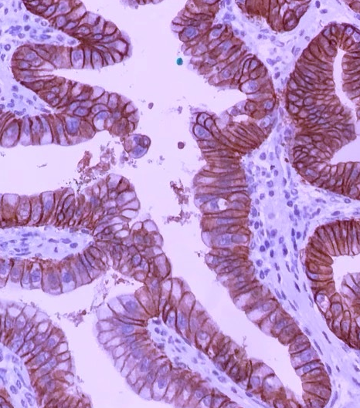
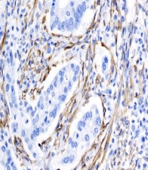
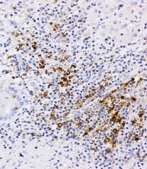
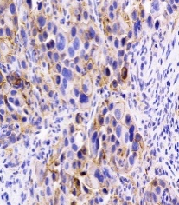
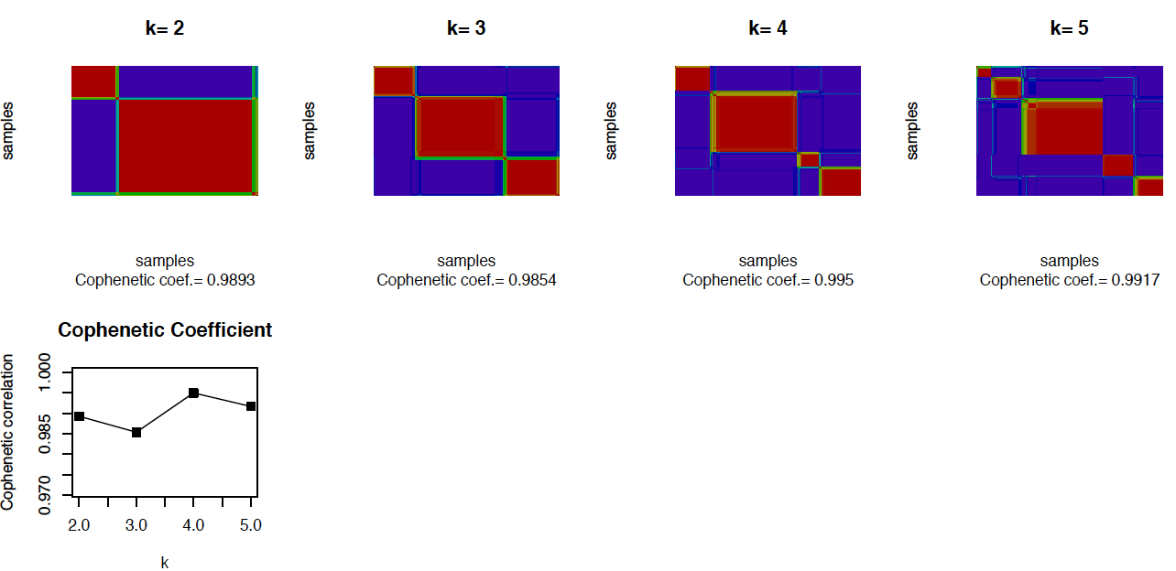
Integrative molecular classification of extrahepatic cholangiocarcinoma
Patients with eCCA treated with surgical resection
(N=189)
7 centres in USA/Europe
Clinical-pathological characteristics
Immuno-histochemistry
ERBB2
α-SMA
PD1
PDL1
Enrichment of signalling pathways (GSEA)
Whole genome expression
Unsupervised clustering (NMF)
RNA extraction
Metabolic
(18.7%)
Proliferation
(22.5%)
Mesenchymal
(47.3%)
Immune
(11.5%)
Transcriptome-based subtyping of eCCA identifies four distinct molecular classes that correlate with clinical-pathological characteristics, enhancing the opportunities for therapeutic development.
Clinical-pathological characteristics
Papillary histology
Metastasis
Precursor lesions (IPNB)
Poor outcome
Activated signalling pathways
Bile acid receptors
ERBB2/mTOR
Hedgehog
IL6-JAK-STAT3
Myc
KRAS
CTNNB1
Cell cycle
TNF-α
PD1/PD-L1
DNA repair
Tumour micro-environment
Immune excluded
Active stroma (TAFs, M2)
Immune exhausted
(CD8 TILs)
Montal R, et al. ILC 2018, GS-004
Notes:
Abbreviations: eCCA, extrahepatic cholangiocarcinoma; GSEA, gene set enrichment analysis; IPNB, papillary neoplasm of the bile duct; NMF, non-negative matrix factorization

