Slide 1
Best of ILC 2018
General hepatology

Slide 2
About these slides
These slides provide highlights of new data presented at the International Liver Congress 2018
Please feel free to use, adapt, and share these slides for your own personal use; however, please acknowledge EASL as the source
Definitions of all abbreviations shown in these slides are provided within the slide notes
These slides are intended for use as an educational resource and should not be used to make patient management decisions. All information included should be verified before treating patients or using any therapies described in these materials

Slide 3
Outline and flow
1. Basic science and preclinical
PS-163 | The I148M PNPLA3 impairs LXR signaling and cholesterol metabolism in human hepatic stellate cells
PS-165 | Interfering with local fibrotic platelet activation significantly inhibits fibrosis in multiple animal models: suggestions of the importance of the platelet-wound healing axis for fibrosis
PS-100 | A novel differentiation system to produce hepatocytes for disease modelling and drug screening
Click here to skip to this section

Slide 4
Outline and flow
2. Liver transplantation
PS-072 | Impact of baclofen treatment in 212 alcohol-dependent patients of the French "OBADE-ANGH" series
PS-122 | Platelet aggregation contributing to reperfusion injury can be prevented by normothermic ex vivo liver perfusion prior to liver transplantation
PS-125 | Orthotopic liver transplantation of xenogeneic livers repopulated with autologous hepatocytes: proof of normal function and consistent survival
PS-048 | 30 years of liver transplantation for metabolic disease in the United States
PS-042 | Liver transplantation in patients with multiple organ failures is feasible with good outcomes
PS-041 | Frequency and outcomes of liver transplantation for nonalcoholic steatohepatitis in Europe
PS-121 | Prognosis of ALF of unknown cause: results of the French multicentre prospective HASIPRO study
Click here to skip to this section

Slide 5
1. Basic science and preclinical

Slide 6
The I148M PNPLA3 impairs LXR signalling and cholesterol metabolism in human hepatic stellate cells
Aims: Investigation of how the pro-fibrogenic and pro-inflammatory I148M PNPLA3 gene variant influences cholesterol homeostasis and its accumulation in hepatic stellate cells (HSCs)
Methods:
Generation of stably overexpressing WT and I148M PNPLA3 LX-2 cells
Quantification of total (TC) and free cholesterol (FC) and expression of cholesterol-related genes
LXR localization in healthy and NASH liver specimens
Conclusions:
HSCs carrying I148M PNPLA3 accumulate cholesterol due to diminished export via LXR activity
Impaired LXR signalling is proposed to be a consequence of reduced PPARγ activity, promoting HSC activation and fibrosis development
Results:
TC and FC were significantly increased in I148M HSCs compared to WT (p<0.01), leading to reduced expression of cholesterol-related genes and their targets
TC and FC accumulation (liver diseases)
SREBP-2
LDL-R
HMG-CoA reductase
LXRα
(in NASH patients)
PPARγ
inhibition and downregulation
ABCA1
(cholestrol efflux)
Lipogenic/quiescent genes
(SREBP-1c and SCD-1)
Bruschi F, et al. ILC 2018, PS-163
Notes:
Abbreviations: ABCA, adenosine triphosphate-binding cassette transporter A; HMG-CoA, hydroxymethylglutaryl coenzyme A; LDL-R, low-density lipoprotein receptor; LXR, liver X receptor; NASH, non-alcoholic steatohepatitis; PPARγ, peroxisome proliferator-activated receptor gamma; SCD-1, stearoyl coenzyme A desaturase 1; SREBP-2, sterol regulatory element-binding protein 2; WT, wild type

Slide 7
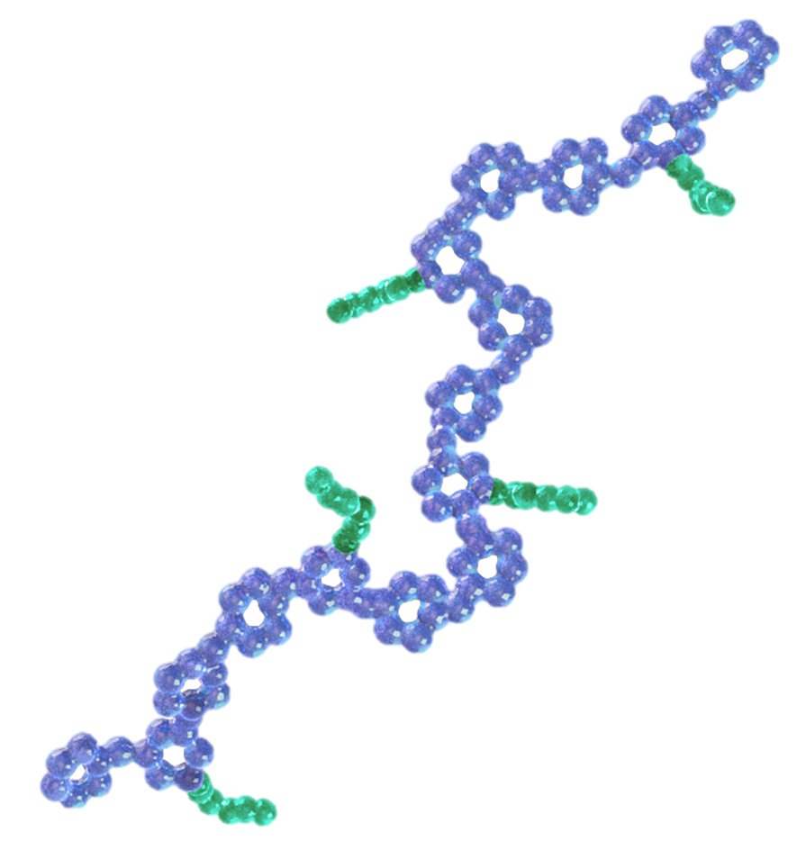
Interfering with local fibrotic platelet activation significantly inhibits fibrosis in multiple animal models
SBR-294 is a bi-functional molecule with localized anti-platelet and anti-fibrotic properties
SBR-294 reduced fibrosis in the CCI₄ mouse model*
5
Injury
Collagen-binding peptide competes platelet-collagen interactions
4
Endothelial damage
3
Exposed collagen
Sirius red-positive area (%)
**
2
Platelet binding/activation
PDGF/TGFβ
1
HSC proliferation/activation
0
Collagen/ECM deposition
GAG backbone inhibits HSC proliferation/activation
Vehicle
Valsartan
SBR-294
2 mg/kg
SBR-294
20 mg/kg
Fibrosis
SBR-294 reduced PDGF-mediated HSC proliferation
    SBR-294 reduced platelet adhesion to fibrillar collagen
60
Conclusions: SBR-294 Activity
Inhibition of fibrogenic collagen-mediated platelet activation
Inhibition of HSC activation and proliferation
In vivo inhibition of fibrosis in CCL₄ and STAM (not shown) models
Control
SBR-294
40
Hepatic stellate cell number (fluorescent units)
**
20
0
Media only
PDGF
(20 ng/mL)
PDGF + SBR-294
*N=8; **p<0.001. ANOVA followed by Dunnett’s multiple comparisons to vehicle
Stuart K, et al. ILC 2018, PS-165
Notes:
Abbreviations: ANOVA, analysis of variance; ECM, extracellular matrix; GAG, glycosaminoglycan; HSC, hepatic stellate cell; PGDF, platelet-derived growth factor; TGFβ, transforming growth factor β
Full title: Interfering with local fibrotic platelet activation significantly inhibits fibrosis in multiple animal models: suggestions of the importance of the platelet-wound healing axis for fibrosis

Slide 8
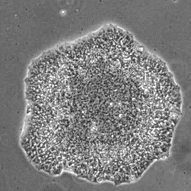
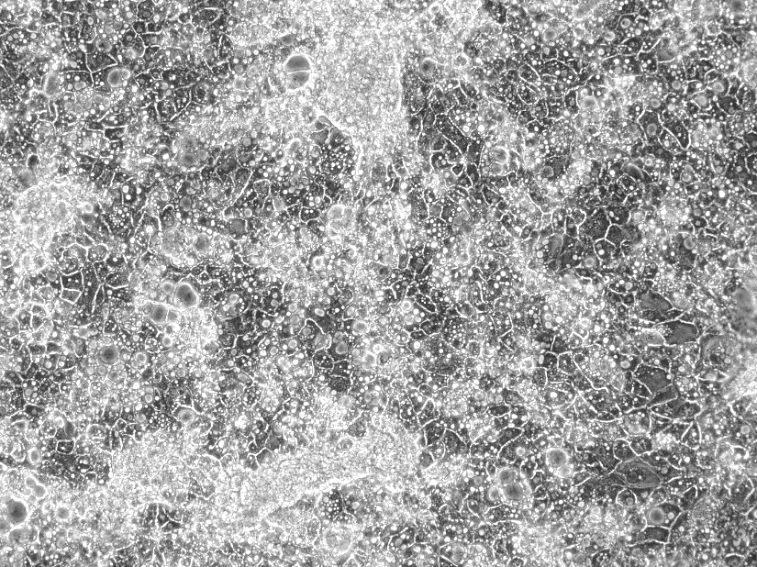
A novel differentiation system to produce hepatocytes for disease modelling and drug screening
Aims: To produce fully functional hepatocytes by overexpressing specific transcription factors in human pluripotent stem cells (hPSCs)
Methods:
Optimized inducible overexpression (OPTi-OX, double targeting + DOX treatment) used to modify hPSCs to express four hepatocyte-specific transcription factors: HNF4a, HNF1a, HNF6 and FOXA3
OPTi-OX, double targeting
Results:
DOX treatment of engineered hPSCs produced cells with a cobblestone-like morphology, binucleation and CYP3A4 activity
Cells expressed hepatocyte markers including albumin, alpha fetoprotein and A1AT
Conclusions:
The OPTi-OX platform has the potential to robustly produce ‘hepatocyte-like’ cells
The system can be further refined to include additional transcription factors to improve hepatocyte maturity and functionality
Day 0
A1AT mRNA at Day 15
+ DOX
Day 15
Tomaz R, et al. ILC 2018, PS-100
Notes:
A1AT, alpha-1 antitrypsin; DOX, doxycycline

Slide 9
2. Liver transplantation

Slide 10
Impact of baclofen in alcohol-dependant patients: the French “OBADE-ANGH” series
Aims: Evaluate the use of baclofen, a GABA_{B} receptor agonist, for the reduction of alcohol cravings/consumption and safety, especially in ALD patients
Methods: Patients in hepato-gastroenterology units in France initiated on baclofen for alcohol misuse between
March 2012–Dec 2016
Results:
Patients were 79.2% male, mean age 50.8 years, 25.1% had non-cirrhotic ALD, 38% had cirrhosis
Median dose at Month 12: 66 (20–210) mg/d; 59 (20–200) mg/d in patients with cirrhosis
There were no SAEs and AEs reduced with duration of treatment
AEs were less frequent among patients with cirrhosis
p=0.0007
p<0.0001
Follow-up and alcohol consumption in the whole population
200
Abstinence
(n=52)
No cirrhosis
LTx
n=3
Deaths
n=5
LTFU
n=91
150
Cirrhosis
Follow-up
N=103 (51%)
113 g/d
p=0.04
Alcohol consumption (g/d)
N=202
Alcohol consumption)
100
≤30g/d (n=25)
50
48 g/d
101 g/d
p=0.04
>30g/d (n=26)
16 g/d
Improvement of hepatic function at Month 12
0
 | Day 1 | Month 12 | p-value
PT, % | 70.4 | 76.5 | 0.0034
Bilirubin, µmol/l | 29.6 | 20.6 | 0.0279
Albumin, g/l | 34.5 | 36.6 | 0.012
0
3
6
9
12
Month
Conclusions: Baclofen is well tolerated and combined with medical and psychosocial monitoring, can help patients reduce or stop alcohol consumption
Barrault C, et al. ILC 2018, PS-072
Notes:
Abbreviations: AE, adverse event; ALD, alcoholic liver disease; DC, decompensated cirrhosis; GABA, gamma-aminobutyric acid; LTFU, lost to follow-up; LTx, liver transplantation; PT, prothrombin time; SAE, serious adverse event

Slide 11
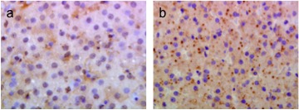
Platelet aggregation contributing to reperfusion injury can be prevented by normothermic ex vivo liver perfusion prior to liver transplantation
Aims: To investigate the impact of normothermic ex vivo liver perfusion (NEVLP) vs. static cold storage (SCS; the current standard) on platelets in sinusoidal endothelial cell (SEC) injury in pigs (N=5 per group)
Methods:
Retrieval
HBD
SCS 8 hours (4°C, HTK)
LTx
3 hours
Biopsy
3-day
survival
SCS
2 hours
NEVLP 5 hours
SCS
Results:
All pigs survived for 3 days
After LTx, the NEVLP group had:
Less endothelial cell injury
(CD31, hyaluronic acid) and significantly less platelet aggregation*
Significantly less liver injury (lower post-LTx AST), faster post-LTx platelet count recovery and lower PF-4 and TGF-β levels†
Conclusions:
NEVLP reduces ischaemia/reperfusion injury in LTx by preventing platelet sequestration in liver after perfusion and reducing platelet-induced SEC damage
Intrahepatic platelet
aggregation post-LTx
Platelet aggregates
NEVLP
150
100
p=0.039
400x
Aggregates/5 HPF (20x)
Cold storage
50
0
400x
HBD + NEVLP
(n=5)
HBD + SCS
(n=5)
*Measured in liver biopsy; †Measured during the 3-day survival period
Kollmann, D, et al. ILC 2018, PS-122
Notes:
Abbreviations: AST, aspartate aminotransferase; HBD, heart-beating donor; HTK, histidine-tryptophan-ketoglutarate; LTx, liver transplantation; PF-4, platelet factor 4; PO, postoperative; SEC, sinusoidal endothelial cell; TGFβ, transforming growth factor β

Slide 12
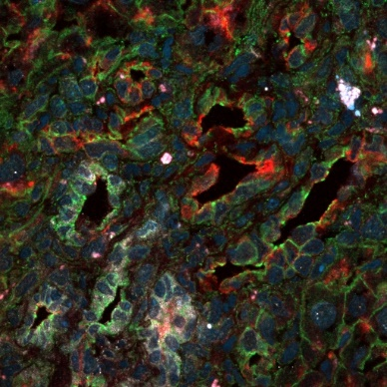
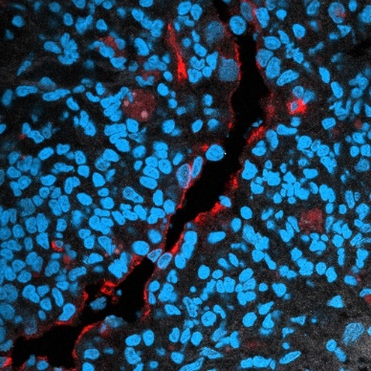
Orthotopic xenogeneic LTx repopulated with autologous hepatocytes: proof of normal function and survival
Aims: proof of concept for growing transplantable patient-like organs in animals, by orthotopic transplant of mouse-rat chimeric livers into baby rats
Lewis rat hepatocytes
Transplanted
to
Post-transplant chimeric mouse liver graft recipient-oriented remodelling
GFP+
112
days
a) Ductular cells were GFP+, suggesting they derived from rat cells
b) Canaliculi were CK19⁺ /OPN⁻ or CD19⁻/OPN⁺, suggesting a complete transdifferentiation
c) Chimeric liver graft demonstrated rat CD31⁺ portal endothelium
Mouse-rat
chimeric liver
3-week old
Lewis RAT
Adult
Lewis rat
Mouse FRG®
(C56BL/6 ^{FAH-/- Rag2 -/- Il2rg -/-})
±Tacrolimus
Results: All non-IS recipients experienced acute rejection and died 8–11 days after transplantation
Under calcineurin inhibitor monotherapy all chimeric liver recipients survived in good health, having normal development and weight gain
  Chimeric livers grew 670% on average, from 1.3±0.2g to 8.7±1.4 g, in line with syngeneic rat controls
  Pure xenogeneic controls showed impaired growth and died before or shortly after the IS was stopped
4 months after implantation into rats, chimeric livers were partially repopulated by rat cholangiocytes and endothelial cells
a
GFP
DAPI OPN CK19 βCAT
DAPI CD31
b
c
Conclusions: This is the first report showing robust survival of orthotopically transplanted chimeric livers; the transplanted organs sustained and followed normal animal growth
Lacotte S, et al. ILC 2018, PS-125
Notes:
Abbreviations: GFP, green fluorescent protein; IS, immunosuppressed; LTx, liver transplantation; OPN: osteopontin; CK-19: cytokeratin-19
Full title: Orthotopic liver transplantation of xenogeneic livers repopulated with autologous hepatocytes: proof of normal function and consistent survival

Slide 13
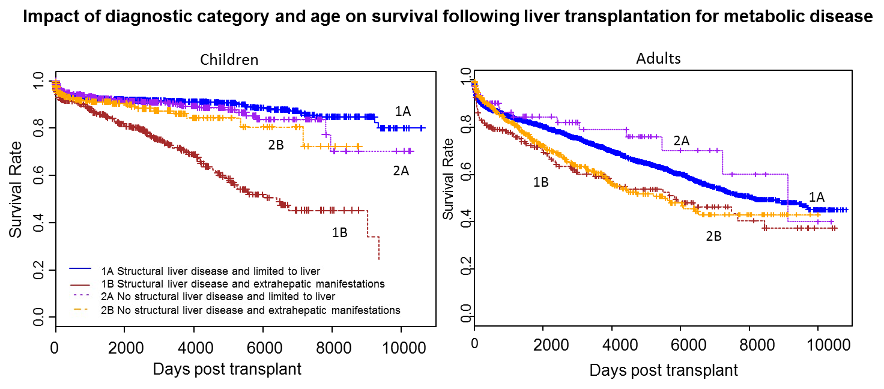
30 years of liver transplantation for metabolic disease in the United States
Methods: Indications and outcomes in LTx were compared over three consecutive 10-year eras, spanning 10/1987 to 6/2017
Results: 5,996 patients underwent LTx of whom 2,354 (39.3%) were children
In children, transplant for SLD fell significantly, indications for adult transplant changed less
20-year patient survival was >80% in children and outcomes improved with time
Latest 5-year patient survival was 94.4% and 81.5% in children and adults, respectively, p<0.01
Impact of diagnostic category and age on survival following LTx for metabolic disease
Children
Adults
Survival rate
Days post transplant
Days post transplant
Conclusion: Long-term outcomes are excellent although extrahepatic manifestations have a major impact. Increasingly, LTx is utilized rather than treating SLD in children
Mckiernan P, et al. ILC 2018, PS-048
Notes:
Abbreviations: LTx, liver transplantation, SLD, structural liver disease

Slide 14
Liver transplantation in patients with multiple organ failures (OF) is feasible with good outcomes
Aims: To explore the independent impact of type and number of OFs on post-LTx graft and patient survival outcomes
Methods:
Post-LTx survival assessed in all adult patients transplanted within 30 days of listing with UNOS (2002–2016), N=19,324
Stratified by the number and type of OF (defined by modified CLIF-C criteria)
Results:
13.2% of patients had ≥3 OFs
1-year patient survival was:
  85% with 3 OFs
  84% with 4 OFs
  80% with 5–6 OFs
  89% in the absence of any OF
≥3 OFs was an independent negative predictor of survival
Conclusions:
LTx is feasible in the presence of multiple OFs with excellent outcomes
Effect of number of OF on post-LTx survival
1.0
0.9
Survival probability
0.8
0.7
0
3
6
9
12
Patient lifespan, months
N of OF
N at risk
0
1
2
3
4
5–6
8,120
4,705
3,723
1,637
546
332
7,172
4,024
3,104
1,340
449
268
6,620
3,632
2,666
1,136
372
222
Thuluvath PJ, et al. ILC 2018, PS-042
Notes:
Abbreviations: CLIF-C, chronic liver failure consortium; LTx, liver transplantation; OF, organ failure; UNOS, United Network for Organ Sharing

Slide 15
Frequency and outcomes of liver transplantation for NASH in Europe
Aims:
Describe the changing frequency of LTx for NASH in Europe
Determine clinical outcomes and prognostic factors
Methods:
Retrospective analysis of data from the ELTR database on 68,950 adult patients who underwent primary LTx for chronic liver disease between 01/01/2002 and 31/12/2016 at 174 centres in 33 countries
Results:
Changing indications for LTx
  Primary indication was NASH (2,741 [4%] pts)
  ⬆ proportion of LTx performed for patients with NASH: 1.2% (2002) ➔ 8.4% (2016)
  ARLD was the most common indication (n=22,226; 32.3%)
Recipient differences
NASH was not an independent predictor of post-LTx patient survival*
  Patient survival HR 1.06 (95% 0.97–1.17)
  Graft survival HR 0.90 (95% 0.79–1.04)
Determinants of post-LT survival in NASH recipients
Conclusions:
The proportion of LTxs performed for patients with NASH has risen more than for any other indication
Significantly higher proportion of NASH recipients with concomitant HCC than for other indications.
NASH is not an independent predictor of
post-LTx patient or graft survival
Amongst NASH recipients, older age, higher MELD and extremes of BMI carry a post-LTx mortality risk, ➔ can aid risk stratification and careful selection of patients with NASH for LTx
For recipients without HCC | HR
Recipient age (years) 61–65 >65 | 1.96 (1.29–2.98) 1.77 (1.11–2.82)
MELD >23 | 1.54 (1.04–2.30)
Recipient BMI (kg/m²) <18.5 18.5–25 >40 | 5.04 (1.18–21.56) 2.34 (1.28–4.26) 2.24 (1.30–3.87)
Donor blood group B | 0.41 (0.23–0.72)
 | NASH | Non-NASH
Age years; (IQR) | 60 (54–64) | 55 (48–61)
BMI kg/m^{–2} (SD) | 32.6 (4.57) | 25.8 (4.45)
HCC (%) | 39.1 | 28.9
*Multivariable Cox regression; adjusted for donor and recipient factors
Haldar D, et al. ILC 2018, PS-041
Notes:
ARLD, alcohol-related liver disease; BMI, body mass index; ELTR, European Liver Transplant Registry; HCC, hepatocellular carcinoma; MELD, Model for End-Stage Liver Disease; NASH, nonalcoholic steatohepatitis; LTx, liver transplantation

Slide 16
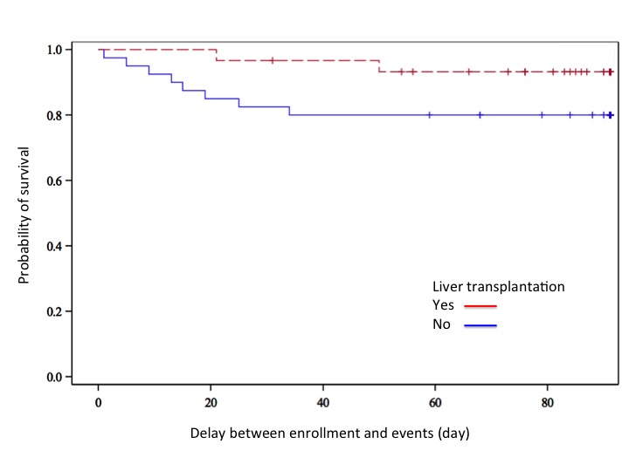
Prognosis of ALF of unknown cause: results of the French multicentre prospective HASIPRO study
Aims:
Prospective, multicentre study to determine the predictive factors associated with LTx-free survival at
3 months in patients presenting with severe ALF of unknown cause
Inclusion criteria:
Severe ALF defined by INR >1.5, no previous history of or sign of
chronic liver disease and exclusion of known cause of ALF
Results:
N=70: 32 (46%) spontaneously recovered, 8 (11%) died,
30 (43%) received LTx
Among LTx recipients 46% met King’s College Hospital
and/or Clichy-Villejuif criteria for LTx
  Median time to LTx: 3 (1–10) days
Prognostic factors for LTx-free survival at 3 months*
  Baseline HE, PT≤35% and relative change in PT on day 1≤0
Conclusions:
Severe ALF of unknown cause represents a proper nosological entity with poor prognosis
The usual transplantation criteria for fulminant hepatitis are not fulfilled in more than half of the patients
An ALF-UC score ≥ 2.3 is associated with a high risk of mortality or liver transplantation
86% overall survival at 3 months
1.0
0.8
0.6
Probability of survival
0.4
ALF-UC score | POINTS
Baseline HE > 0 | 1 | A threshold of 2.3 is associated with the best performance (Se 76% - Sp 84%)
Baseline PT ≤ 35% | 1.9
Relative change in PT on day 1 ≤0 | 2.2
0.2
Liver transplantation
Yes
No
0.0
0
20
40
60
80
Delay – enrolment at event (days)
*Multivariate analysis
Coilly A, et al. ILC 2018, PS-121
Notes:
Abbreviations: ALF, acute liver failure; ALF-UC, acute liver failure of unknown cause; HE, hepatic encephalopathy; INR, international normalized ratio; LTx, liver transplantation; PT, prothrombin time; Se, sensitivity; Sp, specificity.

