Slide 1
Best of ILC 2018
Cirrhosis and complications

Slide 2
About these slides
These slides provide highlights of new data presented at the International Liver Congress 2018
Please feel free to use, adapt, and share these slides for your own personal use; however, please acknowledge EASL as the source
Definitions of all abbreviations shown in these slides are provided within the slide notes
These slides are intended for use as an educational resource and should not be used to make patient management decisions. All information included should be verified before treating patients or using any therapies described in these materials

Slide 3
Contents
1. Treatment strategies
PS-009 | Stem cells as a new therapeutic strategy for portal hypertension and cirrhosis
PS-078 | Therapeutic plasma-exchange improves systemic inflammation and survival in patients with acute on chronic liver failure
PS-137 | Effect of β-blockers on the systemic hemodynamics of decompensated cirrhosis and survival
Click here to skip to this section
2. Bacterial infections
GS-001 | Epidemiology, predictors and outcomes of multi drug resistant bacterial infections in patients with cirrhosis across the world. Final results of the "Global study"
PS-080 | Adherence to EASL antibiotic treatment recommendations improves the outcomes of patients with cirrhosis and bacterial infections. Results from the ICA Global Study
GS-015 | Primary SBP Prophylaxis is associated with greater ICU admission and 30-day mortality compared to Secondary SBP Prophylaxis
PS-015 | Gut microbiome is profoundly altered in acute-on-chronic liver failure as evaluated by quantitative metagenomics. Relationship with liver cirrhosis severity
PS-016 | Diet affects gut microbiota and modulates hospitalization risk differentially in an international cirrhosis cohort
Click here to skip to this section

Slide 4
1. Treatment strategies

Slide 5
Stem cells as a new therapeutic strategy for portal hypertension and cirrhosis
Aim: Characterize the effects of human placenta-derived stem cells in a pre-clinical model of cirrhosis
4x10⁶ viable
hAMSCs or hAECs
Transplantation
CCl₄-cirrhotic rats
2 weeks
Measure
efficacy parameters
hAMSCs and hAECs significantly lowered PP
through reduction in HVR
hAMSCs and hAECs ameliorated liver fibrosis
30
Haemodynamic parameters | Veh | hAMSCs | p | hAECs | p
PP (mmHg) | 15.4±0.7 | 12.8±0.7 | 0.01 | 12.3±0.7 | 0.005
PBF (mL/min) | 12.7±1.6 | 10.5±1.2 | 0.2 | 14.7±1.8 | 0.3
HVR (mmHg*min/mL) | 1.4±0.2 | 1.4±0.2 | 0.7 | 0.9±0.1 | 0.02
MAP (mmHg) | 83.4±4.8 | 96.0±5.6 | 0.09 | 82.5±5.6 | 0.3
-20%
20
p=0.1
Fibre (%)
10
0
Veh
hAMSCs
hAECs
hAMSCs improve hepatocyte function, inflammation and endothelial phenotype
1.5
 | Veh | hAMSCs | p | hAECs | p
Albumin (g/L) | 21±1.2 | 24±0.7 | 0.04 | 24±3.5 | 0.3
Bilirubin (mg/dL) | 0.7±0.2 | 0.1±0.0 | 0.03 | 0.2±0.1 | 0.07
1.0
Relative vWF
expression
-60%
-65%
Conclusion: Transplanted human amniotic stem cells are potentially a viable therapy for cirrhosis and portal hypertension
0.5
*
*
0.0
Fernández-Iglesias A, et al. ILC 2018, PS-009
Veh
hAMSCs
hAECs
Notes:
hAEC, human amniotic epithelial cell; hAMSC, human amniotic mesenchymal stem cell; HVR, hepatic vascular resistance; MAP, mean arterial pressure; PBF, portal blood flow; PP, portal pressure; Veh, vehicle; vWF, von Willebrand factor

Slide 6
Therapeutic plasma exchange improves systemic inflammation and survival in patients with acute-on-chronic liver failure (ACLF)
Aim:
To evaluate artificial liver support (ALS), plasma exchange (PE) and liver dialysis (FPSA) vs. standard medical treatment (SMT) for ACLF
Methods:
Retrospective data from AARC cohort study (www.aclf.in) was analyzed and matched by propensity risk score (PRS) to avoid selection bias
Results:
ALS-treated patients had significantly lower MELD (p=0.03) and CTP scores (p=0.04)
PE associated with a significant improvement in 28-day mortality vs. FPSA (9% vs. 26%; p=0.003)
Conclusions:
In patients with ACLF, ALS improves systemic inflammation, lowers development of MOF and results in improved survival
PE has a significant survival benefit over FPSA and should be the therapy of choice in these patients
ALS associated with significantly (p<0.05) higher resolution of SIRS, reduced new-onset SIRS and MOF
 | Pre-match, % (n=1866) |  | PRS-matched, % (n=208)
ALS vs. SMT, % | ALS | SMT | ALS | SMT
Resolution of SIRS | 75 | 46 | 75 | 30
New SIRS | 13 | 39 | 14 | 39
Development of MOF | 25 | 49 | 11 | 48
PE associated with significantly (p<0.05)
improved liver failure-related mortality
 | Hazard ratio (95% CI)
SMT vs PE vs FPSA | 28-day mortality*,† | 90-day liver failure-related mortality‡
Pre-match | 0.19 (0.11–0.37) 0.56 (0.28–1.13) | 0.34 (0.15–0.77) 0.19 (0.03–1.49)
PRS-matched | 0.07(0.03-0.18) 0.27(0.11–0.67) | 0.13(0.05–0.32) 0.04(0.004–0.45)
*Cox regression analysis; †Differences for 90-day mortality were not significant; ‡Competing risk analysis
Maiwall R, et al. ILC 2018, PS-078
Notes:
AARC, American Association for Respiratory Care; CTP, Child–Turcotte–Pugh; FPSA, fractionated plasma separation adsorption; MELD, Model for End-Stage Liver Disease; MOF, multiorgan failure; SIRS, systemic inflammatory response syndrome

Slide 7
Effect of β-blockers on the systemic haemodynamics of decompensated cirrhosis and survival
Aim: Evaluation of the effect of β-blockers on survival in advanced cirrhosis
Multiple factors associated with mortality‡ | HR (95% CI) | p-value
Age (years) | 1.05 (1.01, 1.09) | 0.010
Baseline Child–Pugh | 1.71 (1.43, 2.24) | <0.001
HVPG at 1–3 months | 1.15 (1.07, 1.24) | <0.001
CO at 1–3 months | 0.84 (0.69, 0.99) | 0.04
Patients with decompensated cirrhosis (all had ascites) and high-risk varices (without previous bleeding)
Patients with decompensated cirrhosis (all had ascites) and high-risk varices (without previous bleeding)
Baseline haemodynamic study*
Treatment with non-selective β-blockers (NSBBs)
Control haemodynamic study
(1–3 months under treatment with NSBBs)
Assessment of haemodynamic changes
and influence on survival
Survival according to CO at 1–3 months on NSBBs
1.0
0.8
Results:
150/190 (79%) patients had further decompensation,† 73 patients (38%) died
Median FU: 36 (IQR 16–62) months
0.6
CO >5 L/min
Survival
0.4
Conclusion:
These results suggest monitoring CO under treatment with NSBBs may achieve more accurate dose adjustment and improve outcomes in advanced cirrhosis
0.2
HR (CI 95%)= 2.40 (1.37–4.20)
p=0.002 (log-rank)
CO ≤5 L/min
0.0
0
12
24
36
48
60
72
84
96
108
120
Time (months)
*Portal pressure (estimated by HVPG), cardiopulmonary pressures and cardiac output (via thermodilution) were measured;
†74% had worsening of ascites, 14% had variceal bleeding; ‡Cox hazard regression
Alvarado E, et al. ILC 2018, PS-137
Notes:
CO, cardiac output; FU, follow-up; HVPG, hepatic venous pressure gradient

Slide 8
2. Bacterial infections

Slide 9
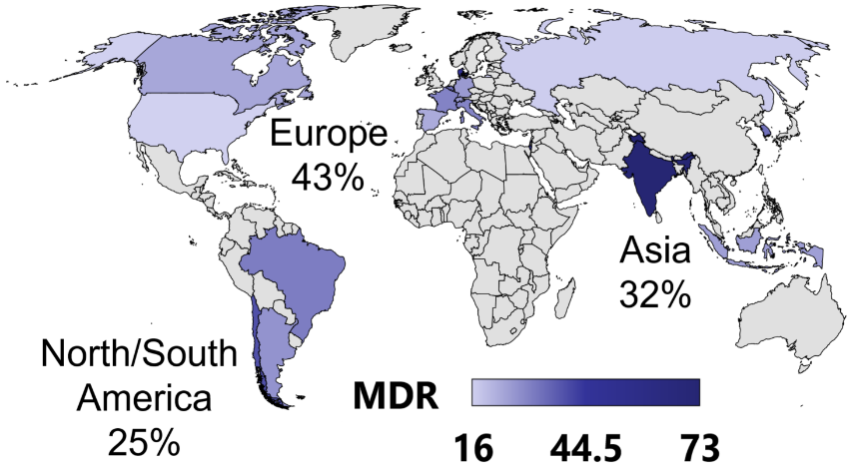
Epidemiology, predictors and outcomes of multidrug-resistant bacterial infections in patients with cirrhosis across the world
The intercontinental “Global study” investigated the epidemiology and outcome of bacterial/fungal infections in hospitalized patients with cirrhosis
Methods:
Demographic, clinical, microbiological and treatment data collected from 1,302 patients at 46 centres
Results:
The most common infections were SBP (27%), UTI (22%) and pneumonia (19%)
The global prevalence of
multidrug-resistant (MDR) bacteria* was 34%
Patient location (%) and
global MDR bacteria prevalence
MDR bacteria infection were associated with:
Lower rate of response to empirical antibiotic treatment
(40 vs. 68%; p<0.001)
Higher incidence of shock
(27 vs. 15%; p<0.001)
New organ failures
(42 vs. 31%; p=0.001)
Lower rate of resolution of infection
(82 vs. 72%; p=0.003)
Higher in-hospital mortality
(31 vs. 21%; p=0.004)
Conclusions:
There is a need to develop different empirical antibiotic strategies across different continents and countries.
Every effort should be made to reduce the spread of MDR bacteria in cirrhosis
Independent risk factors for MDR infections
 | OR | p-value
Infection in Asia | 2.79 | 0.017
Infection in India | 7.94 | <0.001
Infection in South America | 2.23 | 0.053
Antibiotic use in last 3 months | 1.92 | 0.001
Nosocomial infection | 2.65 | <0.001
Healthcare-associated infection | 1.62 | 0.032
Pneumonia | 3.20 | <0.001
UTI | 2.48 | <0.001
Skin/soft tissue infection | 2.92 | 0.004
*MDR bacteria were defined as resistant to at least one antibiotic in >2 classes
Piano S, et al. ILC 2018, GS-001
Notes:
SBP, spontaneous bacterial peritonitis; UTI, urinary tract infection

Slide 10
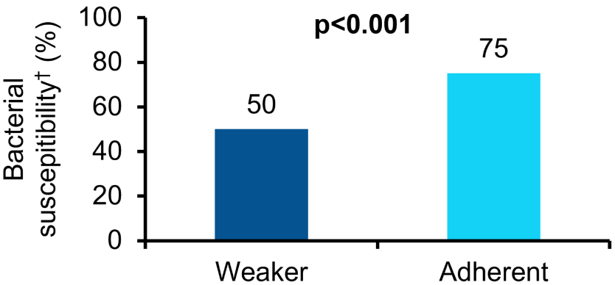
Adherence to EASL antibiotic treatment recommendations improves the outcomes of patients with cirrhosis and bacterial infections
Assessment of the clinical impact of adherence to EASL recommendations on antibiotic treatment* among patients in the ICA “Global Study”
Methods:
Demographic, clinical, microbiological and treatment data were collected from 1,302 patients
Results:
Antibiotic treatment was adherent to EASL recommendations for 61% of patients
Adherence was poorer in pneumonia (27% vs. 71%; p<0.001) and nosocomial infection (54% vs. 64%; p=0.002)
Bacteria isolated in Asian centres had lower susceptibility to recommended antibiotics (58% vs. 80%; p<0.001), mainly due to MDR bacteria (51 vs. 28%; p<0.001)
Conclusions:
Adherence to EASL recommendations was associated with better outcomes in patients with cirrhosis and bacterial infections
Different strategies should be developed in countries with high MDR bacteria prevalence
Weaker than recommended antibiotic regimens were associated with reduced antimicrobial susceptibility
Results:
Antibiotic treatment was adherent in 61% of patients
Adherence was poorer in pneumonia (27% vs. 71%; p<0.001) and nosocomial infection (54% vs. 64%; p=0.002)
Bacteria isolated in Asian centres had lower antimicrobial susceptibility to recommended antibiotics (58% vs. 80%; p<0.001), mainly due to MDR bacteria (51 vs. 28%; p<0.001). Weaker antibiotics associated with higher need to escalate treatment (50% vs. 32%; p<0.001)
Weaker than recommended antibiotic regimens
were associated with higher risks‡
New organ failures
OR 1.50
p=0.010
Septic shock
OR 0.51
p=0.044
In-hospital mortality
OR 1.47
p=0.034
0
0.5
1
1.5
2
2.5
3
Favours lack
of adherence
Favours
adherence
*Treatment was considered adherent if ≥1 recommended antibiotic/combination was administered; †To administered antibiotic;
‡Adjusted for age, ACLF, quick SOFA and MELD-Na score
Piano S, et al. ILC 2018, PS-080
Notes:
ACLF, acute-on-chronic liver failure; MDR, multidrug resistant; MELD, Model for End-Stage Liver Disease; SOFA, Sequential Organ Failure Assessment

Slide 11
Primary SBP prophylaxis is associated with greater ICU admission and 30-day mortality compared to secondary SBP prophylaxis
Aim: Comparison of primary vs. secondary prophylaxis for spontaneous bacterial peritonitis (SBP) in patients with cirrhosis from a large inpatient cohort (the NACSELD database)
Methods:
Inpatients with cirrhosis and on primary or secondary prophylaxis (n=154 each) were propensity matched for admission MELD score and serum albumin
Results:
Conclusions:
Despite prophylaxis, a significant number of patients developed SBP
Unexpectedly, patients on primary prophylaxis had poorer outcomes
The value of both primary and secondary prophylaxis requires re-evaluation
P<0.0001
P=0.005
P=0.02
P=0.05
P=0.01
P=0.01
Bajaj JS, et al. ILC 2018, GS-015
Notes:
ICU, intensive care unit; MELD, Model for End-Stage Liver Disease; NACSELD, North American Consortium for Study of End-Stage Liver Disease; SIRS, systemic inflammatory response syndrome

Slide 12
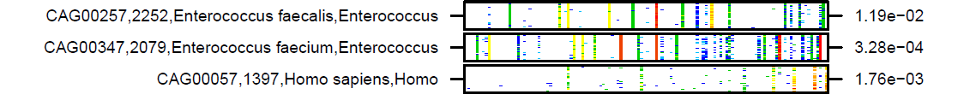
Gut microbiome is profoundly altered in acute-on-chronic liver failure as evaluated by quantitative metagenomics
Aim: Investigation of gut microbiome alterations across the spectrum of disease (outpatients, AD, ACLF)
Methods: Microbial genes from stool DNA grouped into metagenomic species (MGS) based on abundance, and analyzed using non-parametric tests* and Spearman’s correlation
Results:
290/1,158 MGS contrasted between ≥1 disease stage. 44 contrasted between AD and ACLF
Disease severity and organ failure correlated with human DNA in stools
Conclusions
Increasing disease severity is characterized by marked reductions in gene richness, especially in ACLF
Disease stage correlates with reduced gene richness
Patient status at 3 months
1.00
300
0.75
200
Gene count (millions)
Gene count (millions)
0.50
0.25
100
0.00
0
Comp
AD
ACLF
Dead
LTx
Decomp
Number of organ failures, and MELD and Child–Pugh scores, correlate with three Enterococcus MGS
MELD
*Kruskal–Wallis or Dunn tests Spearman’s correlations
Sole C, et al. ILC 2018, PS-015
Notes:
ACLF, acute-on-chronic liver failure; AD, acute decompensation; Comp, compensated; Decomp, decompensated; LTx, liver transplantation; MELD, Model for End-Stage Liver Disease

Slide 13
Diet affects gut microbiota and modulates hospitalization risk differentially in an international cirrhosis cohort
Aim: Investigation of the impact of diet on gut microbiota and clinical outcomes in patients with cirrhosis
Methods: 90 day study of gut microbiota diversity and dietary profile in 296 age-matched healthy controls and outpatients with compensated or decompensated cirrhosis from the USA and Turkey
Results:
US patients with cirrhosis and a Western diet (more coffee) had more advanced disease than Turkish patients (greater tea, fermented milk and chocolate intake), p<0.01
Coffee, tea, vegetable, chocolate and fermented milk predicted higher microbial diversity
Turkish patients had lower 90-day hospitalization risk, associated with microbial diversity, coffee/tea, vegetable and cereal intake
US patients had lower microbial diversity with disease progression
11
p<0.001
p=0.46
10
p<0.001
9
8
7
Shannon Diversity Index
6
5
4
p<0.001
3
2
Control
Comp
USA
Decomp
Control
Comp
Turkey
Decomp
 | USA (n=157) |  |  |  | Turkey (n=139)
 | All | Ctrl (n=48) | Comp (n=59) | Decomp (n=50) | All | Ctrl (n=46) | Comp (n=50) | Decomp (n=43)
Age* |  | 62 ± 14 | 61 ± 8 | 61 ± 7 |  | 42 ± 8 | 60 ± 10 | 60 ±12†
Male* | 121 | 27 | 48 | 46† | 79 | 23 | 29 | 27
MELD |  | – | 8.7 ± 2.9 | 12.6 ± 5.3† |  | – | 8.4 ± 2.4 | 11.2 ± 3.5†
PPI use | 55 | 10 | 19 | 26† | 46 | 8 | 17 | 31
Conclusion:
Microbial diversity, driven by diet,
is associated with an independently lower
risk of 90-day hospitalization in cirrhosis
Bajaj JS, et al. et al. ILC 2018, PS-016
Notes:
Comp, compensated cirrhosis; Decomp, decompensated cirrhosis

