Slide 1
Clinical Practice Guidelines
HBV

Slide 2
About these slides
These slides give a comprehensive overview of the EASL clinical practice guidelines on the management of hepatitis B infection
The guidelines were published in full in the August 2017 issue of the Journal of Hepatology
The full publication can be downloaded from the Clinical Practice Guidelines section of the EASL website
Please cite the published article as: European Association for the Study of the Liver. EASL 2017 Clinical Practice Guidelines on the management of hepatitis B virus infection. J Hepatol 2017;67:370–98
Please feel free to use, adapt, and share these slides for your own personal use; however, please acknowledge EASL as the source

Slide 3
About these slides
Definitions of all abbreviations shown in these slides are provided within the slide notes
When you see a home symbol like this one: , you can click on this to return to the outline or topics pages, depending on which section you are in
Please send any feedback to: slidedeck_feedback@easloffice.eu
These slides are intended for use as an educational resource and should not be used in isolation to make patient management decisions. All information included should be verified before treating patients or using any therapies described in these materials

Slide 4
Guideline panel
Chair
Pietro Lampertico
Panel members
Kosh Agarwal, Thomas Berg, Maria Buti, Harry LA Janssen, George Papatheodoridis, Fabien Zoulim, Frank Tacke (EASL Governing Board representative)
Reviewers
Maurizia Brunetto, Henry Chan, Markus Cornberg
EASL CPG HBV. J Hepatol 2017;67:370–98

Slide 5
Outline
Methods
Grading evidence and recommendations
Background
Epidemiology of HBV
Key recommendations
Guidelines
The future for HBV
New nomenclature for chronic phases
New biomarkers
Future treatments
Unresolved issues
EASL CPG HBV. J Hepatol 2017;67:370–98

Slide 6
Methods
Grading evidence and recommendations

Slide 7
Grading evidence and recommendations
Grading is adapted from the GRADE system¹
Grade of evidence
I | Randomized, controlled trials
II-1 | Controlled trials without randomization
II-2 | Cohort or case-control analytical studies
II-3 | Multiple time series, dramatic uncontrolled experiments
III | Opinions of respected authorities, descriptive epidemiology
Grade of recommendation
1 | Strong recommendation: Factors influencing the strength of the recommendation included the quality of the evidence, presumed patient-important outcomes, and cost
2 | Weaker recommendation: Variability in preferences and values, or more uncertainty: more likely a weak recommendation is warranted Recommendation is made with less certainty: higher cost or resource consumption
1. Guyatt GH, et al. BMJ 2008:336:924–6; EASL CPG HBV. J Hepatol 2017;67:370–98
Notes:
GRADE, Grading of Recommendations Assessment, Development and Evaluation

Slide 8
Background
Epidemiology of HBV
New nomenclature for chronic phases

Slide 9
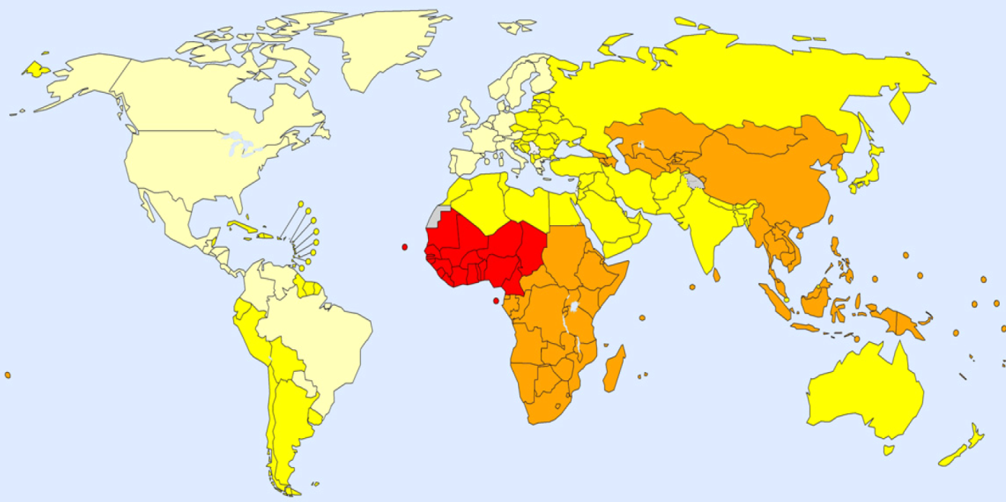
Epidemiology and public health burden¹
Worldwide ≈250 million chronic HBsAg carriers^{2,3}
686,000 deaths from HBV-related liver disease and HCC in 2013⁴
HBsAg prevalence, adults (19−49 years), 2005³
Decreasing prevalence in some endemic countries, e.g. Taiwan⁷
Possible reasons:
Improved socioeconomic status
Vaccination
Effective treatments
<2%
2−4%
5−7%
≥8%
Not applicable
Increasing prevalence in some European countries:^{5,6}
Migration from high endemic countries
1. EASL CPG HBV. J Hepatol 2017;67:370–98; 2. Schweitzer A, et al. Lancet 2015;386:1546–55; 3. Ott JJ, et al. Vaccine 2012;30:2212–9; 4. GBD 2013 Mortality and Causes of Death Collaborators. Lancet 2015;385:117–71; 5. Coppola N, et al. Euro Surveill 2015;20:30009; 6. Hampel A, et al. Bundesgesundheitsblatt Gesundheitsforschung Gesundheitsschutz 2016;59:578–83; 7. Chen C-L, et al. J Hepatol 2015;63:354–63.
Notes:
HBsAg, hepatitis B surface antigen; HCC, hepatocellular carcinoma

Slide 10
New nomenclature for chronic phases
The natural history of chronic HBV infection has been schematically divided into ﬁve phases
 | HBeAg positive |  | HBeAg negative
 | Phase 1 | Phase 2 | Phase 3 | Phase 4 | Phase 5
 | Chronic HBV infection | Chronic hepatitis B | Chronic HBV infection | Chronic hepatitis B | Resolved HBV infection
HBsAg | High | High/ intermediate | Low | Intermediate | Negative
HBeAg | Positive | Positive | Negative | Negative | Negative
HBV DNA | >10⁷ IU/mL | 10⁴–10⁷ IU/mL | <2,000 IU/mL* | >2,000 IU/mL | <10 IU/mL‡
ALT | Normal | Elevated | Normal | Elevated† | Normal
Liver disease | None/minimal | Moderate/ severe | None | Moderate/ severe | None§
Old terminology | Immune tolerant | Immune reactive HBeAg positive | Inactive carrier | HBeAg negative chronic hepatitis | HBsAg negative /anti-HBc positive
Chronic hepatitis B
Chronic HBV
infection
*HBV DNA levels can be between 2,000 and 20,000 IU/mL in some patients without signs of chronic hepatitis; †Persisitently or intermittently, based on traditional ULN (~40 IU/L). ‡cccDNA can frequently be detected in the liver; §Residual HCC risk only if cirrhosis has developed before HBsAg loss. EASL CPG HBV. J Hepatol 2017;67:370–98
Notes:
ALT, alanine aminotransferase; cccDNA, covalently closed circular DNA; HBeAg, hepatitis B ‘e’ antigen; HBsAg, hepatitis B surface antigen; HCC, hepatocellular carcinoma; ULN, upper limit of normal

Slide 11
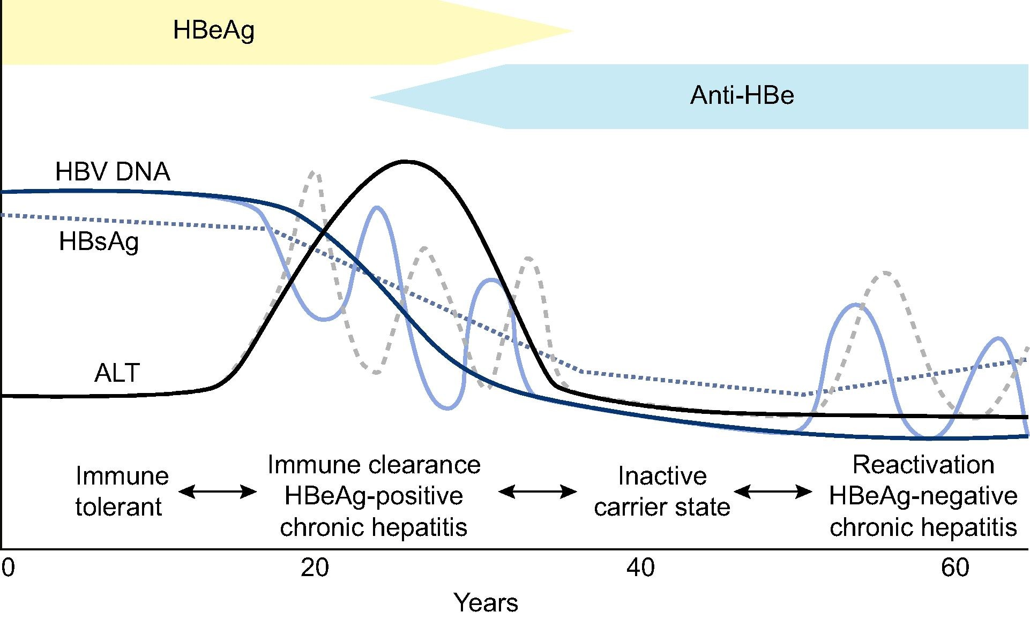
Phases of chronic HBV infection¹
HBeAg
Anti-HBe
Phase 1
Phase 2
Phase 3
Phase 4
New
nomenclature²
HBeAg-positive chronic HBV infection
HBeAg-positive chronic hepatitis B
HBeAg-negative chronic HBV infection
HBeAg-negative
chronic hepatitis B
1. Lok A, et al. J Hepatol 2017;67:847–61; 2. EASL CPG HBV. J Hepatol 2017;67:370–98
Notes:
ALT, alanine aminotransferase; HBeAg, hepatitis B ‘e’ antigen; HBsAg, hepatitis B surface antigen

Slide 12
Guidelines
Key recommendations

Slide 13
Topics
Click on a topic to skip to that section
Goals of therapy
Endpoints of therapy
Indications for treatment
Monitoring of patients currently not treated
Treatment strategies
Definition of response to treatment
NA monotherapy
PegIFNα monotherapy
Combination therapy
Patients with decompensated cirrhosis
Prevention of HBV recurrence after liver transplantation
Treatment in special patient groups
EASL CPG HBV. J Hepatol 2017;67:370–98
Notes:
NA, nucleos(t)ide analogue; PegIFN, pegylated interferon

Slide 14
Goals and endpoints of therapy
Goals
Improve survival and quality of life by preventing disease progression and HCC
Prevent mother-to-child transmission, hepatitis B reactivation, and prevent and treat HBV-associated extrahepatic manifestations
Recommendations
Main endpoint Induction of long-term suppression of HBV DNA | I | 1
Valuable endpoint Induction of HBeAg loss (± anti-HBe seroconversion) in HBeAg-positive patients with chronic hepatitis B* | II-1 | 1
Additional endpoint ALT normalization (biochemical response)† | II-1 | 1
Optimal endpoint HBsAg loss (± anti-HBs seroconversion)‡ | II-1 | 1
Grade of evidence
Grade of recommendation
*Often represents a partial immune control of the chronic HBV infection; †Achieved in most patients with long-term suppression of HBV replication; ‡Indicates profound suppression of HBV replication and viral protein expression EASL CPG HBV. J Hepatol 2017;67:370–98
Notes:
ALT, alanine aminotransferase; HBeAg, hepatitis B ‘e’ antigen; HBsAg, hepatitis B surface antigen; HCC, hepatocellular carcinoma

Slide 15
Indications for treatment
Primarily based on the combination of 3 criteria
HBV DNA, serum ALT and severity of liver disease
Recommendations
Should be treated
Patients with HBeAg-positive or -negative chronic hepatitis B* | I | 1
Patients with cirrhosis, any detectable HBV DNA, regardless of ALT level | I | 1
Patients with HBV DNA >20,000 IU/mL and ALT >2x ULN, regardless of severity of histological lesions | II-2 | 1
May be treated Patients with HBeAg-positive chronic HBV infection† >30 years old, regardless of severity of liver histological lesions | III | 2
Can be treated Patients with HBeAg-positive or -negative chronic HBV infection and family history of HCC or cirrhosis and extrahepatic manifestations‡ | III | 2
Grade of evidence
Grade of recommendation
*Defined by HBV DNA >2,000 IU/ml, ALT >ULN and/or at least moderate liver necroinflammation or fibrosis; †Defined by persistently normal ALT and high HBV DNA levels; ‡Even if typical treatment indications are not fulfilled EASL CPG HBV. J Hepatol 2017;67:370–98
Notes:
ALT, alanine aminotransferase; HBeAg, hepatitis B ‘e’ antigen; HCC, hepatocellular carcinoma; ULN, upper limit of normal

Slide 16
Monitoring of patients currently not treated
Patients with no current indication of antiviral therapy should be monitored
Periodical assessments of serum ALT, HBV DNA and non-invasive markers for liver fibrosis
Recommendations
Follow-up at least every 3–6 months HBeAg-positive chronic HBV infection, <30 years old | II-2 | 1
Follow-up at least every 6–12 months HBeAg-negative chronic HBV infection and serum HBV DNA <2,000 IU/ml | II-2 | 1
Follow-up every 3 months for the first year and every 6 months thereafter HBeAg-negative chronic HBV infection, serum HBV DNA ≥2,000 IU/ml | III | 1
Grade of evidence
Grade of recommendation
EASL CPG HBV. J Hepatol 2017;67:370–98
Notes:
ALT, alanine aminotransferase; HBeAg, hepatitis B ‘e’ antigen

Slide 17
Algorithm for the management of chronic HBV infection
Suspected chronic HBV infection
HBsAg positive
HBsAg negative, anti-HBc positive
Chronic HBV infection* (no signs of chronic hepatitis)
Chronic hepatitis B ± cirrhosis*
No specialist follow-up
but inform patient and general practitioner about the potential risk of HBV reactivation
Monitor
(includes HBsAg, HBeAg, HBV DNA, ALT, fibrosis assessment)
Start antiviral treatment
NO
Consider
Risk of HCC, risk of HBV reactivation, extrahepatic manifestations, risk of HBV transmission
In case of immunosuppression, start oral antiviral prophylaxis or monitor
YES
*See new nomenclature slide. EASL CPG HBV. J Hepatol 2017;67:370–98
Notes:
ALT, alanine aminotransferase; HBeAg, hepatitis B ‘e’ antigen; HBsAg, hepatitis B ‘surface antigen; HCC, hepatocellular carcinoma

Slide 18
Current treatment strategies for chronic hepatitis B: main concepts and features
Features | PegIFNα | ETV, TDF, TAF
Route of administration | Subcutaneous injections | Oral
Treatment duration | 48 weeks | Long-term until HBsAg loss*
Tolerability | Low | High
Long-term safety concerns | Very rarely persistence of on-treatment AEs† | Probably not‡
Contraindications | Many§ | None‖
Strategy | Induction of a long-term immune control | Inhibition of viral replication
Level of viral suppression | Moderate | Universally high
Effect on HBeAg loss | Moderate¶ | Low in first year, moderate over long term
Effect on HBsAg levels | Variable¶ | Low**
Risk of relapse after treatment cessation | Low for those with sustained response 6–12 months after therapy | Moderate if consolidation treatment provided after HBeAg seroconversion. High for HBeAg-negative disease
Early stopping rules | Yes | No
Risk of viral resistance | No | Minimal to none††
*Stopping NAs after some years might be considered in selected cases; †Psychiatric, neurological, endocrinological; ‡Uncertainties regarding kidney function, bone diseases for some NAs; §Decompensated disease, comorbidities etc.; ‖Dose adjustments in patients with eGFR <50 ml/min are required for all NAs except for TAF (no dose recommendation for TAF in patients with CrCl <15 ml/min who are not receiving haemodialysis); ¶Depending on baseline characteristics; **Slowly increases with treatment time in HBeAg-positive patients (a plateau in serological responses has been observed beyond treatment Year 4), usually very low in HBeAg-negative patients; ††So far no TDF or TAF resistance development has been detected EASL CPG HBV. J Hepatol 2017;67:370–98
Notes:
AE, adverse event; CrCl, creatinine clearance; eGFR, estimated glomerular filtration rate; ETV, entecavir; HBeAg, hepatitis B ‘e’ antigen; HBsAg, hepatitis B surface antigen; NA, nucleos(t)ide analogue; PegIFN, pegylated interferon; TAF, tenofovir alafenamide; TDF, tenofovir disoproxil fumarate

Slide 19
Definitions of response to treatment
Responses | NA therapy | PegIFNα therapy
Virological (on-treatment) | Response: HBV DNA <10 IU/ml Primary non-response: <1 log₁₀ decrease in HBV DNA after 3 months of therapy Partial response: HBV DNA decreased by >1 log₁₀ but still detectable after ≥12 months of therapy in compliant patients Breakthrough: confirmed HBV DNA increase of >1 log₁₀ above on-therapy nadir | Response: HBV DNA <2,000 IU/ml
Virological (off-treatment) | Sustained response: HBV DNA <2,000 IU/ml for ≥12 months after end of therapy
Serological | HBeAg loss and development of anti-HBe* HBsAg loss and development of anti-HBs
Biochemical | ALT normalization† (confirmed by ALT determination at least every 3 months for at least 1 year post-treatment)
Histological | Decrease in necroinﬂammatory activity† without worsening in ﬁbrosis compared with pre-treatment histological ﬁndings
*Only for HBeAg-positive patients; †Based on traditional ULN (~40 IU/L); †By ≥2 points in HAI or Ishak’s system EASL CPG HBV. J Hepatol 2017;67:370–98
Notes:
ALT, alanine aminotransferase; HAI, Hepatic Activity Index; HBeAg, hepatitis B ‘e’ antigen; HBsAg, hepatitis B surface antigen; NA, nucleos(t)ide analogue; PegIFN, pegylated interferon; ULN, upper limit of normal

Slide 20
Virological responses on NA therapy
Primary non-response
<1 log₁₀ drop after 3 months
Partial response
>1 log₁₀ drop but detectable after 12 months
6
5
Breakthrough
>1 log₁₀ increase above nadir
4
HBV DNA (log₁₀ IU/mL)
3
Response
HBV DNA PCR undetectable
(<10 IU/ml)
2
1
0
0
1
2
3
4
5
6
….
12
24
Duration of treatment (months)
EASL CPG HBV. J Hepatol 2017;67:370–98
Notes:
NA, nucleos(t)ide analogue; PCR, polymerase chain reaction

Slide 21
NA monotherapy for treatment-naïve patients
Long-term administration of a potent NA with a high barrier to resistance is the treatment of choice
Regardless of severity of liver disease
Recommendations
Treatment of choice Long-term administration of a potent NA with high barrier to resistance (regardless of severity of liver disease) | I | 1
Preferred regimens ETV, TDF and TAF as monotherapies | I | 1
NOT recommended LAM, ADV and TBV | I | 1
Grade of evidence
Grade of recommendation
EASL CPG HBV. J Hepatol 2017;67:370–98
Notes:
ADV, adefovir dipivoxil; ETV, entecavir; LAM, lamivudine; NA, nucleos(t)ide analogue; TAF, tenofovir alafenamide; TBV, telbivudine; TDF, tenofovir disoproxil fumarate

Slide 22
Prevention of resistance should rely on the use of first-line NAs with a high barrier to resistance*
Cumulative incidence of HBV resistance to NAs in pivotal trials in NA-naïve patients with chronic hepatitis B†
80
1 year
2 years
3 years
4 years
5 years
70
67
70
60
50
49
40
38
30
29
24
20
18
17
10
11
3
4
1.2
0
0
0.2
0.5
0
0
0
0
0
0
0
LAM
ADV
TBV
ETV
TDF†
TAF
*Evidence level I, grade of recommendation 1; †Collation of currently available data – not from head-to-head studies; ‡No evidence of resistance has been shown after 8 years of TDF treatment EASL CPG HBV. J Hepatol 2017;67:370–98
Notes:
ADV, adefovir dipivoxil; ETV, entecavir; LAM, lamivudine; NA, nucleos(t)ide analogue; TAF, tenofovir alafenamide; TBV, telbivudine; TDF, tenofovir disoproxil fumarate

Slide 23
Indications for selecting ETV or TAF over TDF*
In some circumstances ETV or TAF may be a more appropriate treatment choice than TDF
Age | >60 years
Bone disease | Chronic steroid use or use of other medications that worsen bone density History of fragility fracture Osteoporosis
Renal alteration† | eGFR <60 ml/min/1.73 m² Albuminuria >30 mg/24 h or moderate dipstick proteinuria Low phosphate (<2.5 mg/dl) Haemodialysis
*TAF should be preferred to ETV in patients with previous exposure to NAs; †ETV dose needs to be adjusted if eGFR <50 ml/min; no dose adjustment of TAF is required in adults or adolescents (aged ≥12 years and ≥35 kg body weight) with estimated CrCl ≥15 ml/min or in patients with CrCl <15 ml/min who are receiving haemodialysis EASL CPG HBV. J Hepatol 2017;67:370–98
Notes:
CrCl, creatinine clearance; eGFR, estimated glomerular filtration rate; ETV, entecavir; NA, nucleos(t)ide analogue; TAF, tenofovir alafenamide; TDF, tenofovir disoproxil fumarate

Slide 24
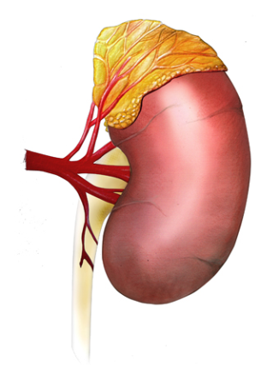
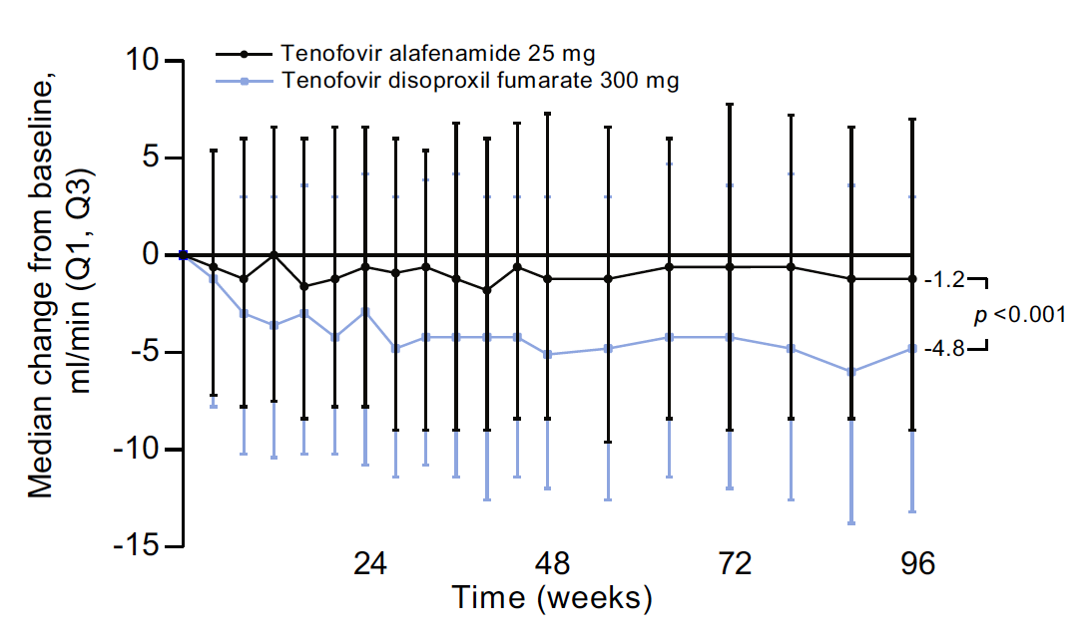
TAF vs. TDF for HBV: change in eGFR
Median change from baseline in eGFR over 96 weeks
TAF 25 mg (n=866) vs. TDF 300 mg (n=432)
TAF
TDF
TAF: -1.2
p<0.001
TDF: -4.8
Agarwal K, et al. J Hepatol 2018;68:672−81
Notes:
eGFR, estimated glomerular filtration rate; TAF, tenofovir alafenamide; TDF, tenofovir disoproxil fumarate

Slide 25
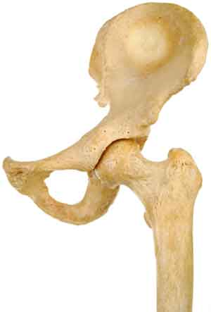
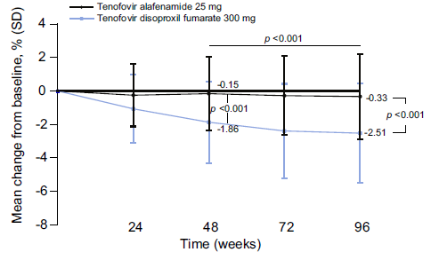
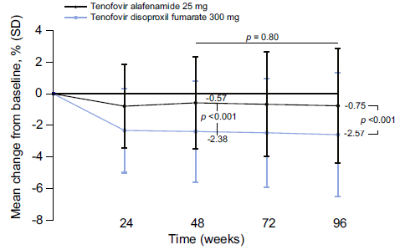
TAF vs. TDF for HBV: change in BMD
Median change from baseline in BMD over 96 weeks
TAF 25 mg (n=866) vs. TDF 300 mg (n=432)
Hip
Spine
TAF
TAF
TDF
TDF
p<0.001
p=0.80
Agarwal K, et al. J Hepatol 2018;68:672−81
Notes:
BMD, bone mineral density; TAF, tenofovir alafenamide; TDF, tenofovir disoproxil fumarate

Slide 26
Monitoring patients treated with ETV, TDF or TAF
Periodical monitoring and long-term surveillance is required in patients treated with an NA with a high barrier to resistance
Grade of evidence
Grade of recommendation
Recommendations (monitoring)
ALT and serum HBV DNA* All patients treated with NAs | I | 1
Renal monitoring† Patients at risk of renal disease treated with any NA All patients treated with TDF, regardless of renal risk | II-2 | 1
Switch to ETV or TAF‡ Should be considered in patients on TDF at risk of development of and/or with underlying renal or bone disease | II-2/I | 1
Recommendations (long-term surveillance)
HCC surveillance recommended All patients under effective long-term NA therapy | II-2 | 1
HCC surveillance mandatory All patients with cirrhosis or with moderate or high HCC risk scores at the onset of NA therapy | II-2 | 1
*Liver function tests should be performed every 3–4 months during the first year and every 6 months thereafter. Serum HBV DNA should be determined every 3–4 months during the first year and every 6–12 months thereafter; †Including at least eGFR and serum phosphate levels. Frequency of renal monitoring can be every 3 months during the first year and every 6 months thereafter, if no deterioration. Closer renal monitoring is required in patients who develop CrCl <60 ml/min or serum phosphate levels <2 mg/dl; ‡Depending on previous LAM exposure EASL CPG HBV. J Hepatol 2017;67:370–98
Notes:
ALT, alanine aminotransferase; CrCl, creatinine clearance; eGFR, estimated glomerular filtration rate; ETV, entecavir; HCC, hepatocellular carcinoma; LAM, lamivudine; NA, nucleos(t)ide analogue; TAF, tenofovir alafenamide; TDF, tenofovir disoproxil fumarate

Slide 27
Discontinuation of NA treatment
Long-term therapy with NAs is usually required
HBV eradication is not usually achieved
Recommendations
NAs should be discontinued After confirmed HBsAg loss (± anti-HBs seroconversion) | II-2 | 1
NAs can be discontinued In HBeAg-positive patients, without cirrhosis, who achieve stable HBeAg seroconversion and undetectable HBV DNA and complete ≥12 months of consolidation therapy Close post-NA monitoring is warranted | II-2 | 2
NAs may be discontinued In selected HBeAg-negative patients, without cirrhosis, who achieve long-term (≥3 years) virological suppression, if close post-NA monitoring can be guaranteed | II-2 | 2
Grade of evidence
Grade of recommendation
EASL CPG HBV. J Hepatol 2017;67:370–98
Notes:
HBeAg, hepatitis B ‘e’ antigen; HBsAg, hepatitis B surface antigen; NA, nucleos(t)ide analogue

Slide 28
Management of patients with NA failure
Compliance with therapy should be checked in all cases of treatment failure*
Management of treatment failure should be based on cross-resistance data†
Cross-resistance data for the most frequent NA-resistant HBV variants:
HBV variant‡ | LAM | TBV | ETV | ADV | TDF/TAF§
Wild-type | S | S | S | S | S
M204V | R | S | I | I | S
M204I | R | R | I | I | S
L180M + M204V | R | R | I | I | S
A181T/V | I | I | S | R | I
N236T | S | S | S | R | I
L180M + M204V/I ± I169T ± V173L ± M250V | R | R | R | S | S
L180M + M204V/I ± T184G ± S202I/G | R | R | R | S | S
*Evidence level II-1, grade of recommendation 1; †Evidence level II-2, grade of recommendation 1; ‡Amino acid substitution proﬁles. Level of susceptibility is given for each drug: S (sensitive), I (intermediate/reduced susceptibility), R (resistant); §In vitro data for tenofovir, in vivo data for TDF, no clinical data for TAF EASL CPG HBV. J Hepatol 2017;67:370–98
Notes:
ADV, adefovir dipivoxil; ETV, entecavir; LAM, lamivudine; NA, nucleos(t)ide analogue; TAF, tenofovir alafenamide; TBV, telbivudine; TDF, tenofovir disoproxil fumarate

Slide 29
Management of patients with NA failure
Treatment should be adapted as soon as virological failure under NAs is confirmed*
Resistance pattern | Recommended rescue strategies
LAM resistance | Switch to TDF or TAF
TBV resistance | Switch to TDF or TAF
ETV resistance | Switch to TDF or TAF
ADV resistance | If LAM-naïve: switch to ETV or TDF or TAF If LAM-resistant: switch to TDF or TAF If HBV DNA plateaus: add ETV† or switch to ETV
TDF or TAF resistance‡ | If LAM-naïve: switch to ETV If LAM-resistant: add ETV§
Multidrug resistance | Switch to ETV + TDF or TAF combination
*Evidence level II-1, grade of recommendation 1; †Especially in patients with ADV-resistant mutations (rA181T/V and/or rN236T) and high viral load, the response to TDF (TAF) can be protracted; ‡Not seen clinically so far; do genotyping and phenotyping in an expert laboratory to determine the cross-resistance profile; §The long-term safety of these combinations is unknown EASL CPG HBV. J Hepatol 2017;67:370–98
Notes:
ADV, adefovir dipivoxil; ETV, entecavir; LAM, lamivudine; NA, nucleos(t)ide analogue; TAF, tenofovir alafenamide; TBV, telbivudine; TDF, tenofovir disoproxil fumarate

Slide 30
PegIFNα monotherapy
Only patients with milder disease should generally be considered for treatment with PegIFNα
Recommendations
PegIFNα can be considered as an initial treatment option for patients with mild-to-moderate HBeAg-positive or -negative chronic hepatitis B | I | 2
The standard duration of PegIFNα therapy is 48 weeks | I | 1
Extension of PegIFNα therapy beyond Week 48 may be beneficial in selected HBeAg-negative patients with chronic hepatitis B | II-1 | 2
Grade of evidence
Grade of recommendation
EASL CPG HBV. J Hepatol 2017;67:370–98
Notes:
HBeAg, hepatitis B ‘e’ antigen; PegIFN, pegylated interferon

Slide 31
Monitoring patients treated with PegIFNα
Patients treated with PegIFNα require ongoing monitoring during treatment and after virological response
Recommendations
Periodical assessments of at least full blood count, ALT, TSH, serum HBV DNA and HBsAg levels All patients with chronic hepatitis B treated with PegIFNα | I/II-2 | 1
Periodical assessments of HBeAg and anti-HBe HBeAg-positive patients with chronic hepatitis B treated with PegIFNα | I | 1
Long-term follow-up Patients with a virological response after PegIFNα therapy (risk of relapse) | II-2 | 1
Surveillance for HCC Patients with sustained responses after PegIFNα therapy and high baseline HCC risk (even if they achieve HBsAg loss) | III | 1
Grade of evidence
Grade of recommendation
EASL CPG HBV. J Hepatol 2017;67:370–98
Notes:
ALT, alanine aminotransferase; HBeAg, hepatitis B ‘e’ antigen; HBsAg, hepatitis B surface antigen; HCC, hepatocellular carcinoma; PegIFN, pegylated interferon; TSH, thyroid-stimulating hormone

Slide 32
Predictors of PegIFNα response and stopping rules
HBeAg-positive chronic hepatitis B*
Genotype
A
B
C
D
Week 12
Stop if HBsAg
No decline
>20,000 IU/ml
>20,000 IU/ml
No decline
Week 24
Stop if HBsAg
>20,000 IU/ml
>20,000 IU/ml
>20,000 IU/ml
>20,000 IU/ml
HBeAg-negative chronic hepatitis B (genotype D)†
HBsAg levels
Any decline
No decline
Week 12
HBV DNA levels
>2 log₁₀ decline
<2 log₁₀ decline
Continue
Continue
Stop
*Evidence level II-2, grade of recommendation 2; †Evidence level II-2, grade of recommendation 1 EASL CPG HBV. J Hepatol 2017;67:370–98
Notes:
HBeAg, hepatitis B ‘e’ antigen; HBsAg, hepatitis B surface antigen; PegIFN, pegylated interferon

Slide 33
Combination therapy
Combination therapy is generally not recommended
Recommendations (NA plus NA)
NOT recommended De novo combination therapy of two NAs with a high barrier to resistance (ETV, TDF, TAF) | I | 1
Drug switch or combination may be considered In treatment-adherent patients with incomplete HBV suppression reaching a plateau during ETV or TDF/TAF long-term therapy | III | 2
Recommendations (NA plus PegIFNα)
NOT recommended
De novo combination of NA and PegIFNα | I | 1
Short-term pretreatment with an NA before PegIFNα in treatment-naïve HBeAg-positive patients | II | 1
Adding PegIFNα or switching to PegIFNα in patients with long-term HBV DNA suppression on NA therapy | II | 1
Grade of evidence
Grade of recommendation
EASL CPG HBV. J Hepatol 2017;67:370–98
Notes:
ETV, entecavir; HBeAg, hepatitis B ‘e’ antigen; NA, nucleos(t)ide analogue; PegIFN, pegylated interferon; TAF, tenofovir alafenamide; TDF, tenofovir disoproxil fumarate

Slide 34
Patients with decompensated cirrhosis
Patients with decompensated cirrhosis should be referred for liver transplantation and treated with NAs as as early as possible
Recommendations
Immediate treatment with an NA with a high barrier to resistance, irrespective of the level of HBV replication Assessment for liver transplantation | II-1 | 1
PegIFNα is contraindicated | II-1 | 1
Patients should be closely monitored for tolerability of the drugs and the development of rare side effects like lactic acidosis or kidney dysfunction | II-2 | 1
Grade of evidence
Grade of recommendation
EASL CPG HBV. J Hepatol 2017;67:370–98
Notes:
NA, nucleos(t)ide analogue; PegIFN, pegylated interferon

Slide 35
Preventing HBV recurrence after liver transplantation
All patients who are candidates for liver transplantation should be treated with NAs to achieve undetectable HBV DNA
Reduce the risk of graft infection
Recommendations
All patients on the transplant waiting list with HBV-related liver disease should be treated with an NA | II | 1
After liver transplantation combination of hepatitis B immunoglobulin (HBIG) and a potent NA is recommended for the prevention of HBV recurrence | II-1 | 1
Patients with a low risk of recurrence can discontinue HBIG but need continued monoprophylaxis with a potent NA | II-1 | 2
HBsAg-negative patients receiving livers from donors with evidence of past HBV infection (anti-HBc positive) are at risk of HBV recurrence and should receive antiviral prophylaxis with an NA | II-2 | 1
Grade of evidence
Grade of recommendation
EASL CPG HBV. J Hepatol 2017;67:370–98
Notes:
HBsAg, hepatitis B surface antigen; NA, nucleos(t)ide analogue

Slide 36
Special patient groups: HCV co-infection
HCV co-infection accelerates liver disease progression and increases the risk of HCC in patients with chronic HBV infection
All patients with chronic HBV infection should be screened for HCV and other blood-borne viruses
Recommendations
Treatment of HCV with DAAs may cause reactivation of HBV. Patients fulfilling the standard criteria for HBV treatment should receive NA treatment | II | 1
HBsAg-positive patients undergoing DAA therapy should be considered for concomitant NA prophylaxis until 12 weeks after completion of DAA treatment, and monitored closely | II-2 | 2
HBsAg-negative, anti-HBc-positive patients undergoing DAA therapy should be monitored and tested for HBV reactivation in case of ALT elevation | II | 1
Grade of evidence
Grade of recommendation
EASL CPG HBV. J Hepatol 2017;67:370–98
Notes:
ALT, alanine aminotransferase; DAA, direct-acting antiviral agent; HBsAg, hepatitis B surface antigen; HCC, hepatocellular carcinoma; HCV, hepatitis C virus; NA, nucleos(t)ide analogue

Slide 37
Special patient groups: HIV or HDV co-infection
The risk of fibrosis progression, cirrhosis and HCC is greater in patients also infected with HDV or HIV
Grade of evidence
Grade of recommendation
Recommendations (HIV)
All HIV-positive patients with HBV co-infection should start antiretroviral therapy (ART) irrespective of CD4 cell count | II-2 | 1
HIV/HBV co-infected patients should be treated with a TDF- or TAF-based ART regimen | I (TDF) II-1 (TAF) | 1
Recommendations (HDV)
PegIFNα for at least 48 weeks is the current treatment of choice in HDV/HBV co-infected patients with compensated liver disease | I | 1
In HDV/HBV co-infected patients with ongoing HBV DNA replication, NA therapy should be considered | II-2 | 1
PegIFNα treatment can be continued until Week 48 irrespective of on-treatment virological response if well tolerated | II-2 | 2
EASL CPG HBV. J Hepatol 2017;67:370–98
Notes:
HCC, hepatocellular carcinoma; HDV, hepatitis D virus; HIV, human immunodeficiency virus; NA, nucleos(t)ide analogue; PegIFN, pegylated interferon; TAF, tenofovir alafenamide; TDF, tenofovir disoproxil fumarate

Slide 38
Special patient groups: acute hepatitis B
Preventing the risk of acute or subacute liver failure is the main treatment goal
Treating to improve quality of life and reducing risk of chronicity are also relevant treatment goals
Recommendations
More than 95% of adults with acute HBV hepatitis do not require specific treatment | II-2 | 1
Only patients with severe acute hepatitis B, characterized by coagulopathy or protracted course, should be treated with NAs and considered for liver transplantation | II-2 | 1
Grade of evidence
Grade of recommendation
EASL CPG HBV. J Hepatol 2017;67:370–98
Notes:
NA, nucleos(t)ide analogue

Slide 39
Special patient groups: pregnant women
Management may depend on severity of liver disease and timing of a future pregnancy
Recommendations
Screening for HBsAg in the first trimester is strongly recommended | I | 1
In women of childbearing age without advanced fibrosis planning a pregnancy in the near future, it may be prudent to delay therapy until the child is born | II-2 | 2
In pregnant women with chronic hepatitis B and advanced fibrosis or cirrhosis, therapy with TDF is recommended | II-2 | 1
In pregnant women already on NA therapy, TDF should be continued while ETV or other NA should be switched to TDF | II-2 | 1
In all pregnant women with HBV DNA >200,000 IU/ml or HBsAg >4 log₁₀ IU/ml, antiviral prophylaxis with TDF should start at Week 24–28 of gestation and continue for up to 12 weeks after delivery | I | 1
Breast feeding is not contraindicated in HBsAg-positive untreated women or those on TDF-based treatment or prophylaxis | III | 2
Grade of evidence
Grade of recommendation
EASL CPG HBV. J Hepatol 2017;67:370–98
Notes:
ETV, entecavir; HBsAg, hepatitis B surface antigen; NA, nucleos(t)ide analogue; TDF, tenofovir disoproxil fumarate

Slide 40
Special patient groups: children
Recommendations
In children, the course of the disease is generally mild, and most children do not meet standard treatment indications. Thus, treatment should be considered with caution | II-3 | 1
In children or adolescents who meet treatment criteria, ETV, TDF, TAF, and PegIFNα can be used | II-2 | 2
Grade of evidence
Grade of recommendation
EASL CPG HBV. J Hepatol 2017;67:370–98
Notes:
ETV, entecavir; PegIFN, pegylated interferon; TAF, tenofovir alafenamide; TDF, tenofovir disoproxil fumarate

Slide 41
Special patient groups: healthcare workers
Recommendations
HBV infection alone should not disqualify infected persons from the practice or study of surgery, dentistry, medicine, or allied health fields | III | 1
Healthcare workers performing exposure-prone procedures with serum HBV DNA >200 IU/ml may be treated with NAs to reduce transmission risk | II-2 | 2
Grade of evidence
Grade of recommendation
EASL CPG HBV. J Hepatol 2017;67:370–98
Notes:
NA, nucleos(t)ide analogue

Slide 42
Special patient groups: patients undergoing immunosuppressive therapy or chemotherapy
Recommendations
All candidates for chemotherapy and immunosuppressive therapy should be tested for HBV markers prior to immunosuppression | I | 1
All HBsAg-positive patients should receive ETV, TDF, or TAF as treatment or prophylaxis | II-2 | 1
HBsAg-negative, anti-HBc-positive subjects should receive anti-HBV prophylaxis if they are at high risk of HBV reactivation | II-2 | 1
Grade of evidence
Grade of recommendation
EASL CPG HBV. J Hepatol 2017;67:370–98
Notes:
ETV, entecavir; HBsAg, hepatitis B surface antigen; TAF, tenofovir alafenamide; TDF, tenofovir disoproxil fumarate

Slide 43
Special patient groups: patients undergoing dialysis and renal transplant
Recommendations
All dialysis and renal transplant recipients should be screened for HBV markers | II-2 | 1
HBsAg-positive dialysis patients who require treatment should receive ETV or TAF | II-2 | 1
All HBsAg-positive renal transplant recipients should receive ETV or TAF as prophylaxis or treatment | II-2 | 1
HBsAg-negative, anti-HBc-positive subjects should be monitored for HBV infection after renal transplantation | III | 1
Grade of evidence
Grade of recommendation
EASL CPG HBV. J Hepatol 2017;67:370–98
Notes:
ETV, entecavir; HBsAg, hepatitis B surface antigen; TAF, tenofovir alafenamide

Slide 44
Special patient groups: patients with extrahepatic manifestations
Some extrahepatic manifestations can be associated with HBV infection
Vasculitis, skin manifestations (purpura), polyarteritis nodosa, arthralgias, peripheral neuropathy and glomerulonephritis
HBsAg-positive patients with extrahepatic manifestations and active HBV replication may respond to antiviral therapy
PegIFNα can worsen some immune-mediated extrahepatic manifestations
Recommendations
Patients with replicative HBV infection and extrahepatic manifestations should receive antiviral treatment with NAs | II-2 | 1
PegIFNα should not be administered in patients with immune-related extrahepatic manifestations | III | 1
Grade of evidence
Grade of recommendation
EASL CPG HBV. J Hepatol 2017;67:370–98
Notes:
HBsAg, hepatitis B surface antigen; NA, nucleos(t)ide analogue; PegIFN, pegylated interferon

Slide 45
The future for HBV
New biomarkers
Future treatments
Unresolved issues

Slide 46
The future for HBV management
New biomarkers
cccDNA – limited by need for liver biopsy, will be important in clinical trials
HBcrAg – composite biomarker, utility still under evaluation
HBV RNA – strong correlation with intrahepatic cccDNA, possible utility in predicting viral rebound after discontinuation of NAs
Future treatment options for HBV
Several novel direct-acting antivirals and immunotherapeutic agents are in preclinical and early clinical development
Combinations of antiviral and immune modulatory therapy, targeting multiple steps in the HBV lifecycle, will likely be needed to achieve an HBV ‘cure’
Future treatment options for HDV
Several candidates are under evaluation in clinical trials, mainly in combination with PegIFNα and/or NAs
Whenever possible, enrolment in these clinical trials of new agents should be considered, either as a rescue of PegIFNα or in treatment-naïve patients
EASL CPG HBV. J Hepatol 2017;67:370–98
Notes:
cccDNA, covalently closed circular DNA; HBcrAg, hepatitis B core-related antigen; NA, nucleos(t)ide analogue; PegIFN, pegylated interferon

Slide 47
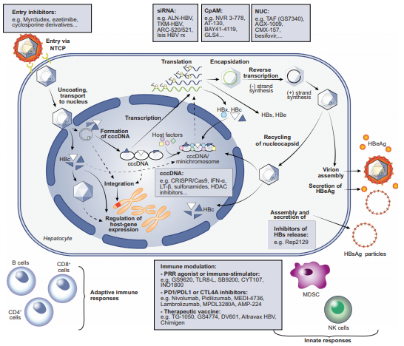
New concepts for antiviral drugs targeting HBV
Durantel D, Zoulim F. J Hepatol 2016;64:S117–31

Slide 48
Unresolved issues and unmet needs
When to start antiviral therapy in patients with HBeAg-positive chronic HBV infection
Stopping rules for HBeAg-negative patients treated with an NA
Retreatment criteria after NA discontinuation
How to accelerate HBsAg decline in long-term NA-treated patients
Better baseline or on-treatment predictors of sustained response in patients treated with PegIFNα
Definition of the residual risk of HCC in patients on long-term NA therapy and impact on surveillance
Requirement for new treatments with finite duration and high cure rates
Novel endpoints to define a cure of HBV infection
Biomarkers for the cure of infection and for the cure of liver disease
EASL CPG HBV. J Hepatol 2017;67:370–98
Notes:
HBeAg, hepatitis B ‘e’ antigen; HBsAg, hepatitis B ‘surface antigen; HCC, hepatocellular carcinoma; NA, nucleos(t)ide analogue; PegIFN, pegylated interferon

