Slide 1
Clinical Practice Guidelines
Endoscopy in PSC
Notes:
PSC, primary sclerosing cholangitis

Slide 2
About these slides
These slides give a comprehensive overview of the EASL/ESGE clinical practice guidelines on the role of endoscopy in primary sclerosing cholangitis
The guidelines were published in full in the April 2017 issue of the Journal
of Hepatology and the June 2017 issue of Endoscopy
  The full publication can be downloaded from the Clinical Practice Guidelines section of the EASL website
  Please cite the published article as: European Association for the Study of the Liver. Role of endoscopy in primary sclerosing cholangitis: European Society of Gastrointestinal Endoscopy (ESGE) and European Association for the Study of the Liver (EASL) Clinical Guideline. J Hepatol 2017;66:1265–81
Please feel free to use, adapt, and share these slides for your own
personal use, except where noted*; however, please acknowledge EASL as the source
*Current slides 9 and 10 include images which may not be adapted or shared without permission; see slide footnotes for details
Notes:
ESGE, European Society of Gastrointestinal Endoscopy

Slide 3

About these slides
Definitions of all abbreviations shown in these slides are provided within the slide notes
When you see a home symbol like this one: , you can click on
this to return to the outline or topics pages, depending on which
section you are in
Please send any feedback to: slidedeck_feedback@easloffice.eu
These slides are intended for use as an educational resource and should not be used in isolation to make patient management decisions. All information included should be verified before treating patients or using any therapies described in these materials

Slide 4
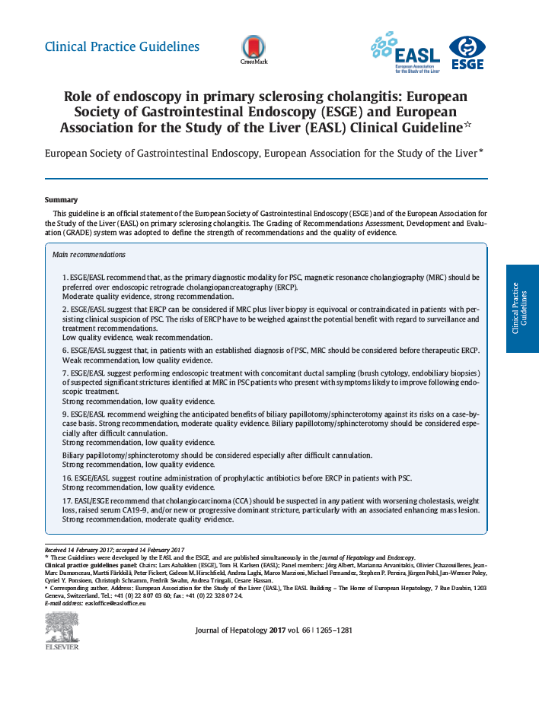
Guideline panel
Chairs
  ESGE: Lars Aabakken
  EASL: Tom Hemming Karlsen
Panel members
  Jörg Albert, Marianna Arvanitakis, Olivier Chazouilleres, Jean-Marc Dumonceau, Martti Färkkilä, Peter Fickert, Gideon M Hirschfield, Andrea Laghi,
  Marco Marzioni, Michael Fernandez, Stephen P Pereira, Jürgen Pohl, Jan-Werner Poley, Cyriel Y Ponsioen, Christoph Schramm, Fredrik Swahn,
  Andrea Tringali, Cesare Hassan
ESGE/EASL CPG Endoscopy in PSC. J Hepatol 2017;66:1265–81
Notes:
ESGE, European Society of Gastrointestinal Endoscopy

Slide 5
Outline
Methods
Grading evidence and recommendations
Background
Definition, prevalence, pathophysiology
Key recommendations
Guidelines
Summary
Main recommendations
Diagnosis
ERCP and MRC in PSC
ESGE/EASL CPG Endoscopy in PSC. J Hepatol 2017;66:1265−81
Notes:
ERCP, endoscopic retrograde cholangiopancreatography; MRC, magnetic resonance cholangiopancreatography; PSC, primary sclerosing cholangitis

Slide 6
Methods
Grading evidence and recommendations

Slide 7
Grading evidence and recommendations
Grading is adapted from the GRADE system¹ and is in line with
that adopted by the American College of Physicians²
Strength of recommendations
Benefits clearly outweigh risks and burden or vice versa | Benefits finely balanced with risks and burden | Quality of evidence
Strong | Weak | High
Strong | Weak | Moderate
Strong | Weak | Low
Insufficient evidence to determine net benefit or risk
1. Atkins D, et al. BMC Health Serv Res 2004;4:38; 2. Qaseem A, et al. Ann Intern Med 2010;153:194−9;
ESGE/EASL CPG Endoscopy in PSC. J Hepatol 2017;66:1265−81
Notes:
GRADE, Grading of Recommendations Assessment, Development and Evaluation

Slide 8
Background
Definition, prevalence, pathophysiology
Diagnosis
ERCP and MRC in PSC
Notes:
ERCP, endoscopic retrograde cholangiopancreatography; MRC, magnetic resonance cholangiography; PSC, primary sclerosing cholangitis

Slide 9
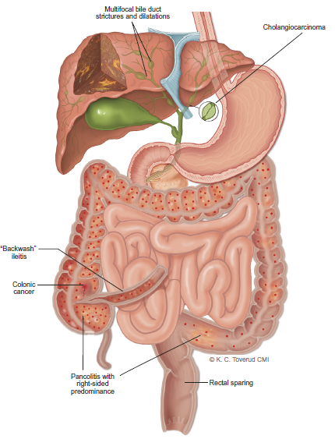
Definition and prevalence
A rare chronic bile duct disease
  Multifocal bile duct strictures and progressive liver disease¹
  IBD coexists in most patients¹
Prevalence is 1–16 per 100,000
  Regional differences across Europe
  More common in men
Most patients present with pancolitis
  Right-sided predominance
  Subtle ileal inflammation* and
  rectal sparing are common
Highly increased and unpredictable risk of biliary and colonic malignancy
  A major challenge in the clinical management of PSC
Macroscopic bowel and bile duct pathology in PSC¹
Multifocal bile duct
strictures and dilatations
Cholangiocarcinoma
‘Backwash’
ileitis
Colonic
cancer
Pancolitis with
right-sided
predominance
Rectal sparing
*‘Backwash’ ileitis
1. Karlsen TH, et al. J Hepatol 2017;67:1298–323;
ESGE/EASL CPG Endoscopy in PSC. J Hepatol 2017;66:1265–81
Image © Kari C Toverud CMI 2017. Please do not adapt or share without permission
Notes:
IBD, inflammatory bowel disease; PSC, primary sclerosing cholangitis
Karlsen TH, Folseraas T, Thorburn D, Vesterhus M. Primary sclerosing cholangitis - a comprehensive review. J Hepatol. 2017 Dec;67(6):1298-1323.

Slide 10
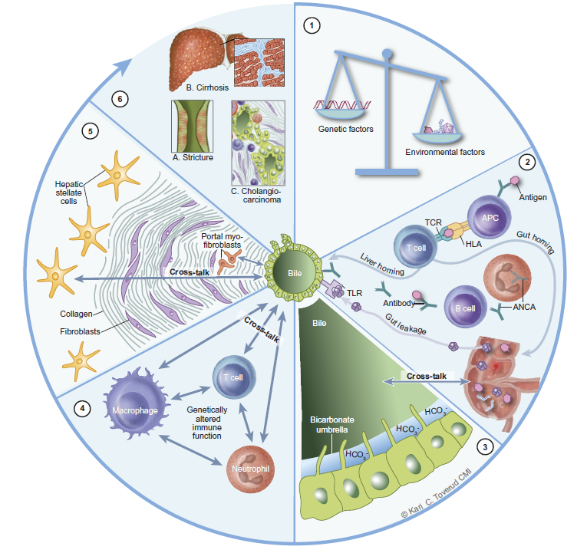
Overview of pathophysiology¹
Liver-related complications in PSC
are mainly represented
by bile duct strictures,
liver cirrhosis and CCA
>20 susceptibility genes
have been identified
Chronic injury + common
fibrotic mechanisms
involving hepatic stellate
cells and portal
myofibroblasts in an
undefined cross-talk
with cholangiocytes
Role of gut-derived
antigens remains unclear
T cells, macrophages and neutrophils
are likely to engage with an
activated cholangiocyte phenotype
Primary or secondary disturbances
in bile homeostasis are thought
to contribute to PSC
1. Karlsen TH, et al. J Hepatol 2017;67:1298–323;
ESGE/EASL CPG Endoscopy in PSC. J Hepatol 2017;66:1265–81
Image © Kari C Toverud CMI 2017. Please do not adapt or share without permission
Notes:
ANCA, anti-neutrophil cytoplasmic antibody; CCA, cholangiocarcinoma; HLA, human leukocyte antigen; PSC, primary sclerosing cholangitis; TLR, toll-like receptor
Karlsen TH, Folseraas T, Thorburn D, Vesterhus M. Primary sclerosing cholangitis - a comprehensive review. J Hepatol. 2017 Dec;67(6):1298-1323.
Integrated overview of the pathophysiology of primary sclerosing cholangitis (PSC). Clockwise, the figure illustrates the development from (1) initiating factors
(upper right piece) to (6) liver-related complications (upper left piece). (1) There have been considerable advances in understanding the genetics of PSC, with more than 20 susceptibility genes now identified. The combined impact of genetic susceptibility factors on overall PSC liability is currently less than 10%, and even accounting for
future gene discoveries, environmental risk likely accounts for more than 50%. (2) The relationship between the gut and the liver affection in PSC is not clear. Early theories were concerned with the possible ‘‘leakage” of pro-inflammatory bacterial products (e.g. lipopolysaccharides, LPS) which would engage innate immune responses (e.g. by tolllike
receptor signalling). The strong human leukocyte antigen (HLA) associations found in genetic studies however claim a strong involvement of adaptive immune responses,
by determining which antigens can be presented to the T cell receptor (TCR). Gut derived antigens are potential triggers of these responses, and activated T cells may migrate to
both the liver and gut following clonal expansion because of the overlapping adhesion molecule profiles of gut and liver endothelia (i.e. mucosal vascular address in cell
adhesion molecule 1 [MadCAM-1] and vascular cell adhesion molecule 1 [VCAM-1] expression along with Chemokine C-C motif ligand 25 [CCL25] secretion). Anti-neutrophil cytoplasmic antibodies (ANCA) are frequently observed in PSC, and may reflect B cell responses to antigens of gut origin. (3) Bile is toxic, and its composition is shaped by involvement of gut-microbial co-metabolism (gut-liver cross-talk). Cholangiocytes are protected against bile acid toxicity by several mechanisms, one of which is the presence of a bicarbonate (HCO3) layer (‘‘umbrella”) generated by an involvement of the Na+-independent Cl/HCO3 anion exchanger (AE2) and active Cl-transporters, most notably the ATP-driven cystic fibrosis transmembrane conductance regulator (CFTR) and the Ca++-driven anoctamin 1 channel. The bile acid receptor TGR5 is most likely expressed at the cilia on the biliary epithelium, and may be involved in the regulation of CFTR. Primary or secondary disturbances in bile homeostasis
are hypothesised to contribute to pathogenesis of PSC, and are the basis of bile acid based therapies (e.g. ursodeoxycholic acid and norursodeoxycholic acid). (4) Several immune cells are found in the proximity of bile ducts of PSC, most notably T cells, macrophages and neutrophils, all of which are affected by the main genetic findings. The exact involvement of each cell type remains unknown, but of key importance is their likely engagement and cross-talk with an activated cholangiocyte phenotype. (5) Chronic injury converges on common mechanisms of fibrosis development involving hepatic stellate cells and portal myofibroblasts in a hitherto undefined cross-talk with cholangiocytes. The key involvement of cholangiocytes in this cross-talk is given by the ‘‘onion skin” features of biliary fibrosis in PSC, but details are unknown. (6) Liver-related complications in PSC are mainly represented by bile duct strictures, liver cirrhosis and cholangiocarcinoma. Printed with permission from Kari C. Toverud.

Slide 11
Diagnosis of PSC
Based on clinical, laboratory, imaging, and histological findings
A diagnostic work-up for PSC should be performed in:
  All patients with IBD and abnormal liver biochemistry
    Especially elevated ALP and GGT values
  Non-IBD patients with elevated cholestatic liver enzymes not otherwise explained
A proposed algorithm for PSC diagnosis in adult patients with cholestasis is the focus of a different guideline
Diagnostic approach to cholestasis in adult patients¹
Abnormal ALP of liver origin, GGT
and/or conjugated bilirubin
Step 1
History and physical examination + US*
Normal US and no clear clinical clue
Abnormal US and/or
clear clinical clue
Step 2
AMA/ANA
-ve: AMA and
PBC-specific ANA
+ve: AMA or
PBC-specific ANA
PBC
Step 3
Drug history negative:
liver biopsy
Drug history positive:
discontinue and observe
Strongly suggested
diagnosis
Normal
Biliary injury
or other lesions
Step 4
MRC ± endoscopic US
Normal
Strictures
SC
Step 5
No clinical
suspicion of SC:
observe and
back to Step 1
Clinical
suspicion of SC:
ERCP
Further workup with
specific investigations
*Dilated bile ducts or focal lesion
1. EASL CPG. Management of cholestatic liver diseases. J Hepatol 2009;51:237–67;
ESGE/EASL CPG Endoscopy in PSC. J Hepatol 2017;66:1265–81
Notes:
AMA, antimitochondrial antibody; ANA, antinuclear antibody; ALP, alkaline phosphatase; ERCP, endoscopic retrograde cholangiopancreatography; GGT, gamma glutamyl transferase; IBD, inflammatory bowel disease; MRC, magnetic resonance cholangiopancreatography; PBC, primary biliary cirrhosis; PSC, primary sclerosing cholangitis; SC, sclerosing cholangitis; US, ultrasound
European Association for the Study of the Liver. EASL Clinical Practice Guidelines: management of cholestatic liver diseases. J Hepatol. 2009 Aug;51(2):237-67.

Slide 12
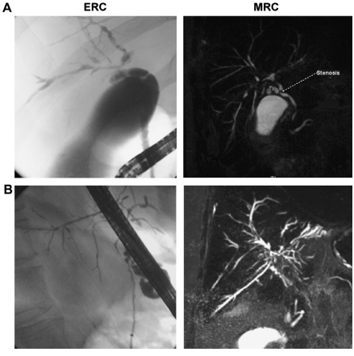
ERCP and MRC in PSC
ERCP plays a significant role in PSC
  High accuracy
  Prognostic value
  Sampling and therapeutic possibilities
However, ERCP must be integrated within well-defined clinical algorithms with less invasive/
non-invasive tests
Widespread use of MRC has restricted ERCP to cases where the diagnosis is equivocal or when sampling or endoscopic treatment are required
ERCP and MRC in patients with PSC¹
ERCP
MRC
A
B
Patient A: multifocal strictures of the intrahepatic bile ducts and high-grade stenosis at the cystic duct junction. Patient B: long-segment filiform stenosis of the common bile duct
1. Weismüller TJ, et al. J Hepatol 2008;48 Suppl 1:S38–57;
ESGE/EASL CPG Endoscopy in PSC. J Hepatol 2017;66:1265–81
Notes:
ERCP, endoscopic retrograde cholangiopancreatography; MRC, magnetic resonance cholangiography; PSC, primary sclerosing cholangitis
Weismüller TJ, Wedemeyer J, Kubicka S, Strassburg CP, Manns MP. The challenges in primary sclerosing cholangitis--aetiopathogenesis, autoimmunity, management and malignancy. J Hepatol. 2008;48 Suppl 1:S38-57.

Slide 13
Guidelines
Key recommendations

Slide 14
Topics
Endoscopic diagnosis of PSC
ERCP in confirmed PSC
  Relevance of dominant strictures
  Assessing risk of CCA
  Therapeutic ERCP
PSC and cholangiocarcinoma
  Brush cytology for identification of CCA
Endoscopic surveillance of PSC-associated IBD
Click on a topic to skip to that section
ESGE/EASL CPG Endoscopy in PSC. J Hepatol 2017;66:1265–81
Notes:
CCA, cholangiocarcinoma; ERCP, endoscopic retrograde cholangiopancreatography; IBD, inflammatory bowel disease; PSC, primary sclerosing cholangitis

Slide 15
Endoscopic diagnosis of PSC
Diagnostic performance of MRC vs. ERCP
  Comparable accuracy: 90% vs. 97%
    MRC better for peripheral ducts: 87% vs. 63%
  Comparable inter-observer agreement: 0.83 vs. 0.73
  Good diagnostic performance with MRCP
    Sensitivity 86%
    Specificity 94%
MRC allows access to occluded or isolated ductal segments
MRC is the optimal cost-effective approach
Angulo J, et al. Hepatol 2000;33:520−7; Moff SL, et al. Gastrointest Endosc 2006;64:219−23;
Vittelas AJR, et al. AJR Am J Roentgenol 2002;179:399−407; Talwalker JA. Hepatology 2004;40:39−45;
Dave M. Radiology 2010;256:387−96
ESGE/EASL CPG Endoscopy in PSC. J Hepatol 2017;66:1265–81
Notes:
ERCP, endoscopic retrograde cholangiopancreatography; MRC, magnetic resonance cholangiography; MRCP, magnetic resonance cholangiopancreatography; PSC, primary sclerosing cholangitis

Slide 16
Endoscopic diagnosis of PSC:
MRC as standard
MRC has replaced ERCP as the standard in diagnosing PSC*
  Confirms PSC in patients with high pre-test probability
  Excludes PSC in patients with low pre-test probability
Confirmatory ERCP not required with clinical and biochemical indicators of PSC
  Unless therapeutic procedures or ductal sampling are indicated
  Unless findings are ambiguous
Recommendations
Magnetic resonance cholangiography should be preferred over endoscopic retrograde cholangiopancreatography as the primary diagnostic modality for PSC | Strong | Moderate
Strength of recommendation
Quality of evidence
*Except in early-stage PSC restricted to intrahepatic bile ducts and rare cases of contraindication to MRC
ESGE/EASL CPG Endoscopy in PSC. J Hepatol 2017;66:1265–81
Notes:
ERCP, endoscopic retrograde cholangiopancreatography; MRC, magnetic resonance cholangiography; PSC, primary sclerosing cholangitis

Slide 17
Differential diagnosis of PSC
Ductographic features defining PSC may be present in other diseases
  Specificity of cholangiographic features of PSC without the additional
  diagnostic clinical and biochemical clues is poor
Classification of secondary sclerosing cholangitis and conditions that may mimic PSC
Infection | Bacterial/parasitic cholangitis | Recurrent pyogenic cholangitis
Immunodeficiency-related (infections) | Congenital immunodeficiency Acquired immunodeficiency (e.g. HIV) | Combined immunodeficiencies Angioimmunoblastic lymphadenopathy
Mechanical/toxic | Cholelithiasis/choledocholithiasis Surgical bile duct trauma | Intra-arterial chemotherapy Drug-induced sclerosing cholangitis
Ischaemic | Vascular trauma Hepatic allograft arterial insufficiency | Paroxysmal nocturnal haemoglobinuria
Other pancreaticobiliary disease | Cystic fibrosis Sclerosing cholangitis of critical illness | ABCB4-associated cholangiopathy Chronic pancreatitis
Systemic inflammatory diseases | IgG4-associated systemic disease Hypereosinophilic syndrome | Sarcoidosis Graft-versus-host disease
Potentially mimicking on cholangiography | Langerhans cell histiocytosis Systemic mastocytosis Caroli’s disease Congenital hepatic fibrosis Other ductal plate abnormalities | Hodgkin’s disease Cholangitis glandularis proliferans Neoplastic/metastatic disease Amyloidosis Hepatic allograft rejection
ESGE/EASL CPG Endoscopy in PSC. J Hepatol 2017;66:1265–81
Notes:
HIV, human immunodeficiency virus; IgG4, immunoglobulin G4; PSC, primary sclerosing cholangitis

Slide 18
Endoscopic diagnosis of PSC: Role of ERCP
ERCP may be warranted in some patients with normal MRC
  Consider level of persisting clinical suspicion
  Consider impact of diagnosis on patient management and prognosis
MRC may miss PSC changes¹
  Minute calibre ducts disappear
  Discreet changes disappear with lower resolution
  Fluid dilation may be necessary
  In patients with early PSC
Recommendations
ERCP can be considered if MRC plus liver biopsy is equivocal or contraindicated in patients with persisting clinical suspicion of PSC. The risks of ERCP have to be weighed against the potential benefit with regard to surveillance and treatment recommendations | Weak | Low
Strength of recommendation
Quality of evidence
1. Cesare Hassan, personal communication
ESGE/EASL CPG Endoscopy in PSC. J Hepatol 2017;66:1265–81
Notes:
ERCP, endoscopic retrograde cholangiopancreatography; MRC, magnetic resonance cholangiography; PSC, primary sclerosing cholangitis

Slide 19
Ductographic criteria for PSC
Amsterdam criteria classify ductographic changes on cholangiography according to severity
  Shown to correlate with prognosis
Type | Intrahepatic | Extrahepatic
0 | No visible abnormalities | No visible abnormalities
I | Multiple calibre changes Minimal dilatation | Slight irregularities of duct contour No stricture
II | Multiple strictures Saccular dilatations, decreased arbourization | Segmental strictures
III | Only central branches filled despite adequate filling pressure Severe pruning | Strictures of almost entire length of duct
IV | – | Extremely irregular margins Diverticulum-like outpouchings
ESGE/EASL CPG Endoscopy in PSC. J Hepatol 2017;66:1265–81
Notes:
PSC, primary sclerosing cholangitis

Slide 20
Ductographic criteria for PSC
None of the ductographic criteria are specific for PSC
  Interpret in the context of demographic data and clinical features
Review by teams with expertise in complex biliary disease is useful
  Multiple secondary causes of sclerosing cholangitis must be considered
Diagnosis | Main cholangiographic features
PSC | Multifocal intrahepatic and extrahepatic bile duct strictures (‘beaded’ appearance), slight biliary dilatation, diverticular outpouchings, ‘pruned tree’ appearance at chronic stage
Ascending cholangitis | Multiple intrahepatic bile duct strictures, stones, biliary abscesses
Ischaemic cholangitis | Proximal intrahepatic bile duct strictures, bile duct necrosis, biliomas, abscesses, biliary cast
Caustic cholangitis | Localized intrahepatic bile duct strictures, irregularities of bile duct wall
AIDS-related cholangitis | Stricture of the distal common bile duct, papillitis, acalculous cholecystitis
IgG4-related cholangitis | Multifocal central bile duct strictures, bile duct wall thickening with visible lumen, pancreatic abnormalities compatible with autoimmune pancreatitis
Portal biliopathy | Central and extrahepatic bile duct irregularities
ESGE/EASL CPG Endoscopy in PSC. J Hepatol 2017;66:1265–81
Notes:
AIDS, acquired immunodeficiency syndrome; IgG4, immunoglobulin G4; PSC, primary sclerosing cholangitis

Slide 21
Endoscopic diagnosis with ERCP
ERCP is the only suggested endoscopic technique for the
diagnosis of PSC
  No role for brush cytology, ductal biopsy, cholangioscopy, or
  confocal laser endomicroscopy
In selected cases with suspected extrahepatic disease and inconclusive MRC findings
  Endoscopic ultrasound and elastography may add information on
  common bile duct strictures, wall thickening, and liver fibrosis stage
Recommendations
The routine use of endoscopic techniques other than ERCP is not suggested for the diagnosis of PSC | Weak | Low
Strength of recommendation
Quality of evidence
ESGE/EASL CPG Endoscopy in PSC. J Hepatol 2017;66:1265–81
Notes:
ERCP, endoscopic retrograde cholangiopancreatography; MRC, magnetic resonance cholangiography; PSC, primary sclerosing cholangitis

Slide 22
ERCP in confirmed PSC: Relevance of dominant strictures
Dominant strictures associated with:
  Pruritus, jaundice, recurrent cholangitis¹
  More advanced histology¹
  Increased risk of CCA¹
  Increased risk of biliary, gallbladder and colorectal carcinoma, when associated with IBD²
  Reduced OLT-free survival³
Multiple dominant structures can be found in the same patients
Survival free of liver transplantation³
73%
No dominant stricture
(n=74)
1.0
0.8
0.6
p=0.011
Survival
0.4
25%
Dominant stricture
(n=97)
0.2
18 years
0.0
0
5
10
15
20
Time after study entry (years)
Strength of recommendation
Quality of evidence
Recommendations
A dominant stricture at ERCP should be defined as a stenosis with a diameter of ≤1.5 mm in the common bile duct and/or ≤1.0 mm in a hepatic duct within 2 cm of the main hepatic confluence | Weak | Low
1. Chapman MH, et al. Eur J Gastroenterol Hepatol 2012;24:1051–8;
2. Rudolph G, et al. J Hepatol 2010;53:313−7; 3. Rudolph G, et al. J Hepatol 2009;51:149–55;
ESGE/EASL CPG Endoscopy in PSC. J Hepatol 2017;66:1265–81
Notes:
CCA, cholangiocarcinoma; ERCP, endoscopic retrograde cholangiopancreatography; IBD, inflammatory bowel disease; OLT, orthoptic liver transplantation; PSC, primary sclerosing cholangitis
Chapman MH, Webster GJ, Bannoo S, Johnson GJ, Wittmann J, Pereira SP. Cholangiocarcinoma and dominant strictures in patients with primary sclerosing cholangitis: a 25-year single-centre experience. Eur J Gastroenterol Hepatol. 2012 Sep;24(9):1051-8.
Rudolph G, Gotthardt D, Kloters-Plachky P, Kulaksiz H, Rost D, Stiehl A. Influence of dominant bile duct stenoses and biliary infections on outcome in primary sclerosing cholangitis. J Hepatol 2009;51:149-155

Slide 23
ERCP in confirmed PSC: Relevance of dominant strictures
Dominant strictures associated with:
  Pruritus, jaundice, recurrent cholangitis¹
  More advanced histology¹
  Increased risk of CCA¹
  Increased risk of biliary, gallbladder and colorectal carcinoma, when associated with IBD²
  Reduced OLT-free survival³
Multiple dominant structures can be found in the same patients
Survival free of liver transplantation³
73%
No dominant stricture
(n=74)
1.0
0.8
0.6
p=0.011
Survival
0.4
25%
Dominant stricture
(n=97)
0.2
Clinical and therapeutic decisions regarding endoscopic interventions
should not be based on the definition of dominant stricture(s) alone
but considered as a compound clinical decision
18 years
0.0
0
5
10
15
20
Time after study entry (years)
Strength of recommendation
Quality of evidence
Recommendations
A dominant stricture at ERCP should be defined as a stenosis with a diameter of ≤1.5 mm in the common bile duct and/or ≤1.0 mm in a hepatic duct within 2 cm of the main hepatic confluence | Weak | Low
1. Chapman MH, et al. Eur J Gastroenterol Hepatol 2012;24:1051–8;
2. Rudolph G, et al. J Hepatol 2010;53:313−7; 3. Rudolph G, et al. J Hepatol 2009;51:149–55;
ESGE/EASL CPG Endoscopy in PSC. J Hepatol 2017;66:1265–81
Notes:
CCA, cholangiocarcinoma; ERCP, endoscopic retrograde cholangiopancreatography; IBD, inflammatory bowel disease; OLT, orthoptic liver transplantation; PSC, primary sclerosing cholangitis
Chapman MH, Webster GJ, Bannoo S, Johnson GJ, Wittmann J, Pereira SP. Cholangiocarcinoma and dominant strictures in patients with primary sclerosing cholangitis: a 25-year single-centre experience. Eur J Gastroenterol Hepatol. 2012 Sep;24(9):1051-8.
Rudolph G, Gotthardt D, Kloters-Plachky P, Kulaksiz H, Rost D, Stiehl A. Influence of dominant bile duct stenoses and biliary infections on outcome in primary sclerosing cholangitis. J Hepatol 2009;51:149-155

Slide 24
ERCP in confirmed PSC: Assessing risk of CCA
ERCP may be indicated in confirmed PSC and changes in:
  Clinical events
    Exacerbation of jaundice*
    Episodes of fever and chills suggestive of cholangitis
    Worsening of pruritus
    Worsening pain in right upper abdominal quadrant, fatigue, and weight loss
  Laboratory abnormalities
    Rapid increase in serum bilirubin levels and/or cholestatic liver enzymes†
  Clinically significant strictures on US or MRC
    New onset or progressive intrahepatic or extrahepatic bile duct dilatation
Recommendations
ERCP and ductal sampling should be considered in confirmed PSC in the case of: Clinically relevant or worsening symptoms Rapid increase of cholestatic enzyme levels New dominant stricture or progression of existing dominant strictures identified at MRC in appropriate clinical context | Weak | Low
Strength of recommendation
Quality of evidence
*Not related to liver failure; †Especially in patients with a diagnosis of clinically significant hilar or extrahepatic strictures on MRC
ESGE/EASL CPG Endoscopy in PSC. J Hepatol 2017;66:1265–81
Notes:
CCA, cholangiocarcinoma; ERCP, endoscopic retrograde cholangiopancreatography; MRC, magnetic resonance cholangiography; PSC, primary sclerosing cholangitis; US, ultrasound

Slide 25
ERCP in confirmed PSC: Assessing risk of CCA
US/MRC findings
Marked biliary dilatation
Common bile duct ≤2 cm
Right or left intrahepatic ducts ≤1 cm
Other intrahepatic ducts ≤5 mm
SUGGESTS CCA
↓
ERCP
Disproportionately severe stricture and concomitant biliary filling defects
New-onset dominant stricture(s)
Abnormal cytological findings Suspicion of malignancy
Aneuploid DNA
ESGE/EASL CPG Endoscopy in PSC. J Hepatol 2017;66:1265–81
Notes:
CCA, cholangiocarcinoma; ERCP, endoscopic retrograde cholangiopancreatography; MRC, magnetic resonance cholangiography; PSC, primary sclerosing cholangitis; US, ultrasound

Slide 26
Therapeutic ERCP in selected patients
In patients with confirmed PSC, MRC should be considered prior to
therapeutic ERCP to confirm the indication*
  Exclude focal parenchymal changes
  Guide clinicians performing the ERCP to minimize the risk of complications
Potential benefits must be weighed against known risks in patients
with no other therapeutic option except LTx
  Following dominant stricture treatment:
    In patients with a significant (≤20%) increase in cholestasis, cholestasis, pruritus, pain, cholangitis, and jaundice are likely to improve
    In patients with ESLD, only cholangitis is expected to improve
Recommendations
Endoscopic treatment with concomitant ductal sampling of suspected dominant strictures is suggested in patients presenting with symptoms likely to improve following endoscopic treatment | Strong | Low
Strength of recommendation
Quality of evidence
*Strength of recommendation, weak; quality of evidence, low
ESGE/EASL CPG Endoscopy in PSC. J Hepatol 2017;66:1265–81
Notes:
ERCP, endoscopic retrograde cholangiopancreatography; ESLD, end stage liver disease; LTx, liver transplantation; MRC, magnetic resonance cholangiography; PSC, primary sclerosing cholangitis

Slide 27
Therapeutic ERCP: Overall outcomes
106 patients treated for up to
13 years with UDCA
  57 with dominant strictures treated endoscopically
    52 repeated balloon dilations
    5 temporary stenting
KM survival rates free of LTx
5 years after first dilation
  Stage 2: 100%
  Stage 3: 72%
  Stage 4: 50%
Survival free of liver transplantation
1.0
Stage 1
0.8
Stage 2
0.6
Overall
Survival
0.4
Stage 3
0.2
Stage 4
0.0
0
20
40
60
80
100
120
140
160
Time after study entry (months)
N=
106
93
67
48
26
7
3
Overall survival improved vs. Mayo prognostic model (p<0.001)
Stage 1 and Stage 2 vs. Stage 3: p<0.01
Stage 1 and Stage 2 vs. Stage 4: p<0.001
Stiehl A, et al. J Hepatol 2002;51:151–6
Notes:
KM, Kaplan–Meier; LTx, liver transplantation; UDCA, ursodeoxycholic acid
Stiehl A, Rudolph G, Klöters-Plachky P, et al. Development of dominant bile duct stenoses in patients with primary sclerosing cholangitis treated with ursodeoxycholic acid: outcome after endoscopic treatment. J Hepatol. 2002;36:151–6.

Slide 28
Balloon dilation vs. balloon dilation + stenting
Data are largely limited to retrospective studies:
  Significant improvement in LTx-free survival compared with the Mayo model has been reported only with balloon dilation
  Reported perforation rate is generally higher with stenting vs. balloon dilation
  Rates of SAEs are higher with stenting vs. balloon dilation
DILSTENT trial comparing single balloon dilation vs. short-term* stenting was prematurely stopped¹
  No differences in recurrence-free re-intervention rates or initial failure
  Significantly higher SAE rate, mainly post-ERCP pancreatitis and suppurative cholangitis, was seen in the stent group (42%) vs. balloon group (10%)
*≤2 weeks
1. Ponsioen C, et al. J Hepatol 2017;66:S1–2;
ESGE/EASL CPG Endoscopy in PSC. J Hepatol 2017;66:1265–81
Notes:
ERCP, endoscopic retrograde cholangiopancreatography; LTx, liver transplantation; SAE, serious adverse event
Ponsioen C, et al. Multicenter randomized trial comparing short-term stenting versus balloon dilation for dominant strictures in primary sclerosing cholangitis. J Hepatol. 2017;66:S1-S2

Slide 29
Balloon dilation vs. balloon dilation + stenting
Data are largely limited to retrospective studies
 | N | R/P | Tech* | FU, median | Improvement | Complications | Survival†
Van Milligen, 1996 | 21 | R | S | 29 months | 57% | 14% | N/A
Ponsioen, 1999 | 32 | R | S | 4 years | 60% | 15% | N/A
Kaya, 2001 | 71 | R | B S | 24 months 22 months | 80% 88% | 14% 54% | N/A
Balayut, 2001 | 63 | R | BS | 34 months | ? | 20% | 5-year 83%
Stiehl, 2002 | 52 | P | B | 5 years | ? | 9% | 5-year 93%
Enns, 2003 | 104 | R | BS | N/A | 52%/70%‡ | 14% | N/A
Gluck, 2008 | 84 | R | B | 8 years§ | ? | 7% | N/A
Gotthardt, 2010 | 96 | P | B | 7 years | ? | 4% | 5-year 81% 10-year 52%
*S, stent; BS, balloon dilation + stent; B, balloon dilation; †LTx-free survival;
‡52% laboratory improvement/70% clinical improvement; §Mean
References are in notes
ESGE/EASL CPG Endoscopy in PSC. J Hepatol 2017;66:1265–81
Notes:
FU, follow-up; LTx, liver transplantation
Baluyut AR, Sherman S, Lehman GA, et al. Impact of endoscopic therapy on the survival of patients with primary sclerosing cholangitis. Gastrointest Endosc. 2001;53:308–12.
Enns R, Eloubeidi MA, Mergener K, et al. Predictors of successful clinical and laboratory outcomes in patients with primary sclerosing cholangitis undergoing endoscopic retrograde cholangiopancreatography. Can J Gastroenterol. 2003;17:243–8.
Gluck M, Cantone NR, Brandabur JJ, et al. A twenty-year experience with endoscopic therapy for symptomatic primary sclerosing cholangitis. J Clin Gastroenterol. 2008;42:1032–9.
Gotthardt DN, Rudolph G, Kloters-Plachky P, et al. Endoscopic dilation of dominant stenoses in primary sclerosing cholangitis: outcome after long term treatment. Gastrointest Endosc. 2010;71:527–34.
Kaya M, Petersen BT, Angulo P, et al. Balloon dilation compared to stenting of dominant strictures in primary sclerosing cholangitis. Am J Gastroenterol. 2001;96:1059–66.
Ponsioen CY, Lam K, van Milligen de Wit AW, et al. Four years experience with short term stenting in primary sclerosing cholangitis. Am J Gastroenterol. 1999;94:2403–7.
Stiehl A, Rudolph G, Klöters-Plachky P, et al. Development of dominant bile duct stenoses in patients with primary sclerosing cholangitis treated with ursodeoxycholic acid: outcome after endoscopic treatment. J Hepatol. 2002;36:151–6.
van Milligen de Wit AW, van Bracht J, Rauws EA, et al. Endoscopic stent therapy for dominant extrahepatic bile duct strictures in primary sclerosing cholangitis. Gastrointest Endosc. 1996;44:293–9.
Ponsioen C, et al. Multicenter randomized trial comparing short-term stenting versus balloon dilation for dominant strictures in primary sclerosing cholangitis. J Hepatol. 2017;66:S1-S2

Slide 30
Balloon dilation vs. balloon dilation + stenting
Data are largely limited to retrospective studies
 | N | R/P | Tech* | FU, median | Improvement | Complications | Survival†
Van Milligen, 1996 | 21 | R | S | 29 months | 57% | 14% | N/A
Ponsioen, 1999 | 32 | R | S | 4 years | 60% | 15% | N/A
Kaya, 2001 | 71 | R | B S | 24 months 22 months | 80% 88% | 14% 54% | N/A
Balayut, 2001 | 63 | R | BS | 34 months | ? | 20% | 5-year 83%
Stiehl, 2002 | 52 | P | B | 5 years | ? | 9% | 5-year 93%
Enns, 2003 | 104 | R | BS | N/A | 52%/70%‡ | 14% | N/A
Gluck, 2008 | 84 | R | B | 8 years§ | ? | 7% | N/A
Gotthardt, 2010 | 96 | P | B | 7 years | ? | 4% | 5-year 81% 10-year 52%
Choice between stenting and balloon dilation should be at discretion of endoscopist‖
*S, stent; BS, balloon dilation + stent; B, balloon dilation; †LTx-free survival;
‡52% laboratory improvement/70% clinical improvement; §Mean; ‖Strength of recommendation, weak; quality of evidence, low
References are in notes
ESGE/EASL CPG Endoscopy in PSC. J Hepatol 2017;66:1265–81
Notes:
FU, follow-up
Baluyut AR, Sherman S, Lehman GA, et al. Impact of endoscopic therapy on the survival of patients with primary sclerosing cholangitis. Gastrointest Endosc. 2001;53:308–12.
Enns R, Eloubeidi MA, Mergener K, et al. Predictors of successful clinical and laboratory outcomes in patients with primary sclerosing cholangitis undergoing endoscopic retrograde cholangiopancreatography. Can J Gastroenterol. 2003;17:243–8.
Gluck M, Cantone NR, Brandabur JJ, et al. A twenty-year experience with endoscopic therapy for symptomatic primary sclerosing cholangitis. J Clin Gastroenterol. 2008;42:1032–9.
Gotthardt DN, Rudolph G, Kloters-Plachky P, et al. Endoscopic dilation of dominant stenoses in primary sclerosing cholangitis: outcome after long term treatment. Gastrointest Endosc. 2010;71:527–34.
Kaya M, Petersen BT, Angulo P, et al. Balloon dilation compared to stenting of dominant strictures in primary sclerosing cholangitis. Am J Gastroenterol. 2001;96:1059–66.
Ponsioen CY, Lam K, van Milligen de Wit AW, et al. Four years experience with short term stenting in primary sclerosing cholangitis. Am J Gastroenterol. 1999;94:2403–7.
Stiehl A, Rudolph G, Klöters-Plachky P, et al. Development of dominant bile duct stenoses in patients with primary sclerosing cholangitis treated with ursodeoxycholic acid: outcome after endoscopic treatment. J Hepatol. 2002;36:151–6.
van Milligen de Wit AW, van Bracht J, Rauws EA, et al. Endoscopic stent therapy for dominant extrahepatic bile duct strictures in primary sclerosing cholangitis. Gastrointest Endosc. 1996;44:293–9.
Ponsioen C, et al. Multicenter randomized trial comparing short-term stenting versus balloon dilation for dominant strictures in primary sclerosing cholangitis. J Hepatol. 2017;66:S1-S2

Slide 31
Therapeutic ERCP: Role of sphincterotomy
Biliary sphincterotomy is not recommended routinely prior to
biliary stenting
If cannulation is difficult, biliary sphincterotomy is advised
  These patients are likely to require multiple procedures
Recommendations
The anticipated benefits of biliary papillotomy/sphincterotomy should be weighted against its risks on a case-by-case basis | Strong | Moderate
Biliary papillotomy/sphincterotomy should be considered, especially after difficult cannulation | Strong | Low
Strength of recommendation
Quality of evidence
ESGE/EASL CPG Endoscopy in PSC. J Hepatol 2017;66:1265–81
Notes:
ERCP, endoscopic retrograde cholangiopancreatography

Slide 32
Therapeutic ERCP: Dilation schemes
No comparative data on optimal dilation scheme or balloon diameter
  Consider bile duct diameter upstream and downstream of the dominant stricture to avoid dilating to more than the duct diameter
Balloon dilations are usually repeated at intervals of 1−4 weeks
  Until technical success*
  For an average of 2–3 balloon dilations
Recommendations
Selecting a balloon calibre of up to the maximum calibre of the ducts delimiting the stricture is suggested | Weak | Low
Repeat dilation of relapsing dominant stricture is suggested if: The dominant stricture is regarded as the cause of recurrent symptoms or of significant increase in cholestasis The patient’s response to previous dilations has been satisfactory | Weak | Very low
Strength of recommendation
Quality of evidence
*Complete balloon inflation within the dominant stricture with no waist observed fluoroscopically, followed by the unobstructed passage of contrast medium through the dilated biliary segment to the duodenum
ESGE/EASL CPG Endoscopy in PSC. J Hepatol 2017;66:1265–81
Notes:
ERCP, endoscopic retrograde cholangiopancreatography

Slide 33
Therapeutic ERCP: Stent therapy
Plastic stents only should be used¹
Stent calibre and length should be adapted to the specific biliary tree configuration
  Need for pre-stent balloon dilation is unclear
Short-term stenting duration is favoured
  Stents tend to clog rapidly in PSC patients
  Similar efficacy with stenting for 1–2 weeks vs. 8–12 weeks
Recommendations
Select a single 10-Fr stent for dominant stricture in the extrahepatic ducts or two 7-Fr stents for hilar strictures extending into the left or right hepatic duct* | Weak | Very low
Stents used for treating dominant stricture should be removed 1–2 weeks following insertion | Weak | Low
Strength of recommendation
Quality of evidence
*Final stent diameter in the case of stepwise stenting
1. Cesare Hassan, personal communication
ESGE/EASL CPG Endoscopy in PSC. J Hepatol 2017;66:1265–81
Notes:
ERCP, endoscopic retrograde cholangiopancreatography; PSC, primary sclerosing cholangitis

Slide 34
Therapeutic ERCP: Complications
ERCP carries an increased risk of complications in the context
of PSC
  Pancreatitis in up to 7% of procedures
    NSAIDs and prophylactic pancreatic stenting are beneficial
  Cholangitis in up to 8% of procedures
Suggest that cannulation in patients with PSC may be more
difficult than in other patients
Recommendations
ERCP in PSC patients should be undertaken by experienced pancreaticobiliary endoscopists | Strong | Very low
Administer routine rectal administration of 100 mg diclofenac or indomethacin immediately before or after ERCP in all patients without contraindication. In the case of high risk of post-ERCP pancreatitis, consider use of a 5-Fr prophylactic pancreatic stent | Strong | High
Strength of recommendation
Quality of evidence
ESGE/EASL CPG Endoscopy in PSC. J Hepatol 2017;66:1265–81
Notes:
ERCP, endoscopic retrograde cholangiopancreatography; NSAID, nonsteroidal anti-inflammatory drug; PSC, primary sclerosing cholangitis

Slide 35
Therapeutic ERCP: Risk of pancreatitis
High risk for post-ERCP pancreatitis
Pre-cut biliary sphincterotomy
Pancreatic guidewire-assisted biliary cannulation
Endoscopic balloon sphincteroplasty
Pancreatic sphincterotomy
Plus > 3 of:
Female gender
Previous pancreatitis
Younger age
Non-dilated extrahepatic bile ducts
Absence of chronic pancreatitis
Normal serum bilirubin,
Duration of cannulation attempts >10 minutes
>1 pancreatic guidewire passage
Pancreatic injection
Failure to clear bile duct stones
Intraductal ultrasound
ESGE/EASL CPG Endoscopy in PSC. J Hepatol 2017;66:1265–81
Notes:
ERCP, endoscopic retrograde cholangiopancreatography; PSC, primary sclerosing cholangitis

Slide 36
Therapeutic ERCP: Bacterial cholangitis
Bacterial cholangitis and bacteriobilia are relatively common in PSC
Use of prophylactic antibiotics are beneficial in elective ERCP
  Reduce bacteraemia
  Seem to prevent cholangitis and septicaemia
Bile fluid sampling could be considered during ERCP
  Guide antibiotic treatment if cholangitis occurs despite prophylaxis
Recommendations
Routine administration of prophylactic antibiotics before ERCP is suggested in patients with PSC | Strong | Low
Strength of recommendation
Quality of evidence
ESGE/EASL CPG Endoscopy in PSC. J Hepatol 2017;66:1265–81
Notes:
ERCP, endoscopic retrograde cholangiopancreatography; PSC, primary sclerosing cholangitis

Slide 37
ERCP in confirmed PSC: Assessing risk of CCA
US/MRC findings
Marked biliary dilatation
Common bile duct ≤2 cm
Right or left intrahepatic ducts ≤1 cm
Other intrahepatic ducts ≤5 mm
SUGGESTS CCA
↓
ERCP
Disproportionately severe stricture and concomitant biliary filling defects
New-onset dominant stricture(s)
Abnormal cytological findings Suspicion of malignancy
Aneuploid DNA
ESGE/EASL CPG Endoscopy in PSC. J Hepatol 2017;66:1265–81
Notes:
CCA, cholangiocarcinoma; ERCP, endoscopic retrograde cholangiopancreatography; MRC, magnetic resonance cholangiography; PSC, primary sclerosing cholangitis; US, ultrasound

Slide 38
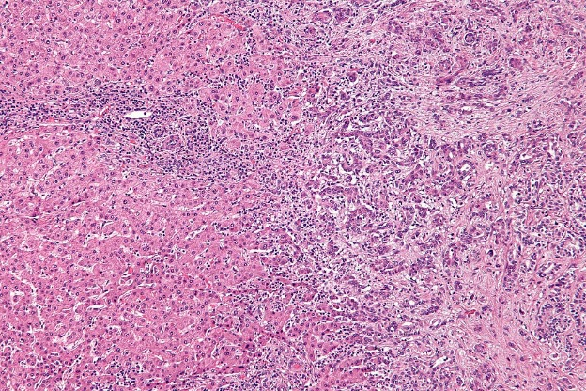
PSC and cholangiocarcinoma
Cancer screening is a key part of follow-up¹
  Lifetime risk for CCA in patients with PSC
  is 10–20%
    Up to 400-fold higher than general population
  CCA is a common cause of death among
  patients with PSC
  In a large Dutch study:²
    CCA in 41/590 (7%) patients
    33/41 died (80%) after a median period of 1 year (range, 0–7)²
Recommendations
CCA should be suspected in any patient with worsening cholestasis, weight loss, raised serum CA19-9, and/or new or progressive dominant stricture* | Strong | Moderate
Raised serum CA19-9 may support the diagnosis of CCA, but specificity is poor | Weak | Low
Strength of recommendation
Quality of evidence
*Particularly with an associated enhancing mass lesion
1. Dyson JK, et al. Lancet 2018; http://dx.doi.org/10.1016/S0140-6736(18)30300-3;
2. Boonstra K, et al. Hepatology 2013;58:2045–55;
ESGE/EASL CPG Endoscopy in PSC. J Hepatol 2017;66:1265–81
Notes:
CCA, cholangiocarcinoma; PSC, primary sclerosing cholangitis
Dyson JK, Beuers U, Jones DEJ, Lohse AW, Hudson M. Primary sclerosing cholangitis. Lancet. 2018 Feb 13. pii: S0140-6736(18)30300-3. doi: 10.1016/S0140-6736(18)30300-3. [Epub ahead of print]
Boonstra K, Weersma RK, van Erpecum KJ, Rauws EA, Spanier BW, Poen AC, van Nieuwkerk KM, Drenth JP, Witteman BJ, Tuynman HA, Naber AH, Kingma PJ, van Buuren
HR, van Hoek B, Vleggaar FP, van Geloven N, Beuers U, Ponsioen CY; EpiPSCPBC Study Group. Population-based epidemiology, malignancy risk, and outcome of primary sclerosing cholangitis. Hepatology. 2013 Dec;58(6):2045-55.

Slide 39
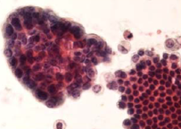
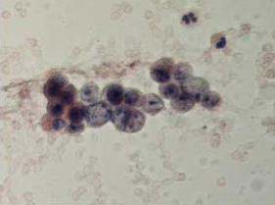
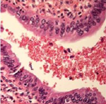
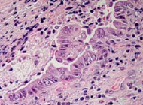
Brush cytology for identification of CCA
Bile duct brushing is highly specific for CCA
  Sensitivity is modest
  Precludes utility for early detection of CCA in PSC
Addition of FISH analysis enhances the sensitivity for detecting CCA
Ductal biopsy improves sensitivity, specificity, and accuracy
Other techniques are not established in routine clinical practice
Brush cytology specimens showing
low- and high-grade dysplasia¹
Low
High
Corresponding bile duct histology¹
1. Boberg KM, et al. J Hepatol 2006;45:568–74;
ESGE/EASL CPG Endoscopy in PSC. J Hepatol 2017;66:1265–81
Notes:
CCA, cholangiocarcinoma; FISH, fluorescent in situ hybridization; PSC, primary sclerosing cholangitis

Slide 40
ERCP findings alone cannot exclude CCA
Not possible to distinguish malignant and benign strictures
with ERCP alone
  Diagnosis always requires additional techniques
Most CCAs develop in the perihilar region or in extrahepatic bile ducts
  Reachable with a cytological brush
Recommendations
Ductal sampling (brush cytology, endobiliary biopsies) is recommended as part of the initial investigation for the diagnosis and staging of suspected CCA in patients with PSC | Strong | High
FISH or equivalent chromosomal assessments should be considered in patients with suspected CCA when brush cytology results are equivocal | Weak | Low
Additional investigations such as cholangioscopy, endoscopic ultrasound, and probe-based confocal laser endomicroscopy (pCLE) may be useful in selected cases | Weak | Low
Strength of recommendation
Quality of evidence
ESGE/EASL CPG Endoscopy in PSC. J Hepatol 2017;66:1265–81
Notes:
CCA, cholangiocarcinoma; ERCP, endoscopic retrograde cholangiopancreatography; FISH, fluorescent in situ hybridization; PSC, primary sclerosing cholangitis

Slide 41
Endoscopic surveillance of PSC-associated IBD
Relationship between PSC and IBD is well-established
Risk of CRC is higher in patients with PSC + IBD than PSC alone¹
Long-term risk of CRC in PSC + IBD patients is about threefold higher than risk of CCA¹
Occurrence of CRC in these patients leads to reduced survival¹
Cumulative risk of CRC
in 211 patients with PSC¹
50
40
31%
With IBD
30
Cumulative risk (%)
p=0.008
20
2%
Without IBD
10
20 years
0
0
5
10
15
20
25
Time (years)
Number at risk:
Without IBD
85
56
33
10
3
1
With IBD
114
75
43
23
4
0
1. Claessen MM, et al. J Hepatol 2009;50:158–64;
ESGE/EASL CPG Endoscopy in PSC. J Hepatol 2017;66:1265–81
Notes:
CCA, cholangiocarcinoma; CRC, colorectal cancer; IBD, inflammatory bowel disease; PSC, primary sclerosing cholangitis
Claessen MM, Vleggaar FP, Tytgat KM, Siersema PD, van Buuren HR. High lifetime risk of cancer in primary sclerosing cholangitis. J Hepatol. 2009 Jan;50(1):158-64

Slide 42
Endoscopic surveillance of PSC-associated IBD
Risk of CRC in PSC-associated IBD makes it crucial to perform
a full ileocolonoscopy at the time of PSC diagnosis in all patients
  Follow-up based on findings
Endoscopic surveillance of PSC-associated colitis is presumed to increase the chance of early detection of dysplasia or malignancy
Recommendations
Screening ileocolonoscopy at PSC diagnosis is recommended | Strong | High
If IBD is documented endoscopically or histologically, annual surveillance colonoscopies are warranted | Strong | Low
If no IBD is documented, consider next ileocolonoscopy at 5 years or whenever bowel complaints suggestive of IBD occur | Weak | Low
Ileocolonoscopy with four-quadrant biopsies from all colonic segments and the terminal ileum is recommended | Strong | Low
Ileocolonoscopy with dye-based chromoendoscopy with targeted biopsies is recommended for dysplasia surveillance of PSC-associated IBD | Strong | Low
Strength of recommendation
Quality of evidence
ESGE/EASL CPG Endoscopy in PSC. J Hepatol 2017;66:1265–81
Notes:
CRC, colorectal cancer; IBD, inflammatory bowel disease; PSC, primary sclerosing cholangitis

Slide 43
Endoscopic surveillance of PSC-associated IBD
Most dysplasia is visible at colonoscopy
  Invisible dysplastic lesions be diagnosed by random biopsies during surveillance
Recommendations
Endoscopic resection of any visible lesions and assessment of the surrounding mucosa is recommended. Proctocolectomy is recommended in the case of dysplasia in the surrounding mucosa, or when the lesion cannot be completely resected. Otherwise, repeat colonoscopy and close follow-up is warranted | Strong | Low
In the case of invisible lesions with high-grade dysplasia confirmed by two expert pathologists, proctocolectomy should be advised | Strong | Low
In the case of invisible lesions with low grade dysplasia confirmed by two expert pathologists, repeat colonoscopy after 3 months with chromoendoscopy is recommended | Strong | Low
Strength of recommendation
Quality of evidence
ESGE/EASL CPG Endoscopy in PSC. J Hepatol 2017;66:1265–81
Notes:
IBD, inflammatory bowel disease; PSC, primary sclerosing cholangitis

Slide 44
Summary

Slide 45
Main recommendations
Strength of recommendation
Quality of evidence
Recommendations
MRC should be preferred over ERCP as the primary diagnostic modality for PSC | Strong | Moderate
ERCP can be considered if MRC plus liver biopsy is equivocal or contraindicated in patients with persisting clinical suspicion of PSC. The risks of ERCP have to be weighed against the potential benefit | Low | Weak
In patients with an established diagnosis of PSC, MRC should be considered before therapeutic ERCP | Weak | Low
Endoscopic treatment with concomitant ductal sampling (brush cytology, endobiliary biopsies) of suspected dominant strictures identified at MRC is suggested in PSC patients who present with symptoms likely to improve following endoscopic treatment | Strong | Low
Weigh anticipated benefits of biliary papillotomy/sphincterotomy against risks on a case-by-case basis | Strong | Moderate
Biliary papillotomy/sphincterotomy should be considered, especially after difficult cannulation | Strong | Low
Routine administration of prophylactic antibiotics before ERCP is suggested | Strong | Low
CCA should be suspected in any patient with worsening cholestasis, weight loss, raised serum CA19-9, and/or new or progressive dominant stricture, particularly with an associated enhancing mass lesion | Strong | Moderate
ESGE/EASL CPG Endoscopy in PSC. J Hepatol 2017;66:1265–81
Notes:
CCA, cholangiocarcinoma; ERCP, endoscopic retrograde cholangiopancreatography; MRC, magnetic resonance cholangiopancreatography; PSC, primary sclerosing cholangitis

