Slide 1
Clinical Practice Guidelines
Autoimmune hepatitis

Slide 2
About these slides
These slides give a comprehensive overview of the EASL clinical practice guidelines on autoimmune hepatitis
The guidelines were published in full in the October 2015 issue of the Journal of Hepatology
  The full publication can be downloaded from the Clinical Practice Guidelines section of the EASL website
  Please cite the published article as: European Association for the Study
  of the Liver. EASL Clinical Practice Guidelines: Autoimmune hepatitis.
  J Hepatol 2015;63:971–1004
Please feel free to use, adapt, and share these slides for your own personal use; however, please acknowledge EASL as the source

Slide 3

About these slides
Definitions of all abbreviations shown in these slides are provided within the slide notes
When you see a home symbol like this one: , you can click on
this to return to the outline or topics pages, depending on which
section you are in
Please send any feedback to: slidedeck_feedback@easloffice.eu
These slides are intended for use as an educational resource and should not be used in isolation to make patient management decisions. All information included should be verified before treating patients or using any therapies described in these materials

Slide 4
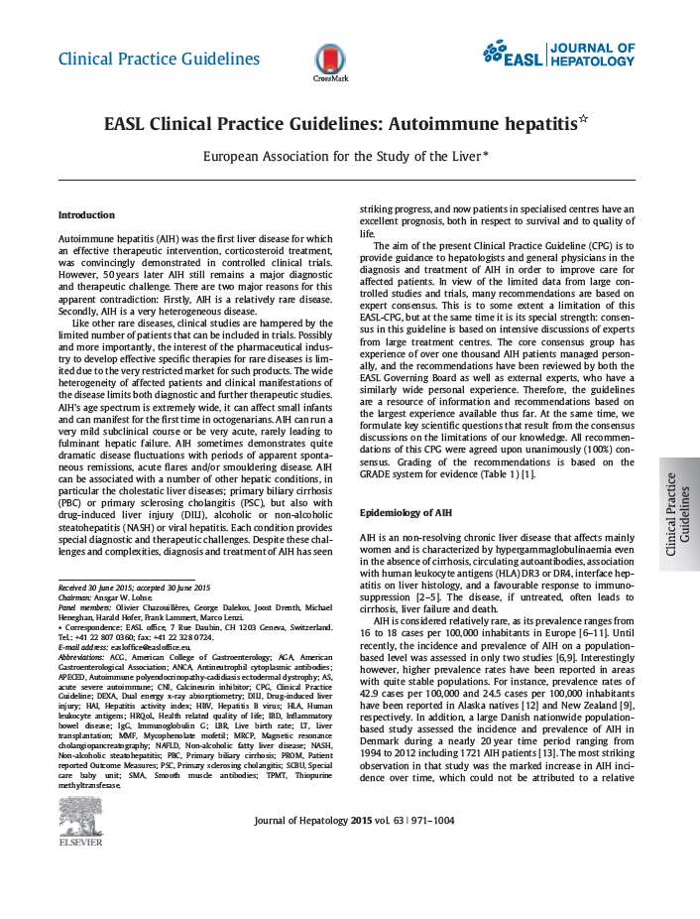
Guideline panel
Chair:
  Ansgar W Lohse
Panel members:
  Olivier Chazouillères, George Dalekos, Joost Drenth, Michael Heneghan, Harald Hofer, Frank Lammert, Marco Lenzi
EASL CPG AIH. J Hepatol 2015;63:971–1004

Slide 5
Outline
Methods
Grading evidence and recommendations
Key statements and recommendations
Guidelines
EASL CPG AIH. J Hepatol 2015;63:971–1004

Slide 6
Methods
Grading evidence and recommendations

Slide 7
Grading evidence
Grading is adapted from the GRADE system¹
Grade of recommendation
I | Randomized controlled trials
II-1 | Controlled trials without randomization
II-2 | Cohort or case-control analytic studies
II-3 | Multiple time series, dramatic uncontrolled experiments
III | Opinions of respected authorities, descriptive epidemiology
1. Adapted from Shaneyfelt TM, et el. JAMA 1999;281:1900–5;
EASL CPG AIH. J Hepatol 2015;63:971–1004
Notes:
Shaneyfelt TM, Mayo-Smith MF, Rothwangl J. Are guidelines following guidelines? The methodological quality of clinical practice guidelines in the peer-reviewed medical literature. JAMA 1999;281:1900–1905

Slide 8
Guidelines
Key statements and recommendations

Slide 9
Topics
Epidemiology
Clinical spectrum
Diagnosis
Treatment
Special patient populations
Difficult-to-treat patients
Drug intolerance and side effects
Quality of life and delivery of care
Click on a topic to skip to that section
EASL CPG AIH. J Hepatol 2015;63:971–1004

Slide 10
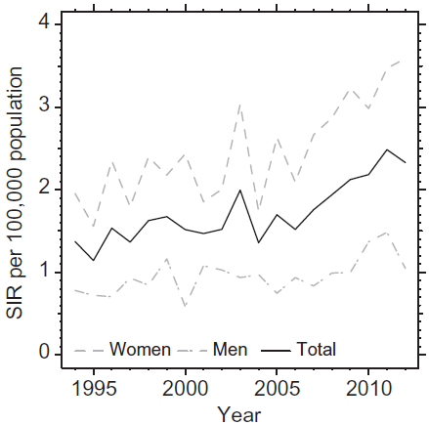
Epidemiology: prevalence
AIH is an non-resolving chronic liver disease that occurs in both sexes but affects mainly women
The incidence of AIH is increasing
Danish nationwide patient registry¹
Grade of recommendation
Guideline statement*^{,2}
Prevalence of AIH ranges from 15 to 25 cases per 100,000 inhabitants in Europe and is increasing in both women and men | II-2
*Statement number: 1
1. Grønbæk L, et al. J Hepatol 2014;60:612–7;
EASL CPG AIH. J Hepatol 2015;63:971–1004
Notes:
AIH, autoimmune hepatitis; SIR, standardized incidence rate
Grønbæk L, Vilstrup H, Jepsen P. Autoimmune hepatitis in Denmark: incidence, prevalence, prognosis, and causes of death. A nationwide registry-based cohort study. J Hepatol. 2014 Mar;60(3):612-7. doi: 10.1016/j.jhep.2013.10.020. Epub 2013 Oct 26.

Slide 11
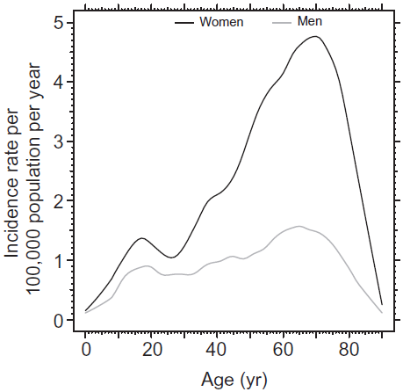
Epidemiology: demographics
AIH occurs in all ethnic groups and in all age groups^{1,2}
Bimodal distribution usually with peaks around puberty and between 4th and 6th decade^{1,2}
A significant proportion of patients are above 65 years of age²
Danish nationwide patient registry¹
Grade of recommendation
Guideline statement*^{,2}
AIH can affect all populations and all age groups | II-2
*Statement number: 1
1. Grønbæk L, et al. J Hepatol 2014;60:612–7;
EASL CPG AIH. J Hepatol 2015;63:971–1004
Notes:
AIH, autoimmune hepatitis; yr, year
Grønbæk L, Vilstrup H, Jepsen P. Autoimmune hepatitis in Denmark: incidence, prevalence, prognosis, and causes of death. A nationwide registry-based cohort study. J Hepatol. 2014 Mar;60(3):612-7. doi: 10.1016/j.jhep.2013.10.020. Epub 2013 Oct 26.

Slide 12
Clinical spectrum: AIH is a very heterogeneous disease
Grade of recommendation
Guideline statements*
AIH should be considered in any patient with acute or chronic liver disease, particularly in the context of hypergammaglobulinaemia | II-2
Prompt and timely diagnosis is crucial as untreated AIH has a high mortality rate | I
~ 1/3 of adult and 1/2 of child patients with AIH have cirrhosis at presentation | II-2
Acute presentation of AIH can occur: either as an acute exacerbation of previously undiagnosed AIH or as new onset acute AIH | II-2
AIH is associated with a broad variety of other autoimmune diseases | II-2
All children with a diagnosis of AIH should undergo (MR) cholangiography to exclude primary (autoimmune) sclerosing cholangitis | II-2
AIH patients with cirrhosis should undergo liver ultrasound in 6-month intervals for HCC screening | II-2
Counselling for UV-protective measures should be considered for patients on immunosuppressants. Dermatological monitoring for non-melanoma skin cancer after long-term immunosuppressant treatment may be considered | III
*Statement numbers: 2–9
EASL CPG AIH. J Hepatol 2015;63:971–1004
Notes:
AIH, autoimmune hepatitis; HCC, hepatocellular carcinoma; MR, magnetic resonance; UV, ultraviolet

Slide 13
Presentation of AIH
Broad range from asymptomatic to acute/severe or even fulminant
Insidious onset (most common clinical phenotype)
  Either without apparent symptoms or with one or more of the following
  non-specific symptoms:
    Fatigue, general ill health, right upper quadrant pain, lethargy, malaise, anorexia, weight loss, nausea, pruritus, fluctuating jaundice and polyarthralgia involving the small joints without arthritis (sometimes dating back years)
Acute onset (about 25% of patients)
  Acute exacerbation of chronic AIH, or
  True acute AIH without histological findings of chronic liver disease
  Centrilobular zone 3 necrosis (central perivenulitis) usually predominant
  Autoantibodies or other classical features can be absent
Cirrhosis already present in ~1/3 of patients at diagnosis
  Irrespective of the presence of symptoms
  Due to delay in diagnosis (often long asymptomatic course)
EASL CPG AIH. J Hepatol 2015;63:971–1004
Notes:
AIH, autoimmune hepatitis

Slide 14
Subclassification of AIH
Sometimes used sub-classiﬁcation of AIH based on autoantibody pattern
  Validity and clinical implications of this sub-classification are uncertain
Sub-type | Features
AIH-1 | Almost 90% of AIH cases Detection of ANAs, SMAs or anti-SLA/LP Association with HLA DR3, DR4 and DR13 Any age at onset Variable clinical and histopathological severity | Usually excellent treatment response, but variable relapse rates after drug withdrawal and need for long-term maintenance therapy
AIH-2 | Up to 10% of AIH cases Anti-LKM1, anti-LC1 and rarely anti-LKM3 Association with HLA DR3 and DR7 Onset usually in childhood/young adulthood Clinical and histopathological severity commonly acute and advanced | Sometimes failure of treatment and frequent relapse rates after drug withdrawal; need for long-term maintenance therapy very common
AIH-3 | Up to 10% of cases Only SLA/LP positive Otherwise very similar to AIH-1* Often Ro52-antibody positive | Lifelong immuno-suppression in most, if not all patients
*Possibly more severe
EASL CPG AIH. J Hepatol 2015;63:971–1004
Notes:
AIH, autoimmune hepatitis; ANA, antinuclear antibody; HLA, human leucocyte antigen; LC, liver cytosol; LKM, liver-kidney microsomal; LP, liver-pancreas; SLA, soluble liver antigen; SMA, smooth muscle antibody

Slide 15
Specific characteristics of AIH
Characteristics
Clinical features in special conditions | Some patients within AIH spectrum have characteristics of PBC or PSC Internationally agreed diagnostic criteria are lacking Concurrent cholestatic findings require investigation for AMAs and cholangiography (particularly in children) Presentation of AIH can occur in pregnant women or after delivery Usually subsides but post-partum exacerbations are common Maternal and fetal complications are similar to general population AIH-like disease can arise after liver transplantation (de novo AIH), but may be an expression of chronic rejection
Specific characteristics | Onset of disease after viral infections has been described AIH should be considered in cases with previous viral infections followed by unexplained and prolonged hepatitis Development after administration of drugs, supplements or herbals (“drug-induced” AIH – difficult to differentiate from DILI, maybe the same) Nitrofurantoin and minocycline Biological agents (TNF-α blockade) Interferon-α for HCV Concurrent autoimmune or immune-mediated diseases in the patient (and/or first-degree relatives) are common An unusual form of AIH occurs in 10–20% of patients with APECED
EASL CPG AIH. J Hepatol 2015;63:971–1004
Notes:
AIH, autoimmune hepatitis; AMA, antimitochondrial antibody; APECED, autoimmune polyendocrinopathy candidiasis ectodermal dystrophy; APS-1, autoimmune polyglandular syndrome type 1; ASC, autoimmune sclerosing cholangitis; DILI, drug-induced liver injury; HCV, hepatitis C virus; PBC, primary biliary cirrhosis; PSC, primary sclerosing cholangitis; TNF, tumour necrosis factor
Examples of concurrent autoimmune or immune-mediated diseases in the patient or first-degree relatives: Hashimoto thyroiditis (strongest association), Grave’s disease, vitiligo, alopecia, rheumatoid arthritis, diabetes mellitus type-1, inflammatory bowel disease, psoriasis, systemic lupus erythematosus, Sjögren’s syndrome, celiac disease, panniculitis, mononeuritis, urticaria pigmentosa, Sweet´s syndrome, idiopathic thrombocytopenic purpura, polymyositis, haemolytic anaemia, uveitis.

Slide 16
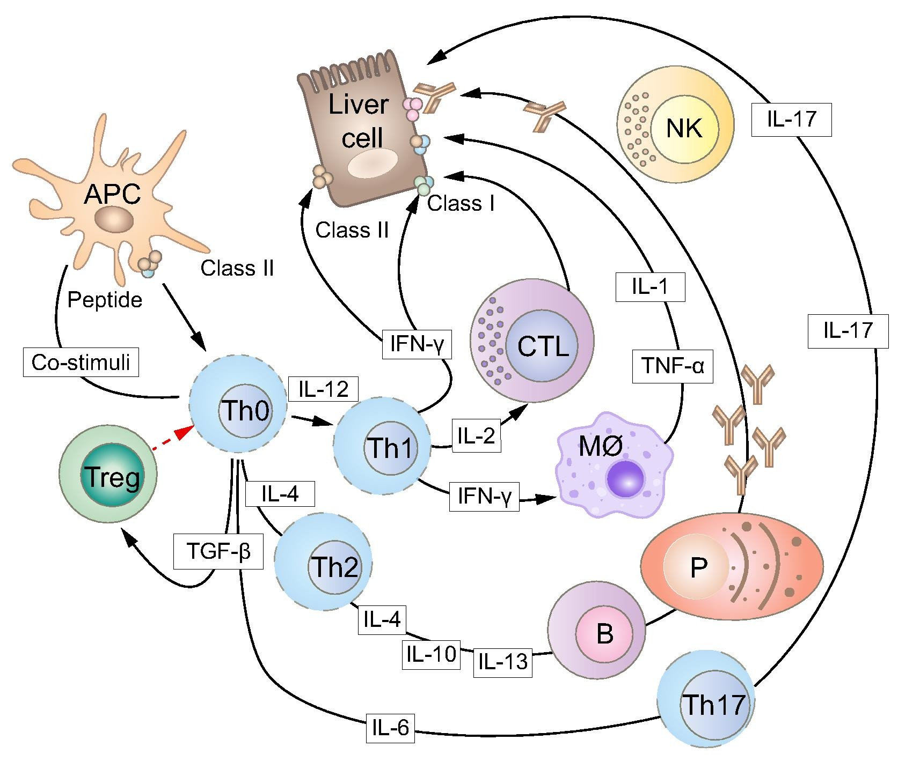
Pathogenesis of AIH
Manns MP, et al. J Hepatol 2015;62:S100–11
EASL CPG AIH. J Hepatol 2015;63:971–1004
Notes:
AIH, autoimmune hepatitis; APC, antigen-presenting cell; CTL, cytotoxic T lymphocyte; IFN, interferon; IL, interleukin; NK, natural killer cell; Th, T helper cell; Treg, T regulatory cell
Molecular pathogenesis of autoimmune hepatitis. An autoantigenic peptide is presented to an uncommitted T helper (Th0) lymphocyte within the HLA class II molecule of an antigen-presenting cell (APC). Th0 cells become activated and, according to the cytokines present in the microenvironment and the nature of the antigen, differentiate into Th1, Th2, or Th17 cells, initiating a series of immune reactions determined by the cytokines they produce: Th2 secrete mainly IL-4, IL-10, and IL-13, and direct autoantibody production by B lymphocytes; Th1 secrete IL-2 and IFN-c, which stimulate cytotoxic T lymphocytes (CTL), enhance expression of class I and induce expression of class II HLA molecules on hepatocytes and activate macrophages; activated macrophages (MØ) release IL-1 and tumour necrosis factor alpha (TNF-a). Regulatory T cells (Treg) are derived from Th0 in the presence of transforming growth factor (TGF). If Tregs do not oppose, a variety of effector mechanisms can be activated: liver cell destruction could derive from the action of CTL; cytokines released by Th1 and recruited macrophages; complement activation or engagement of Fc receptor-bearing cells such as natural killer (NK) lymphocytes by the autoantibody bound to the hepatocyte surface. The role of the recently described Th17 cells, which arise in the presence of TGF-beta and IL-6, is under investigation. Of note, TGF-beta is highly expressed in the inflamed liver, dwindling during remission
Manns MP et al. Autoimmune hepatitis – Update 2015 J Hepatol 2015;62:S100–S111

Slide 17
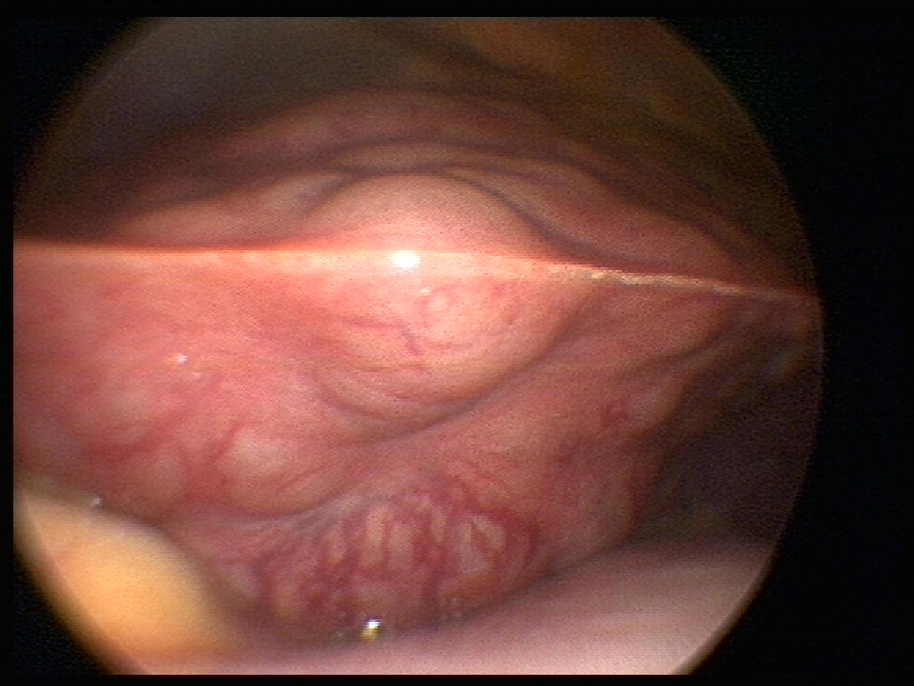
AIH with cirrhosis
Macroscopic aspect of autoimmune cirrhosis¹
Typical macro-modular cirrhosis of a patient with autoimmune hepatitis diagnosed at a relatively advanced stage
1. Lohse AW, et al. J Hepatol 2011;55:171–82
EASL CPG AIH. J Hepatol 2015;63:971–1004
Notes:
AIH, autoimmune hepatitis

Slide 18
Diagnosis (1 of 2)
Diagnosis is usually based on typical disease phenotype
  Plus exclusion of other chronic liver disease (yet, comorbidity is possible)
Guideline statements*
AIH is a clinical diagnosis. Diagnosis of AIH relies particularly on the presence of autoantibodies, hypergammaglobulinaemia and typical or compatible histology | II-2
Elevated IgG levels, especially in the absence of cirrhosis, are a distinctive feature of AIH. A selectively elevated IgG in the absence of IgA and IgM elevation is particularly suggestive of AIH | II-3
Normal IgG or γ-globulin levels do not preclude the diagnosis of AIH. Most of these patients demonstrate a fall of IgG levels upon treatment | III
Circulating non-organ-specific antibodies are present in the vast majority of AIH patients. Autoantibody profiles have been used for sub-classification of AIH.† The clinical implications arising from this sub-classification are uncertain | II-2
Indirect immunofluorescence is the test of choice for the detection of ANA, SMA, LKM and LC-1 autoantibodies. Immunoassays‡ are the tests of choice for the detection of SLA/LP autoantibodies. Methods and cut-off values should be reported by the laboratory | III
Grade of recommendation
*Statement numbers: 10–14
† AIH-1 (ANA and/or SMA positive); AIH-2 (LKM1, LKM3 and/or LC-1 positive); AIH-3 (SLA/LP positive);
‡ELISA/Western blot
EASL CPG AIH. J Hepatol 2015;63:971–1004
Notes:
AIH, autoimmune hepatitis; ANA, antinuclear antibody; ELISA, enzyme-linked immunosorbent assay; Ig, immunoglobulin; LC, liver cytosol; LKM, liver-kidney microsomal; LP, liver-pancreas; SLA, soluble liver antigen; SMA, smooth muscle antibody

Slide 19
Diagnosis (2 of 2)
Guideline statements*
Histological demonstration of hepatitis is a prerequisite for the diagnosis of AIH and needs to be part of the initial diagnostic work-up | II-2
No morphological features are pathognomonic of AIH. Suggestive of AIH: interface hepatitis, periportal necrosis, emperipolesis and rosetting of hepatocytes. These features should be reported by the pathologist in addition to grading (hepatitis activity index) and staging of disease | II-2
Pericentral necrosis may be present in the acute onset of AIH and histologically indistinguishable from DILI | II-3
The simplified scoring system (2008) of the IAIHG is a useful clinical tool. By considering response to treatment, the revised scoring system (1999) of the IAIHG can be helpful in diagnosing difficult cases | II-2
Coexistence of features of AIH and cholestatic liver diseases can be observed, both at diagnosis and during follow-up. Diagnostic tests for PBC and PSC should be performed in patients showing features of cholestasis | II-2
In adult patients with AIH and cholestatic lab changes, and in all children with AIH, (MR) cholangiography should be performed in order to recognize sclerosing cholangitis | II-3
Grade of recommendation
*Statement numbers: 15–20
EASL CPG AIH. J Hepatol 2015;63:971–1004
Notes:
AIH, autoimmune hepatitis; DILI, drug-induced liver injury; IAIHG, International Autoimmune Hepatitis Group; MR, magnetic resonance; PBC, primary biliary cirrhosis; PSC, primary sclerosing cholangitis;

Slide 20
Suggested diagnostic algorithm for AIH
Liver disease of unknown origin
IFL autoantibody test on rodent tissue sections
+ SLA/LP (ELISA or blot)
ANA+
SMA+
LKM1/LC1+
SLA/
LP+
Test Negative
Clinical suspicion*
remains
Consider AIH*
Repeat testing in
specialty lab
(including pANCAs and specific immunoassays for LKM1, LKM3, LC1, SLA/LP, F-actin, Ro52,
gp210†, sp100†)
Negative
Consider alternate diagnoses or
Autoantibody-negative AIH
Liver biopsy
Positive
Consider AIH
*Test also for elevated IgG levels; †These antibodies are highly specific for PBC diagnosis
EASL CPG AIH. J Hepatol 2015;63:971–1004
Notes:
AIH, autoimmune hepatitis; ANA, antinuclear antibody; ELISA, enzyme-linked immunosorbent assay; IFL, immunofluorescence; Ig, immunoglobulin; LC, liver cytosol; LKM, liver-kidney microsomal; LP, liver-pancreas; pANCA, perinuclear antineutrophil cytoplasmic antibody; PBC, primary biliary cirrhosis; SLA, soluble liver antigen; SMA, smooth muscle antibody
Suggested diagnostic algorithm for autoimmune hepatitis using routine autoantibody testing by indirect immunofluorescence (IFL) and enzyme linked immunosorbent assay (ELISA) testing with a set of four autoantibodies. A liver biopsy is always required for the demonstration of inflammatory hepatitis, as well as for staging and grading of the liver disease.

Slide 21
Suggested algorithm for AIH vs DILI
Probable or possible AIH vs DILI
0.5−1 mg/kg predniso(lo)ne
Response
Non-response
Taper steroids
until withdrawal
Consider alternative
diagnoses
Relapse
No relapse
Definite AIH
DILI*
Treatment of AIH
Avoid this drug in future
*Long-term follow-up is advised in order not to miss a late relapse of AIH (e.g. 6 monthly for 3 years)
EASL CPG AIH. J Hepatol 2015;63:971–1004
Notes:
AIH, autoimmune hepatitis; DILI, drug-induced liver injury
A case based algorithm for patients with a suspicion of autoimmune hepatitis or drug-induced liver injury (DILI) using a response guided approach.

Slide 22
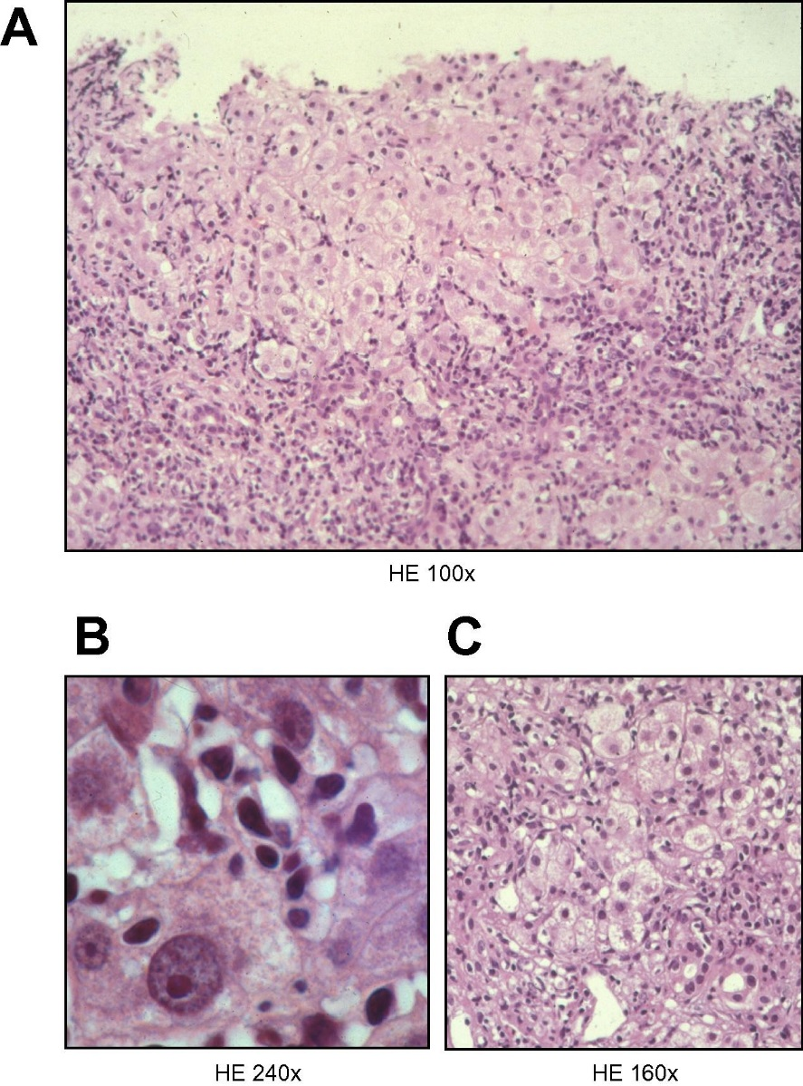
Typical histopathology of AIH
Typical histopathology of AIH with
portal/periportal predominance of
necroinflammatory lesions and broad
interface hepatitis
Emperipolesis with a lymphocyte in the
cytoplasm of a damaged hepatocyte
Typical rosetting of hepatocytes in the area
of interface hepatitis
Manns MP, et al. J Hepatol 2015;62:S100–11
Histopathology pictures were provided by Hans Peter Dienes, University of Vienna, Austria
Notes:
AIH, autoimmune hepatitis

Slide 23
Differential diagnosis of AIH
AIH should be considered in any patient with acute or
chronic liver disease
  Particularly if hypergammaglobulinaemia is present and if the patient has features of other
  autoimmune diseases
Other autoimmune liver diseases
Primary biliary cirrhosis Primary sclerosing cholangitis* | IgG4-associated cholangitis
Chronic viral hepatitis
Chronic hepatitis B ± HDV | Chronic hepatitis C
Other conditions
Cholangiopathy due to HIV infection Alcoholic liver disease Drug-induced liver injury Granulomatous hepatitis Haemochromatosis | Non-alcoholic steatohepatitis α1-antitrypsin deficiency Wilson disease Systemic lupus erythematosus Coeliac disease
*Including small duct primary sclerosing cholangitis
EASL CPG AIH. J Hepatol 2015;63:971–1004
Notes:
AIH, autoimmune hepatitis; HDV, hepatitis delta virus; HIV, human immunodeficiency virus; Ig, immunoglobulin

Slide 24
IAIHG criteria for diagnosis (1999)
Typical features that inform a diagnosis of AIH
Definite AIH | Probable AIH
Normal α-1AT phenotype | Partial α-1AT deficiency
Normal ceruloplasmin level | Non-diagnostic ceruloplasmin/copper levels
Normal iron and ferritin levels | Non-diagnostic iron and/or ferritin changes
No active hepatitis A/B/C infection | No active hepatitis A/B/C infection
Daily alcohol <25 g/day | Daily alcohol <50 g/day
No recent hepatotoxic drugs | No recent hepatotoxic drugs
Predominant AST/ALT abnormality | Predominant AST/ALT abnormality
γ-globulins or IgG level >1.5x ULN | Hypergammaglobulinaemia of any degree
ANA, SMA anti-LKM1 >1:80, in adults and >1:20 in children | ANA, SMA, anti-LKM1 >1:40 in adults
AMA negative | Other autoantibodies
Liver histology Interface hepatitis moderate to severe No biliary lesions, granulomas or prominent changes suggestive of another disease | Liver histology Interface hepatitis moderate to severe No biliary lesions, granulomas or prominent changes suggestive of another disease
Alvarez F, et al. J Hepatol 1999;31:929–38; EASL CPG AIH. J Hepatol 2015;63:971–1004
Notes:
AIH, autoimmune hepatitis; AMA, antimitochondrial antibody; ANA, antinuclear antibody; AST, aspartate aminotransferase; ALT, alanine aminotransferase; AT, antitrypsin; IAIHG, International Autoimmune Hepatitis Group; LKM, liver-kidney microsomal; SMA, smooth muscle antibody; ULN, upper limit of normal
Alvarez F, Berg PA, Bianchi FB, Bianchi L, Burroughs AK, Cancado EL, et al. International Autoimmune Hepatitis Group Report: review of criteria for
diagnosis of autoimmune hepatitis. J Hepatol 1999;31:929–938.

Slide 25
IAIHG criteria for diagnosis (1999)
Typical features that inform a diagnosis of AIH
Definite AIH | Probable AIH
Normal α-1AT phenotype | Partial α-1AT deficiency
Normal ceruloplasmin level | Non-diagnostic ceruloplasmin/copper levels
Normal iron and ferritin levels | Non-diagnostic iron and/or ferritin changes
No active hepatitis A/B/C infection | No active hepatitis A/B/C infection
Daily alcohol <25 g/day | Daily alcohol <50 g/day
No recent hepatotoxic drugs | No recent hepatotoxic drugs
Predominant AST/ALT abnormality | Predominant AST/ALT abnormality
γ-globulins or IgG level >1.5x ULN | Hypergammaglobulinaemia of any degree
ANA, SMA anti-LKM1 >1:80, in adults and >1:20 in children | ANA, SMA, anti-LKM1 >1:40 in adults
AMA negative | Other autoantibodies
Liver histology Interface hepatitis moderate to severe No biliary lesions, granulomas or prominent changes suggestive of another disease | Liver histology Interface hepatitis moderate to severe No biliary lesions, granulomas or prominent changes suggestive of another disease
Complex as a clinical tool
Fails to distinguish AIH from cholestatic syndromes
Alvarez F, et al. J Hepatol 1999;31:929–38; EASL CPG AIH. J Hepatol 2015;63:971–1004
Notes:
AIH, autoimmune hepatitis; AMA, antimitochondrial antibody; ANA, antinuclear antibody; AST, aspartate aminotransferase; ALT, alanine aminotransferase; AT, antitrypsin; IAIHG, International Autoimmune Hepatitis Group; LKM, liver-kidney microsomal; SMA, smooth muscle antibody; ULN, upper limit of normal
Alvarez F, Berg PA, Bianchi FB, Bianchi L, Burroughs AK, Cancado EL, et al. International Autoimmune Hepatitis Group Report: review of criteria for
diagnosis of autoimmune hepatitis. J Hepatol 1999;31:929–938.

Slide 26
IAIHG simplified scoring system (2008)
Diagnostic criteria for routine clinical use
Feature/parameter | Discriminator | Score
Antibodies (max 2 points) ANA or SMA+ ANA or SMA+ or LKM+ or SLA/LP+ | ≥1:40 ≥1:80 ≥1:40 Any titre | (0−2 points total) +1 +2 +2 +2
IgG or γ-globulins level | >ULN >1.1x ULN | +1 +2
Liver histology (evidence of hepatitis is required) | Compatible with AIH Typical of AIH Atypical | +1 +2 0
Absence of viral hepatitis | No Yes | 0 +2
Score ≥7 = Definite AIH
Score ≥6 = Probable AIH
Hennes EM, et al. Hepatology 2008;48:169–76; EASL CPG AIH. J Hepatol 2015;63:971–1004
Notes:
AIH, autoimmune hepatitis; ANA, antinuclear antibody; IAIHG, International Autoimmune Hepatitis Group; Ig, immunoglobulin; LKM, liver-kidney microsomal; LP, liver-pancreas; SLA, soluble liver antigen; SMA, smooth muscle antibody; ULN, upper limit of normal
Hennes EM, Zeniya M, Czaja AJ, Pares A, Dalekos GN, Krawitt EL, et al. Simplified criteria for the diagnosis of autoimmune hepatitis. Hepatology 2008;48:169–176.

Slide 27
Treatment
Aims:
  To obtain complete remission of the disease
  To prevent further progression of liver disease
Generally requires permanent maintenance therapy
Guideline statements*
Aim of treatment of AIH should be complete biochemical and histological resolution of disease to prevent further progression of liver disease | II-2
The management of patients with AIH should also include early recognition of extrahepatic manifestations and symptoms, and associated autoimmune diseases as well as surveillance for disease-specific, and treatment-associated complications | III
All patients with active AIH should be treated | I
Dosage of therapy should be adapted to the activity of the disease | III
Only patients in (spontaneous) remission may not require therapy but must be closely followed (3–6 monthly), because spontaneous relapse, often asymptomatic at first, is very common | III
Grade of recommendation
*Statement numbers: 21–23
EASL CPG AIH. J Hepatol 2015;63:971–1004
Notes:
AIH, autoimmune hepatitis

Slide 28
Therapeutic algorithm
Diagnosis of AIH
Advanced fibrosis/ cirrhosis*
Active disease
(HAI ≥ 4/18)
Mild disease
(ALT <3x ULN; HAI <4/18)
and no advanced fibrosis
Treatment required
Treatment optional
Individual decision based on:
Age
Co-morbidities
Patient preference
Serology
Induction therapy
If no treatment, monitor every
3 months (ALT, IgG)
Follow-up liver biopsy if there is increase of ALT and/or IgG
*Treatment probably no longer indicated in decompensated, burned-out cirrhosis, unless high inflammatory score on liver biopsy
EASL CPG AIH. J Hepatol 2015;63:971–1004
Notes:
AIH, autoimmune hepatitis; ALT, alanine aminotransferase; HAI, hepatitis activity index; Ig, immunoglobulin; ULN, upper limit of normal
Therapeutic algorithm with case-by-case decisions about commencing steroid therapy, informed by baseline assessments. For example, a patient with
active disease (elevated transaminases >3 normal values and hepatitis activity index (HAI) >4/18) requires treatment.
Treatment probably no longer indicated in decompensated, burn-out cirrhosis, unless high inflammatory score on liver biopsy.

Slide 29
Remission induction
Induction of remission with steroids
  Plus thiopurines as a steroid-sparing strategy
Prednis(ol)one/azathioprine high efﬁcacy with minimal side effects
  Monitor clinical and laboratory parameters for the ﬁrst 4 weeks
  Every 1–3 months thereafter†
Grade of recommendation
Guideline statements*
First line treatment: predniso(lo)ne followed by the addition of azathioprine after 2 weeks | I
Initial predniso(lo)ne dose: 0.5 to 1 mg/kg/day. These relatively high initial doses can induce remission more quickly, albeit at the expense of steroid-related side effects | II-2
Azathioprine can be initiated when bilirubin levels are <6 mg/dl (100 μmol/l), ideally 2 weeks after initiation of steroid treatment. Initial dosage: 50 mg/day, increased depending on toxicity and response up to 1–2 mg/kg | II-2
Treatment of AIH should be response guided and regimens should be individualized | III
*Statement numbers: 24–26
†Patients with AIH require lifelong monitoring
EASL CPG AIH. J Hepatol 2015;63:971–1004
Notes:
AIH, autoimmune hepatitis

Slide 30
Suboptimal response
Primary non-response to immunosuppressive treatment is
experienced in only a very small proportion of patients
  Carefully reconsider diagnosis
  Re-evaluate adherence to treatment
Guideline statements*
A failure of adequate response should lead to a reconsideration of diagnosis or re-evaluation of adherence to treatment | II-2
In patients with sub-optimal response despite reconfirmation of diagnosis and adherence, dosage of prednisolone and azathioprine should be increased, or alternative medications should be used | II-2
Patients with acute severe AIH should be treated with high doses of intravenous corticosteroids (≥1 mg/kg) as early as possible. Lack of improvement within 7 days should lead to consideration of emergency liver transplantation | III
Grade of recommendation
*Statement numbers: 27–29
EASL CPG AIH. J Hepatol 2015;63:971–1004

Slide 31
Therapeutic strategy
AIH
0.5−1 mg/kg prednisolone
Good response
Insufficient response
Add azathioprine
gradually up to 1–2 mg/kg
Consider
non-compliance
Consider alternative diagnoses
Azathioprine intolerance
Increase to i.v.
100 mg prednisolone
Manage
alternative disease
Second-line
therapy†
Taper steroids*
Response
Insufficient response
Individualize doses to achieve and maintain normal ALT and IgG
Refer to specialist centre for
confirmation of diagnosis,
LT evaluation and/or
alternative immunosuppressives
*Ideally trial of steroid withdrawal;
†Usually MMF
EASL CPG AIH. J Hepatol 2015;63:971–1004
Notes:
AIH, autoimmune hepatitis; ALT, alanine aminotransferase; Ig, immunoglobulin; i.v., intraveneous; LT, liver transplantation; MMF, mycophenolate mofetil
Therapeutic strategy in autoimmune hepatitis. Treatment requires induction of remission and prolonged maintenance therapy. Induction is delivered by steroids and thiopurines are added as steroid sparing strategy. Laboratory endpoints are normalisation of IgG and ALT. MMF, mycophenolate mofetil

Slide 32
Treatment duration and response
Aim:
  Complete normalization of aminotransferases and IgG levels
    Persisting elevations of aminotransferases associated with:
      Relapse after treatment withdrawal
      Activity on liver biopsy
      Progression to cirrhosis
      Poor outcome
Guideline statements*
Biochemical remission = normalization of IgG and aminotransferases. Histological remission = normal histology or minimal hepatitis (HAI <4 or equivalent) | II-2
Immunosuppressive treatment should be continued for at least 3 years, and at least 2 years following complete normalization of transaminases and IgG | II-2
Without biochemical remission, treatment should not be discontinued. In patients who have been in biochemical remission for >2 years, liver biopsy should be considered prior to treatment withdrawal. In patients with continued histological disease activity (HAI >3), treatment should not be discontinued‡ | II-2
Grade of recommendation
*Statement numbers: 30–32;
†Histological resolution of disease typically lags behind reaching the biochemical endpoint
EASL CPG AIH. J Hepatol 2015;63:971–1004
Notes:
HAI, hepatitis activity index; Ig, immunoglubulin

Slide 33
Treatment withdrawal and relapse
Relapse occurs in 50–90% of cases after drug withdrawal
  Deﬁned as reappearance of ALT elevation >3x ULN
  May also present with milder ALT elevations and/or increase in IgG levels
Guideline statements*
Only a small minority of patients stay in remission without maintenance therapy. A trial of treatment withdrawal requires close cooperation between patient and physician. Relapse occurs most commonly within 12 months after treatment withdrawal. However, relapse may even occur many years later. Patients should be closely monitored after treatment withdrawal, and surveillance continued lifelong. An increase in IgG can precede the rise of aminotransferases in a relapse | II-2
Treatment of the relapse or flare may require steroid doses similar to the induction regimen. Earlier detection of relapse allows lower doses of immunosuppressants to re-induce full remission | II-2
Patients who have received adequate immunosuppression and have relapsed during drug withdrawal, or who experienced a flare during adequate maintenance therapy should be kept on immunosuppression permanently | II-2
Grade of recommendation
*Statement numbers: 33–35
EASL CPG AIH. J Hepatol 2015;63:971–1004
Notes:
ALT, alanine aminotransferase; IAIHG, International Autoimmune Hepatitis Group; Ig, immunoglobulin; ULN, upper limit of normal

Slide 34
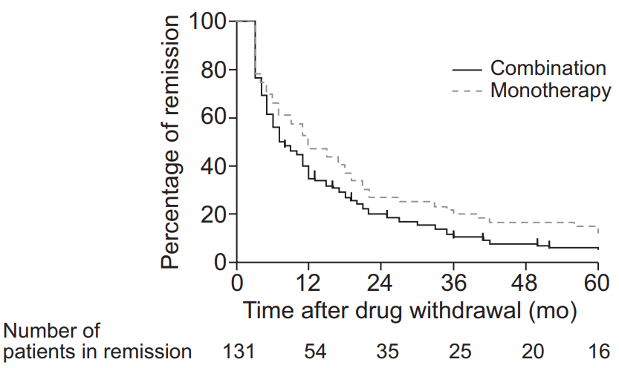
Treatment withdrawal and relapse
Relapse occurs rapidly after treatment withdrawal
  Incidence of relapse or loss of remission
    59% after 1 year
    73% after 2 years
    81% after 3 years
In patients with combination therapy at start of withdrawal
  Risk of relapse was higher
  Time to relapse was shorter
Probability of remission
after drug withdrawal*
Relapse is almost universal on withdrawal of immunosuppressive therapy
*All patients had been in remission for at least 2 years prior to drug withdrawal
Van Gerven et al. J Hepatol 2013;58:141–7
EASL CPG AIH. J Hepatol 2015;63:971–1004
Notes:
ALT, alanine aminotransferase; IAIHG, International Autoimmune Hepatitis Group; Ig, immunoglobulin; ULN, upper limit of normal

Slide 35
Follow-up of patients with remission
Remission
(normal ALT/normal IgG)
Re-induce remission
with predniso(lo)ne
(induction dose)
Reduce immunosuppression stepwise
Stable remission on monotherapy
for >24 (36) months
Remission
Relapse
Taper out immunosuppression completely (consider prior
liver biopsy)
Taper steroids,
adapt azathioprine-dose
(check 6-TG levels) as required to retain remission
Stable remission without treatment
Long-term (lifelong?)
maintenance treatment
Monitor lifelong
(3 monthly for 1 year, then
6 monthly)
EASL CPG AIH. J Hepatol 2015;63:971–1004
Notes:
6-TG, 6-thioguanine; ALT, alanine aminotransferase; Ig, immunoglobulin
Follow-up of patients with AIH who have achieved remission. Note that drug-free remission of AIH is infrequent and cannot be achieved in the majority of patients.

Slide 36
Maintenance treatment
Azathioprine is the drug of choice for maintenance of remission
  Alternatively prednisolone as low as possible to maintain normal aminotransferase levels may
  be added
  Strategy should be individualized
Guideline statements*
In patients with mild disease and intolerant to azathioprine, prednisolone monotherapy can be considered | II-2
In all other patients, steroid-free monotherapy with azathioprine (or MMF) should be the goal of maintenance therapy. Maintenance treatment should be adapted in dose to sustain stable remission with normalized aminotransferases and IgG levels. The rate of relapse after prednisolone withdrawal can be reduced by application of azathioprine at a dose of up to 2 mg/kg/day | II-2
Grade of recommendation
*Statement numbers: 36–37
EASL CPG AIH. J Hepatol 2015;63:971–1004
Notes:
Ig, immunoglobulin; MMF, mycophenolate mofetil

Slide 37
TPMT deficiency
TPMT is an enzyme involved in the metabolism of azathioprine
  TPMT deficiency can result in increased toxicity of azathioprine
TPMT testing cannot always identify those likely to experience toxicity
  Deficiency associated with various alleles
  Alternative pathways of metabolism
  Variable penetrance
  Possible substrate induction of TPMT activity
Potential serious consequences make TPMT testing valid prior to azathioprine
In patients with TPMT deﬁciency consider
  Prednisolone monotherapy
  Lower dose prednisolone + MMF
Close monitoring for toxicity (blood counts) of all patients started on azathioprine is mandatory
Guideline statements*
TGN measurements may help to guide azathioprine dosage and to detect possible non-adherence. Undetectable TGN levels may be due to altered metabolism or non-adherence. High TGN levels may suggest toxicity | II-2
Grade of recommendation
*Statement number: 38
EASL CPG AIH. J Hepatol 2015;63:971–1004
Notes:
MMF, mycophenolate mofetil; TGN, thioguanine nucleotide; TPMT, thiopurine methyltransferase

Slide 38
Special patient populations: AIH and pregnancy
Characteristics
Manifestation | AIH can manifest within a few months after pregnancy/delivery AIH can also manifest during pregnancy, though rarely
Management | Maternal and foetal complications are similar to general population Anti-SLA/LP antibodies and anti-Ro52 antibodies seem to be associated with a higher rate of spontaneous abortion/congenital heart block Immunosuppressive therapy with azathioprine plus/minus predniso(lo)ne is not a contraindication for pregnancy,* and patients should be counselled accordingly The risks for mother and baby are higher when treatment is stopped and a disease flare occurs, than on continued treatment Disease activity is usually milder during pregnancy (as in other immune-mediated diseases), and may thus allow a dose reduction of immunosuppression As flares after delivery are common, transient increase in immunosuppression after delivery may be considered
*MMF is contraindicated in pregnancy
EASL CPG AIH. J Hepatol 2015;63:971–1004
Notes:
AIH, autoimmune hepatitis; AMA, antimitochondrial antibody; APECED, autoimmune polyendocrinopathy candidiasis ectodermal dystrophy; APS-1, autoimmune polyglandular syndrome type 1; ASC, autoimmune sclerosing cholangitis; DILI, drug-induced liver injury; HCV, hepatitis C virus; LP, liver-pancreas; PBC, primary biliary cirrhosis; PSC, primary sclerosing cholangitis; SLA, soluble liver antigen; TNF, tumour necrosis factor
Examples of concurrent autoimmune or immune-mediated diseases in the patient or first-degree relatives: Hashimoto thyroiditis (strongest association), Grave’s disease, vitiligo, alopecia, rheumatoid arthritis, diabetes mellitus type-1, inflammatory bowel disease, psoriasis, systemic lupus erythematosus, Sjögren’s syndrome, celiac disease, panniculitis, mononeuritis, urticaria pigmentosa, Sweet´s syndrome, idiopathic thrombocytopenic purpura, polymyositis, haemolytic anaemia, uveitis.

Slide 39
Special patient populations: Pregnant women and children
Pregnancy is possible in AIH, if disease is in remission
Management of AIH in children is broadly the same as in adults
Guideline statements* on treatment of pregnant patients
Controlled AIH is a contraindication to neither pregnancy nor breastfeeding | II-2
Maintenance treatment of azathioprine +/- predniso(lo)ne should be continued | II-2
Mild flares can occur in the first trimester and in particular after delivery and may require transient increase in immunosuppression | II-2
MMF is contraindicated in pregnancy | II-2
Guideline statement† on treatment of children
Children with AIH require higher doses of steroid at initiation of therapy. The principles of management of AIH in children are otherwise similar as in adults | II-2
Grade of recommendation
*Statement number: 39; †Statement number: 40
EASL CPG AIH. J Hepatol 2015;63:971–1004
Notes:
AIH, autoimmune hepatitis; MMF, mycophenolate mofetil

Slide 40
Special patient populations: Osteopenia/osteoporosis, LT and vaccination
Patients receiving several courses of high dose steroids have a substantially increased
risk of fracture
Guideline statement* on management of patients with osteopenia/osteoporosis
Measurement of bone density is recommended at the initiation of steroid therapy. Supplementation of vitamin D and adequate calcium intake should be recommended to all patients receiving steroid therapy | II-2
Grade of recommendation
Recurrent and ‘de novo’ AIH may occur years after LT
Guideline statement† on management of patients post-liver transplant
Treatment of AIH following liver transplantation (recurrent or de novo) should follow the standard management principles of AIH | II-3
Viral hepatitis and its management can complicate AIH
Guideline statement‡ on vaccination
All patients with AIH should receive hepatitis A and B vaccination and yearly influenza vaccination | III
*Statement number: 41; †Statement number: 51; ‡Statement number: 52
EASL CPG AIH. J Hepatol 2015;63:971–1004
Notes:
AIH, autoimmune hepatitis; LT, liver transplantation

Slide 41
Difficult-to-treat patients
Second-line immunosuppressive therapy include MMF and CNIs†
Guideline statements* on difficult-to-treat patients
In patients requiring high-dose, long-term (>20 mg/ day) steroid therapy, conventional treatment should be optimized.‡ Alternatively, a trial of CNIs, infliximab, methotrexate, or cyclophosphamide can be initiated. The relative effectiveness of second-line treatments has not been examined in clinical trials. These drugs should be used after consultation with a specialist centre only | II-3
Incomplete response to budesonide-based regimen, replacement of budesonide with predniso(lo)ne (>20 mg/day initially) should be considered | III
Incomplete response to azathioprine-predniso(lo)ne-based regimen, increasing the dose of azathioprine to 2 mg/kg/day, together with 5–10 mg/day predniso(lo)ne may be tried, with repeat liver biopsy after a further 12–18 months | II-3
Complete response may not be attainable in some patients and the goal should be the lowest achievable biochemical activity with a minimum of side effects. Histological control may be necessary | II-3
Grade of recommendation
*Statement number: 42–45;
†Cyclosporin or tacrolimus;
‡ Hgh doses of predniso(lo)ne combined with 2 mg/kg/day azathioprine.
EASL CPG AIH. J Hepatol 2015;63:971–1004
Notes:
CNI, calcineurin inhibitor; MMF, mycophenolate mofetil

Slide 42
Non-compliance
Compliance can be a problem during long-term follow-up
  Especially in paediatric patients entering puberty
    May be exacerbated by the cosmetic side effects of steroids
Management of non-adherence is difﬁcult
  Relies on a non-judgemental approach
Guideline statements* on treating adolescents and young adults
Maintaining treatment adherence is of particular importance in adolescents and young adults | II-2
Management of the transition to adult care is better achieved in specialized transition services with a multidisciplinary approach | II-3
Grade of recommendation
*Statement number: 46
EASL CPG AIH. J Hepatol 2015;63:971–1004

Slide 43
Drug intolerance and side effects
Prednisone or prednisolone adverse effects are common in AIH
  In up to 80% of patients after 2 years, with treatment discontinuation in ~15%
Azathioprine adverse effects are less common
  In up to 25% of patients after 2 years, with treatment discontinuation in ~10%
Guideline statements*
In patients without cirrhosis, budesonide plus azathioprine may be used as an alternative induction therapy and can be considered for patients with comorbidities that will be be exacerbated by predniso(lo)ne treatment | II-2
Long-term data on budesonide safety and efficacy in AIH are lacking | I
If adequately dosed therapy with azathioprine is insufficient to maintain remission in predniso(lo)ne responders with severe steroid side effects, a switch from predniso(lo)ne to budesonide may be considered | II-3
In patients intolerant to azathioprine, MMF is the second-line drug of choice | II-2
The relative efficacy and tolerability of MMF in other patients compared to azathioprine has not been established | II-2
A trial of 6-MP or 6-TG in patients intolerant to azathioprine is an alternative option | III
Grade of recommendation
*Statement number: 47–49
EASL CPG AIH. J Hepatol 2015;63:971–1004
Notes:
AIH, autoimmune hepatitis; 6-MP, 6-mercaptopurine; 6-TG, 6-thioguanine; MMF, mycophenolate mofetil

Slide 44
Variant syndromes
Randomized controlled trials are lacking, but also impractical
  Low prevalence of the variant syndromes
  Lack of universal deﬁnitions
Guideline statements*
In AIH patients with features of PBC (“AIH-PBC variant syndrome”), combined therapy with UDCA and immunosuppressants is recommended | III
In AIH patients with PSC features (“AIH-PSC variant syndrome”) addition of UDCA to immunosuppressant can be considered | III
In patients with dominant AIH features, an alternative approach is to start with immunosuppressants only and then add UDCA if response is insufficient | III
Grade of recommendation
*Statement number: 50
EASL CPG AIH. J Hepatol 2015;63:971–1004
Notes:
AIH, autoimmune hepatitis; PBC, primary biliary cirrhosis; PSC, primary sclerosing cholangitis; UDCA, ursodeoxycholic acid

Slide 45
Quality of life, and delivery of care
AIH is a rare disease and patients require access to expert medical care
Care of patients with AIH should include:
  Access to referral and to specialist centres
  Coordinated care
  Practical integrated patient support
  Development of patient-reported outcome measures
  Quality control
  Consideration of quality of life
Guideline statements*
The heterogeneity and complexity of AIH requires specialized diagnostic and therapeutic services, either in specialized centres or through managed clinical networks | II-3
There is increased recognition of decreased quality of life in AIH patients. Management of AIH should therefore also address psychosocial needs | II-2
Grade of recommendation
*Statement numbers: 53, 54
EASL CPG AIH. J Hepatol 2015;63:971–1004
Notes:
AIH, autoimmune hepatitis

